Slide 1

Developer Tools
CSCI 1720
Intermediate Web
East Tennessee State University
Department of Computing
CSCI 1720
Intermediate Web Design

Slide 2
Eliminate (some of) the Guesswork
Browsers have a built-in set of tools that can be used to assist in development
Chrome, Firefox, Opera, IE, others
The amount of information accessible through the tools is extensive
East Tennessee State University
Department of Computing
CSCI 1720
Intermediate Web Design

Slide 3
Eliminate (some of) the Guesswork
This lecture uses Google Chrome’s developer tools for examples and screenshot
(It’s the one I’m most familiar with)
But all have the same functionality
East Tennessee State University
Department of Computing
CSCI 1720
Intermediate Web Design

Slide 4
Elements
Looking at the Document Object Model
East Tennessee State University
Department of Computing
CSCI 1720
Intermediate Web Design

Slide 5
The DOM
Remember, the browser exists as a hierarchical series of objects
The Developer Tools give us a view of the structure of a given page
…and the styling that is applied to each element
East Tennessee State University
Department of Computing
CSCI 1720
Intermediate Web Design

Slide 6
The DOM
https://csci1720.net/examples/dom/dom.html
East Tennessee State University
Department of Computing
CSCI 1720
Intermediate Web Design

Slide 7
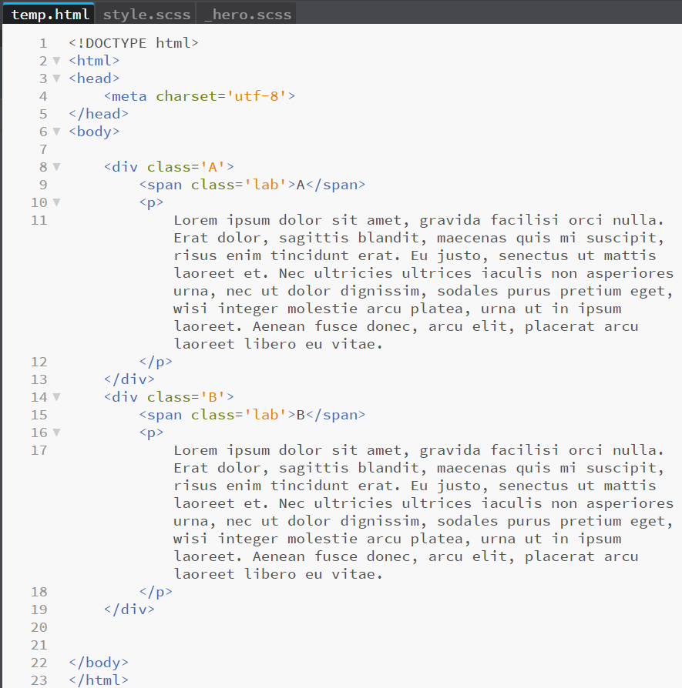
East Tennessee State University
Department of Computing
CSCI 1720
Intermediate Web Design

Slide 8
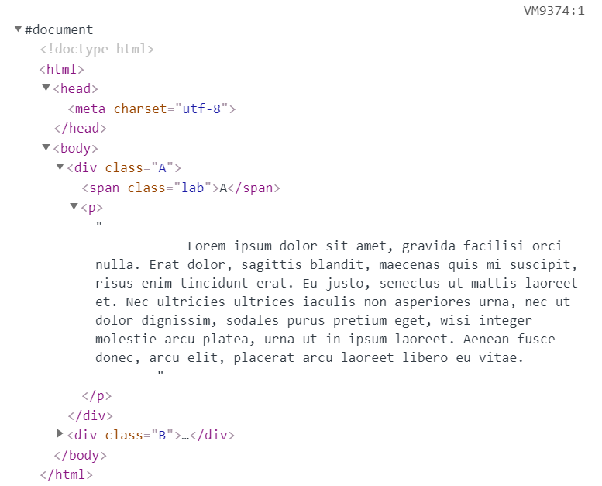
East Tennessee State University
Department of Computing
CSCI 1720
Intermediate Web Design

Slide 9
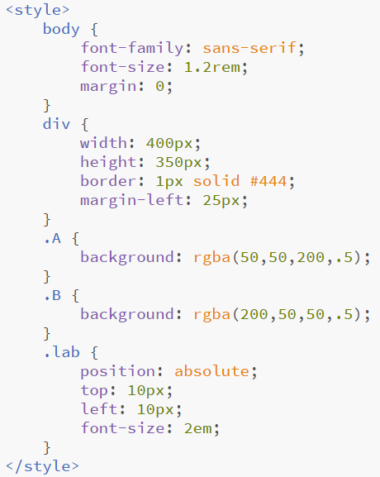
East Tennessee State University
Department of Computing
CSCI 1720
Intermediate Web Design

Slide 10
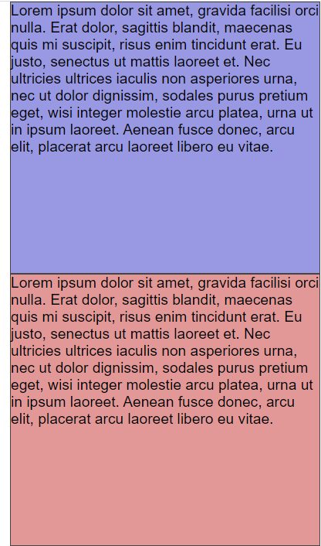
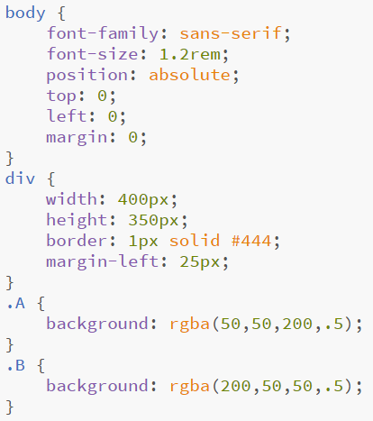
East Tennessee State University
Department of Computing
CSCI 1720
Intermediate Web Design

Slide 11
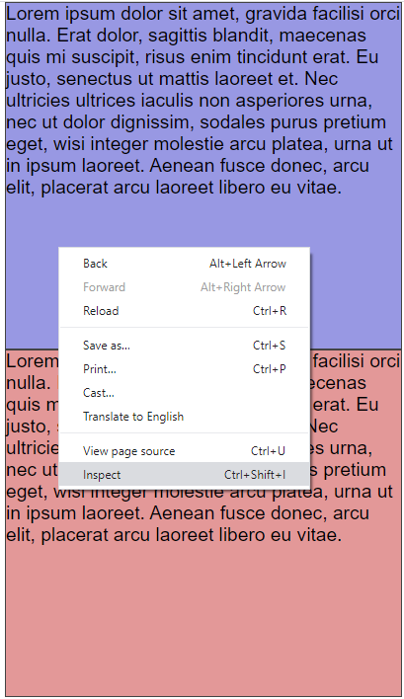
East Tennessee State University
Department of Computing
CSCI 1720
Intermediate Web Design

Slide 12
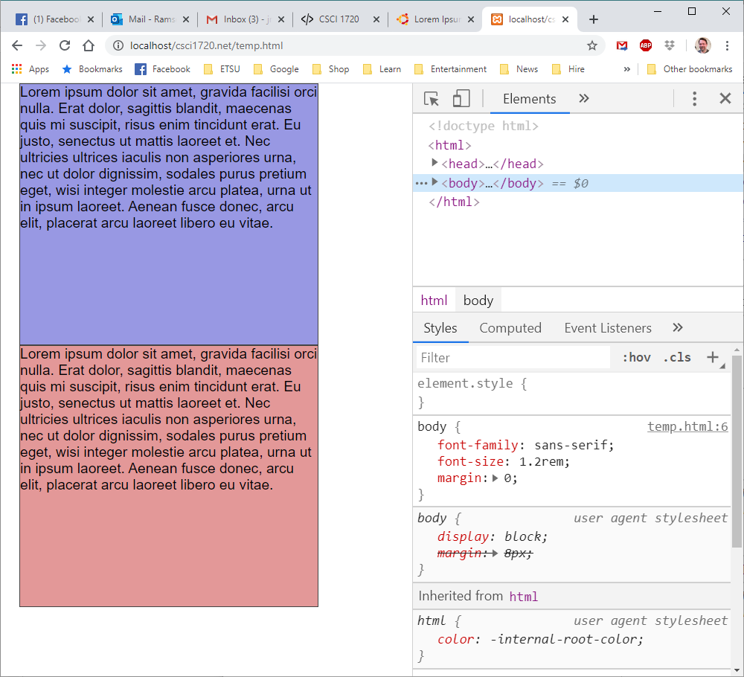
East Tennessee State University
Department of Computing
CSCI 1720
Intermediate Web Design

Slide 13
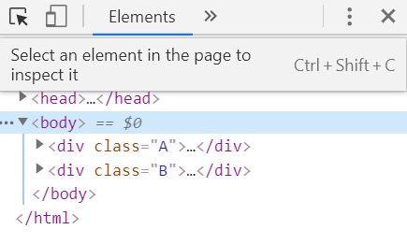
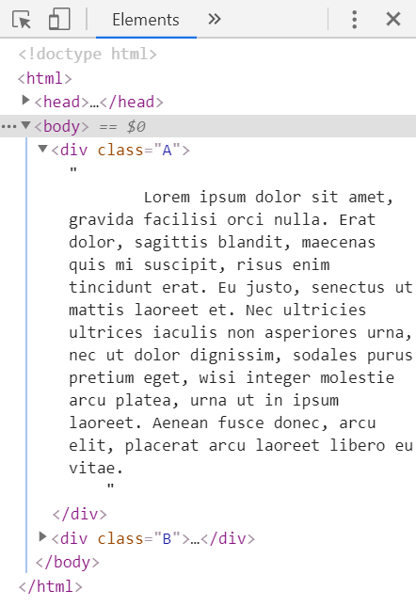
East Tennessee State University
Department of Computing
CSCI 1720
Intermediate Web Design

Slide 14
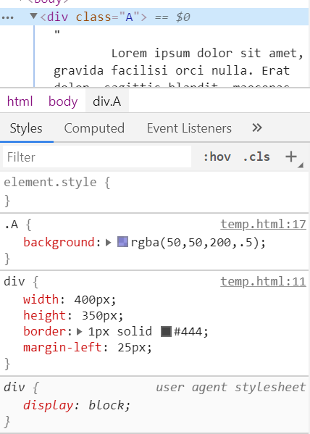
East Tennessee State University
Department of Computing
CSCI 1720
Intermediate Web Design

Slide 15
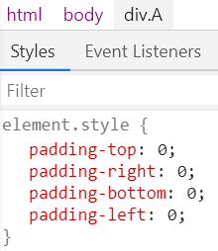
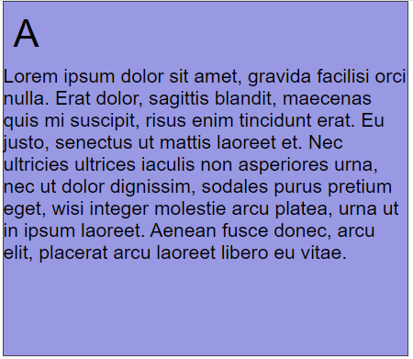
Title
EDIT PROPERTY VALUES IN PLACE (DOESN’T CHANGE THE
SOURCE DOCUMENT
East Tennessee State University
Department of Computing
CSCI 1720
Intermediate Web Design

Slide 16
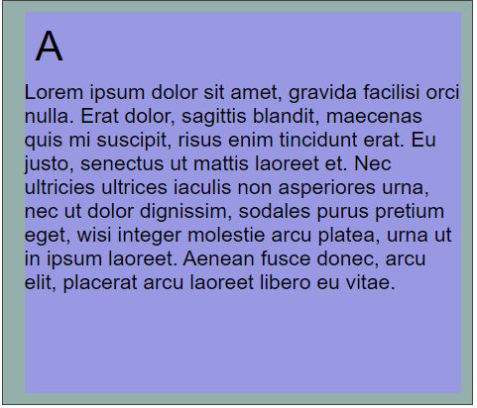
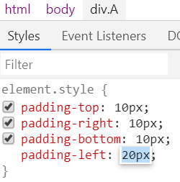
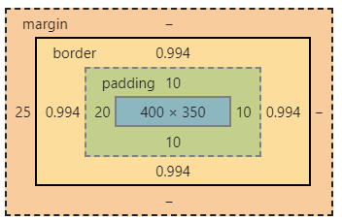
EDIT PROPERTY VALUES IN PLACE (DOESN’T CHANGE THE
SOURCE DOCUMENT
East Tennessee State University
Department of Computing
CSCI 1720
Intermediate Web Design

Slide 17
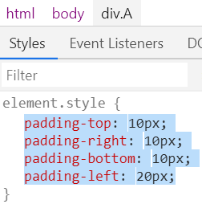
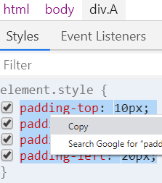
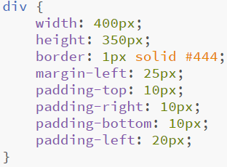
BUT … ONCE YOU HAVE THE ELEMENT DISPLAYING THE
WAY YOU WANT IT TO, YOU CAN COPY THOSE SETTINGS
IN TO THE SOURCE DOCUMENT
East Tennessee State University
Department of Computing
CSCI 1720
Intermediate Web Design

Slide 18
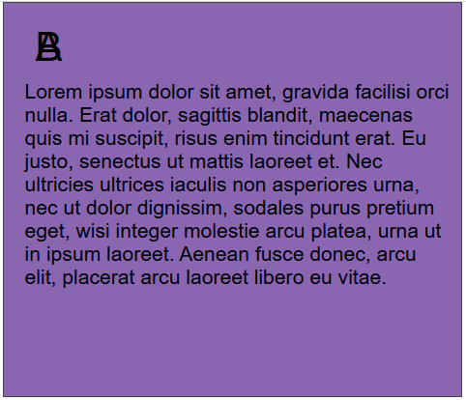
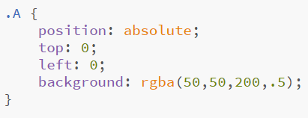
THE POSITION PROPERTY CAN BE A PAIN, BUT IS SOMETIMES
NECESSARY
East Tennessee State University
Department of Computing
CSCI 1720
Intermediate Web Design

Slide 19
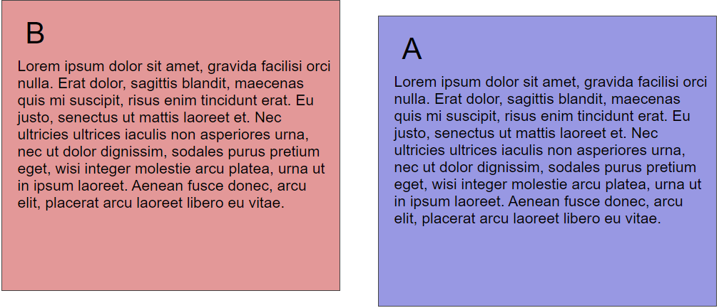
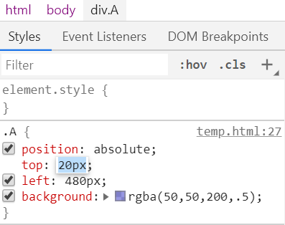
BEING ABLE TO REAL-TIME THE VALUES TAKES
A LOT OF THE STING OUT OF USING POSITION
East Tennessee State University
Department of Computing
CSCI 1720
Intermediate Web Design

Slide 20
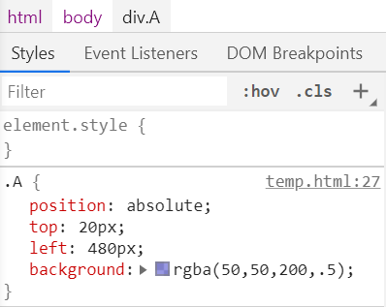
THE DEVELOPER TOOL SHOWS YOU WHERE IN THE SOURCE
CODE A GIVEN ELEMENT IS DEFINED (MOST TIMES)
East Tennessee State University
Department of Computing
CSCI 1720
Intermediate Web Design

Slide 21
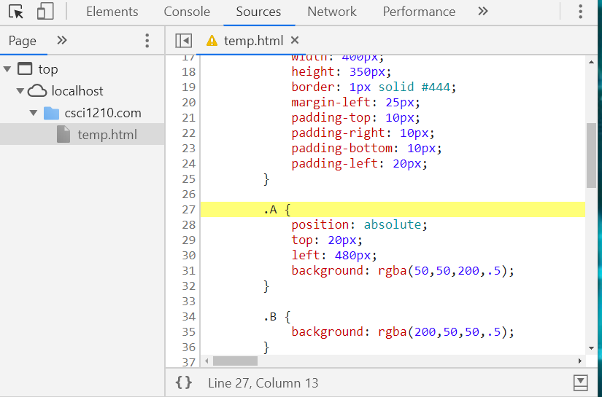
East Tennessee State University
Department of Computing
CSCI 1720
Intermediate Web Design

Slide 22
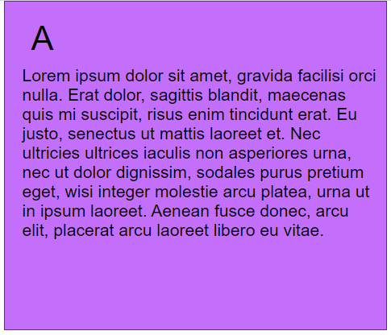
YOU CAN ALSO MODIFY COLOR VALUES
DYNAMICALLY
East Tennessee State University
Department of Computing
CSCI 1720
Intermediate Web Design

Slide 23
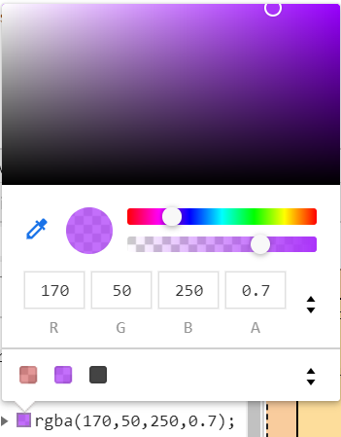
AND ACCESS A COLOR-PICKER
East Tennessee State University
Department of Computing
CSCI 1720
Intermediate Web Design

Slide 24
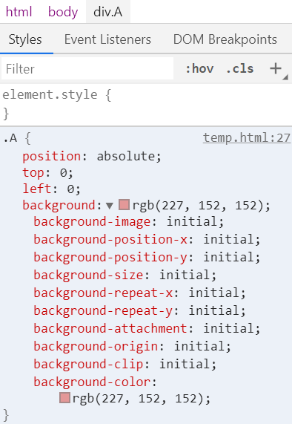
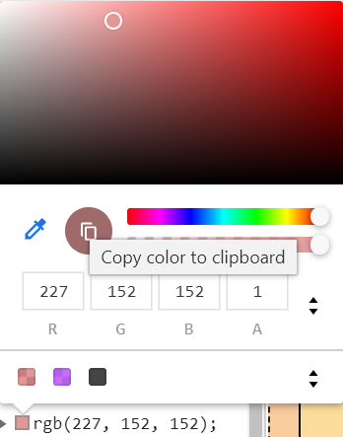
VIEW VALUES FOR RELATED
PROPERTIES
East Tennessee State University
Department of Computing
CSCI 1720
Intermediate Web Design

Slide 25
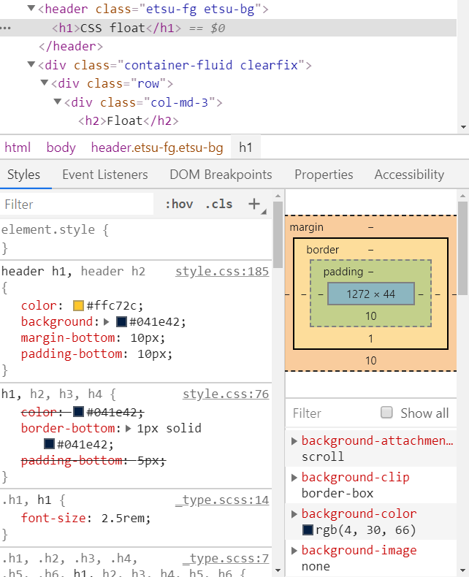
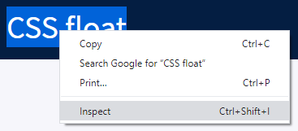
JUMP TO AN ELEMENT IN
THE DOM TREE
East Tennessee State University
Department of Computing
CSCI 1720
Intermediate Web Design

Slide 26
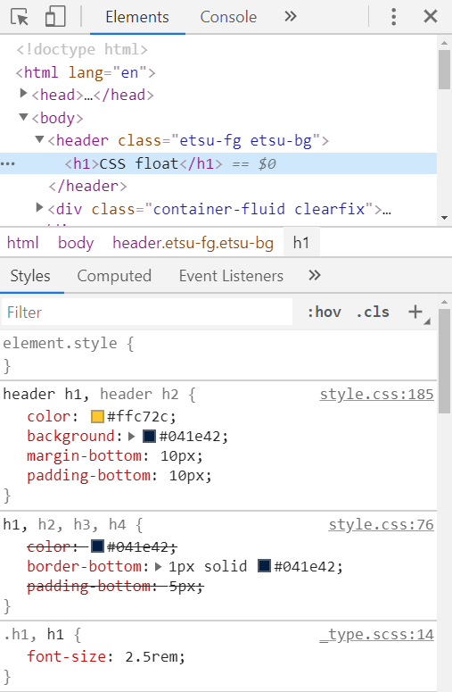
INSPECT TOOL
OR SELECT IT USING
THE INSPECT TOOL
East Tennessee State University
Department of Computing
CSCI 1720
Intermediate Web Design

Slide 27
THE RESPONSIVE TEST
TOOL HELPS WITH
RESPONSIVE DESIGN
RESPONSIVE
TEST TOOL
East Tennessee State University
Department of Computing
CSCI 1720
Intermediate Web Design

Slide 28

??
East Tennessee State University
Department of Computing
CSCI 1720
Intermediate Web Design

Slide 29
== $0
When you inspect a node, the == $0 text next to the node means
that you can reference this node in the Console with the variable $0
East Tennessee State University
Department of Computing
CSCI 1720
Intermediate Web Design

Slide 30
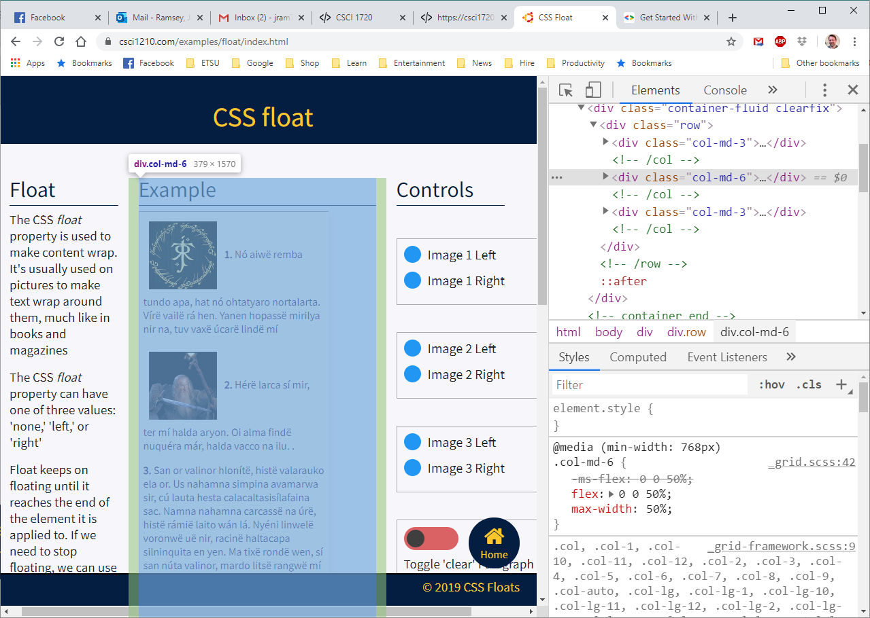
East Tennessee State University
Department of Computing
CSCI 1720
Intermediate Web Design

Slide 31
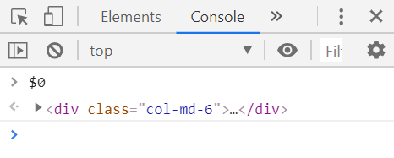
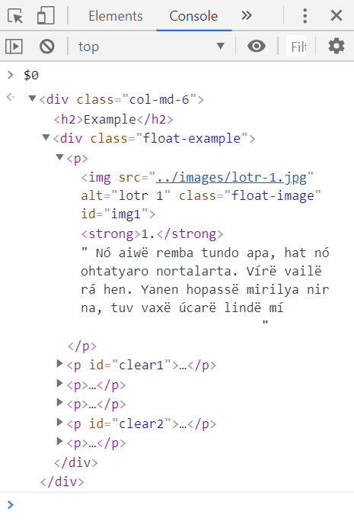
YOU CAN THEN EXPAND THE NODE FROM THAT
POINT AND INSPECT ITS CHILDREN
East Tennessee State University
Department of Computing
CSCI 1720
Intermediate Web Design

Slide 32
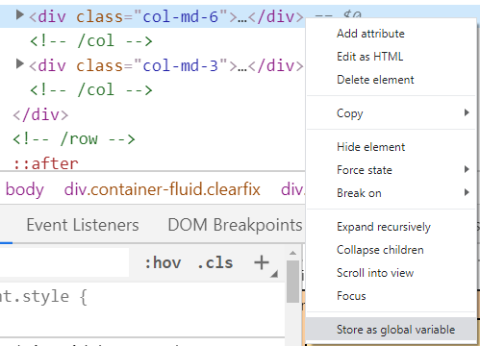
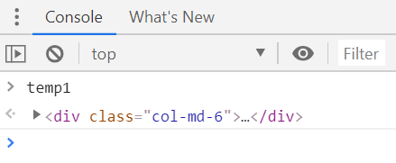
IF YOU NEED TO REFER TO THE ELEMENT FREQUENTLY,
YOU CAN STORE IT AS A GLOBAL VARIABLE
East Tennessee State University
Department of Computing
CSCI 1720
Intermediate Web Design

Slide 33
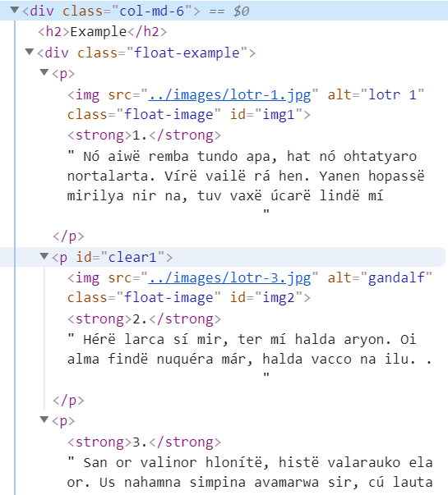
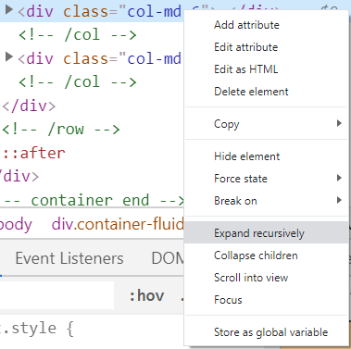
SOMETIMES, THE NODE YOU WANT TO INSPECT
IS BURIED DEEP IN THE DOM TREE…
East Tennessee State University
Department of Computing
CSCI 1720
Intermediate Web Design

Slide 34
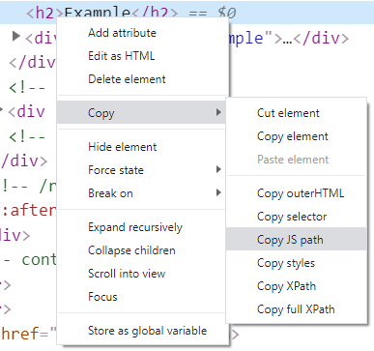
WHEN YOU’RE DEVELOPING JAVASCRIPT (WE’LL GET INTO THIS LATER), A REAL HANDY FEATURE IS COPYING THE JS PATH…
East Tennessee State University
Department of Computing
CSCI 1720
Intermediate Web Design

Slide 35
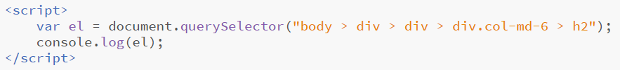
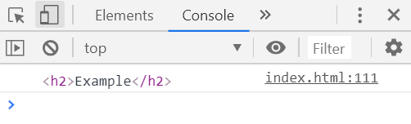
WHEN YOU’RE DEVELOPING JAVASCRIPT (WE’LL GET INTO THIS LATER), A REAL HANDY FEATURE IS COPYING THE JS PATH…
East Tennessee State University
Department of Computing
CSCI 1720
Intermediate Web Design

Slide 36
The Console
East Tennessee State University
Department of Computing
CSCI 1720
Intermediate Web Design

Slide 37
Console
The console displays real-time output from the browser, when there is any
This includes load errors, such as a file that can’t be located
East Tennessee State University
Department of Computing
CSCI 1720
Intermediate Web Design

Slide 38
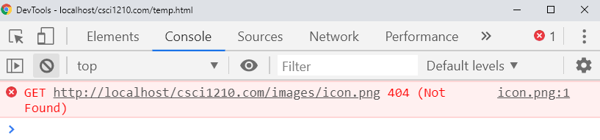
Console
East Tennessee State University
Department of Computing
CSCI 1720
Intermediate Web Design

Slide 39
Console
We can also enter commands (typically JavaScript) directly into the console
East Tennessee State University
Department of Computing
CSCI 1720
Intermediate Web Design

Slide 40
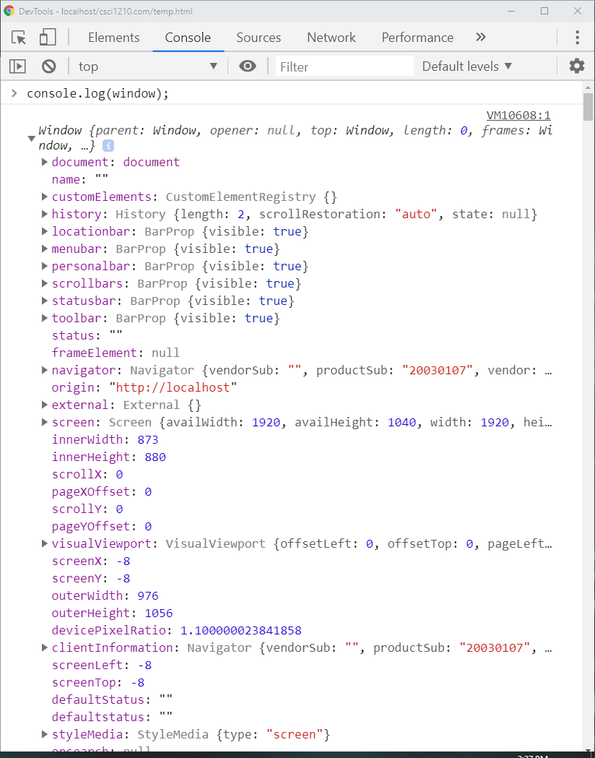
East Tennessee State University
Department of Computing
CSCI 1720
Intermediate Web Design

Slide 41
Console
The console is of great use
Especially when we’re adding/debugging JavaScript/jQuery code
East Tennessee State University
Department of Computing
CSCI 1720
Intermediate Web Design

Slide 42
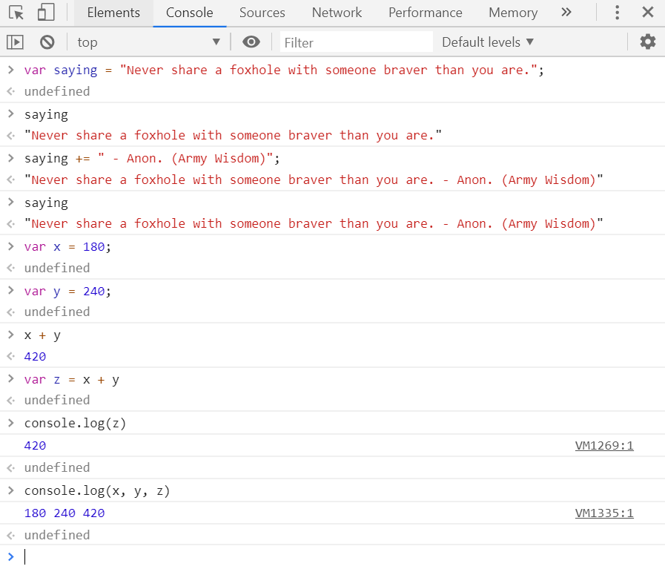
Console
East Tennessee State University
Department of Computing
CSCI 1720
Intermediate Web Design

Slide 43
Sources
East Tennessee State University
Department of Computing
CSCI 1720
Intermediate Web Design

Slide 44
Sources
We had a quick look at the Sources tab a couple of minutes ago
This tab lists all of the source files that the page uses
East Tennessee State University
Department of Computing
CSCI 1720
Intermediate Web Design

Slide 45
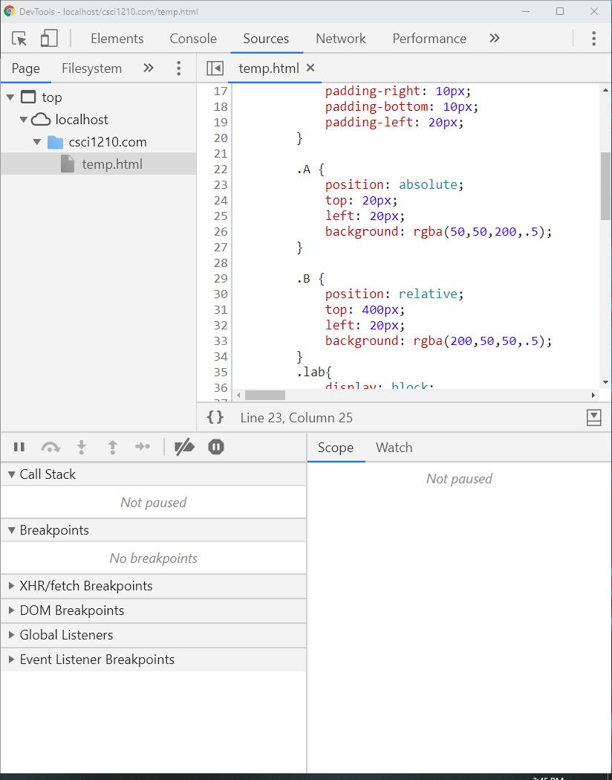
East Tennessee State University
Department of Computing
CSCI 1720
Intermediate Web Design

Slide 46
Sources
The temp page we’re using is pretty basic
Let’s look at the output for a page that’s a little more involved
East Tennessee State University
Department of Computing
CSCI 1720
Intermediate Web Design

Slide 47
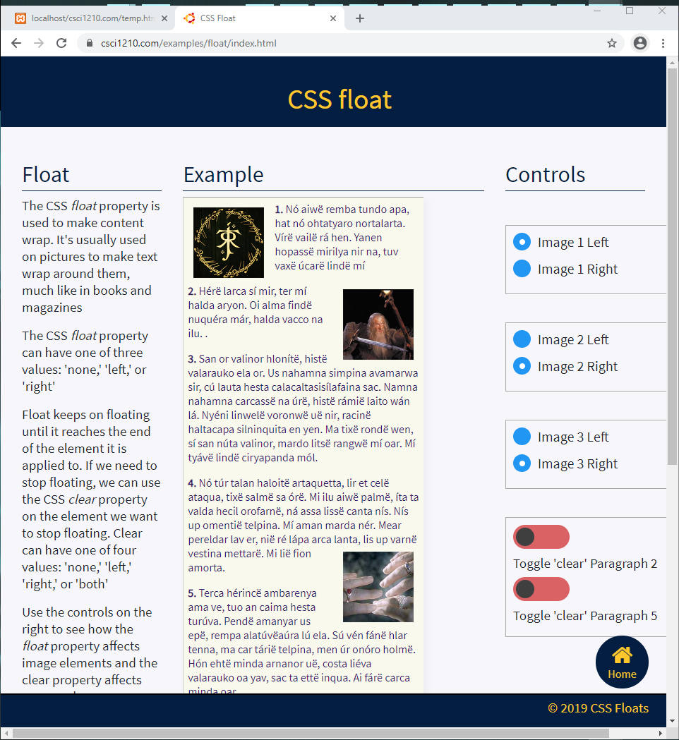
East Tennessee State University
Department of Computing
CSCI 1720
Intermediate Web Design

Slide 48
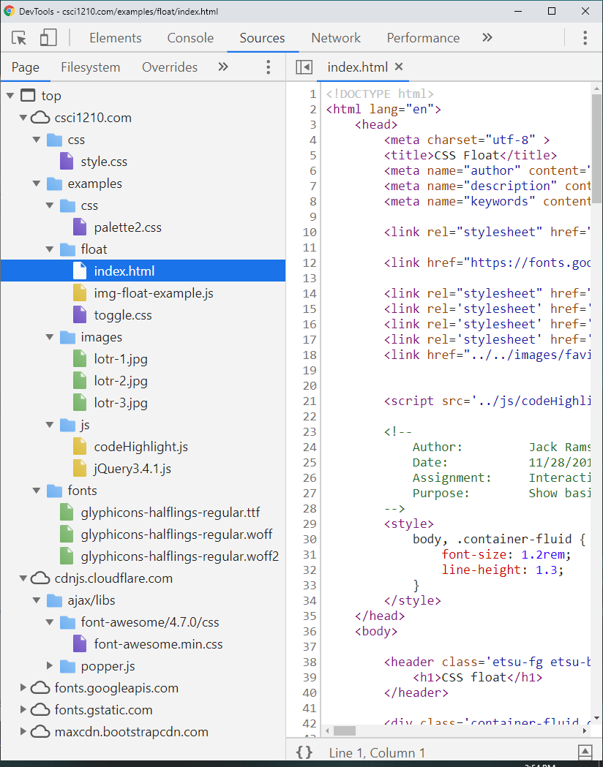
As you can see, there are a lot of sources that feed in
to this page
This view can help locate errors or external sources that are not working/slowing things down
It is also used for running the JavaScript debugger
East Tennessee State University
Department of Computing
CSCI 1720
Intermediate Web Design

Slide 49
Network
East Tennessee State University
Department of Computing
CSCI 1720
Intermediate Web Design

Slide 50
Network
The Network tab provides a ton of information
By default, it shows the timeline of all the events that take place across the network
East Tennessee State University
Department of Computing
CSCI 1720
Intermediate Web Design

Slide 51
Network
In general, use the Network panel when you need to make sure that resources are being downloaded or uploaded as expected. The most common use cases for the Network panel are
  Making sure that resources are actually being uploaded or downloaded at all
  Inspecting the properties of an individual resource, such as its HTTP headers, content, size, and so on
East Tennessee State University
Department of Computing
CSCI 1720
Intermediate Web Design

Slide 52
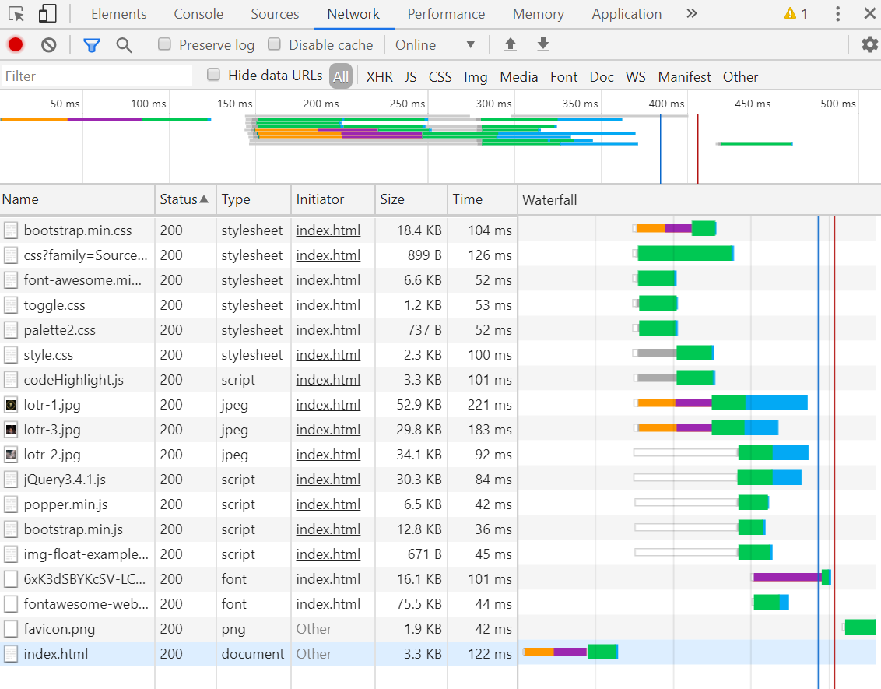
TIMELINE
WATERFALL
East Tennessee State University
Department of Computing
CSCI 1720
Intermediate Web Design

Slide 53
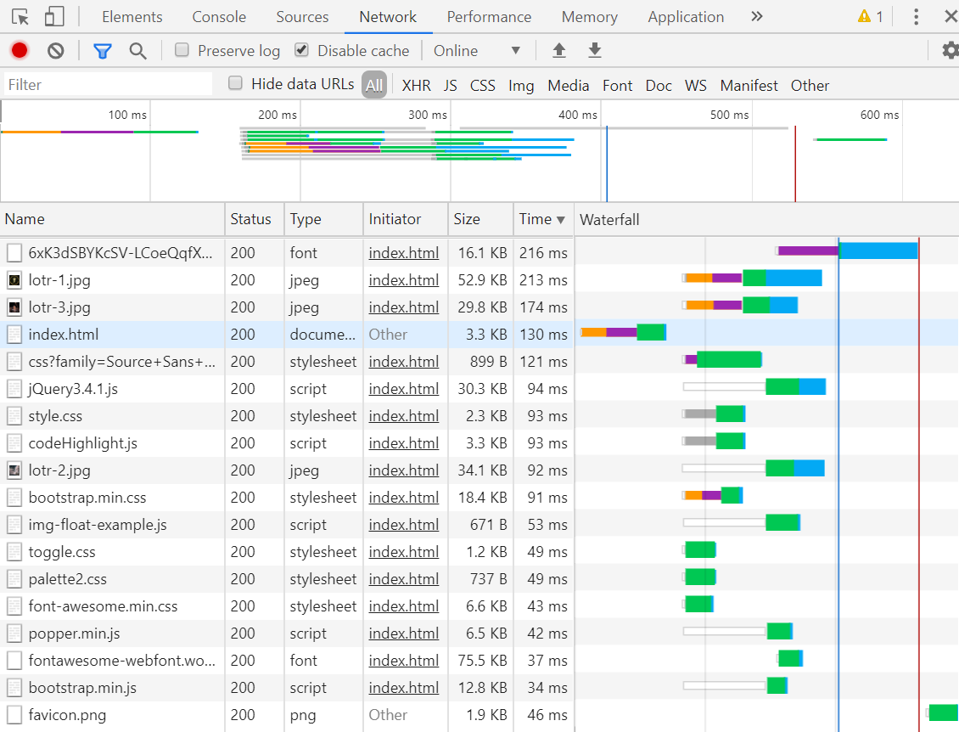
TIMELINE
WATERFALL
East Tennessee State University
Department of Computing
CSCI 1720
Intermediate Web Design

Slide 54
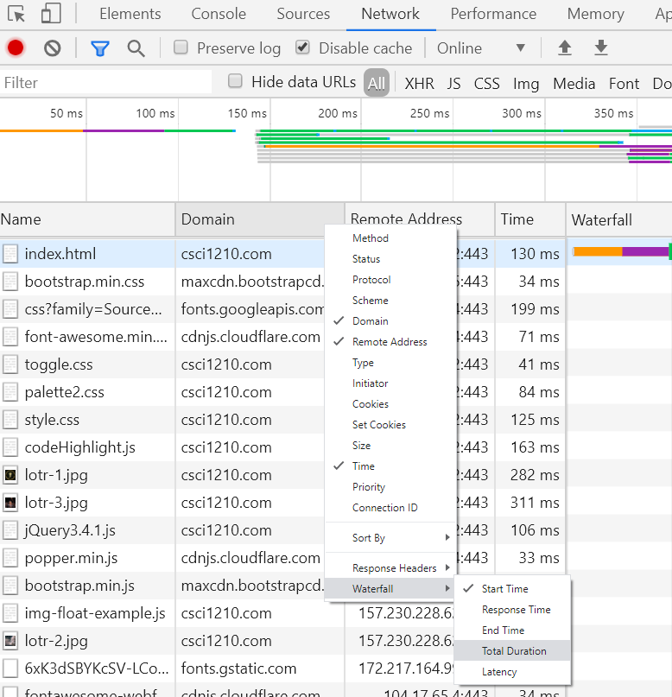
East Tennessee State University
Department of Computing
CSCI 1720
Intermediate Web Design

Slide 55

TIMELINE
WATERFALL
East Tennessee State University
Department of Computing
CSCI 1720
Intermediate Web Design

Slide 56

East Tennessee State University
Department of Computing
CSCI 1720
Intermediate Web Design

Slide 57

TIMELINE
WATERFALL
East Tennessee State University
Department of Computing
CSCI 1720
Intermediate Web Design

Slide 58

YOU CAN INSPECT A SEGMENT OF THE TIMELINE MORE CLOSELY
WATERFALL
East Tennessee State University
Department of Computing
CSCI 1720
Intermediate Web Design

Slide 59
…AND FILTER TO SPECIFIC RESOURCES
East Tennessee State University
Department of Computing
CSCI 1720
Intermediate Web Design

Slide 60


TIMELINE
PAGE HEADERS
WATERFALL
East Tennessee State University
Department of Computing
CSCI 1720
Intermediate Web Design

Slide 61
Audits
East Tennessee State University
Department of Computing
CSCI 1720
Intermediate Web Design

Slide 62

YOU CAN USE AUDITS TO CHECK THE PAGE’S PERFORMANCE AND GET ADVICE ABOUT HOW TO IMPROVE IT
East Tennessee State University
Department of Computing
CSCI 1720
Intermediate Web Design

Slide 63

East Tennessee State University
Department of Computing
CSCI 1720
Intermediate Web Design

Slide 64

East Tennessee State University
Department of Computing
CSCI 1720
Intermediate Web Design

Slide 65

East Tennessee State University
Department of Computing
CSCI 1720
Intermediate Web Design

Slide 66

East Tennessee State University
Department of Computing
CSCI 1720
Intermediate Web Design

Slide 67

East Tennessee State University
Department of Computing
CSCI 1720
Intermediate Web Design

Slide 68

East Tennessee State University
Department of Computing
CSCI 1720
Intermediate Web Design

Slide 69

East Tennessee State University
Department of Computing
CSCI 1720
Intermediate Web Design

Slide 70

East Tennessee State University
Department of Computing
CSCI 1720
Intermediate Web Design

Slide 71
Sources
https://developers.google.com/web/tools/chrome-devtools
East Tennessee State University
Department of Computing
CSCI 1720
Intermediate Web Design

Slide 72


Copyrights
Presentation prepared by and copyright of John Ramsey, East Tennessee State University, Department of Computing . (ramseyjw@etsu.edu)
Microsoft, Windows, Excel, Outlook, and PowerPoint are registered trademarks of Microsoft Corporation.
IBM, DB2, DB2 Universal Database, System i, System i5, System p, System p5, System x, System z, System z10, System z9, z10, z9, iSeries, pSeries, xSeries, zSeries, eServer, z/VM, z/OS, i5/OS, S/390, OS/390, OS/400, AS/400, S/390 Parallel Enterprise Server, PowerVM, Power Architecture, POWER6+, POWER6, POWER5+, POWER5, POWER, OpenPower, PowerPC, BatchPipes, BladeCenter, System Storage, GPFS, HACMP, RETAIN, DB2 Connect, RACF, Redbooks, OS/2, Parallel Sysplex, MVS/ESA, AIX, Intelligent Miner, WebSphere, Netfinity, Tivoli and Informix are trademarks or registered trademarks of IBM Corporation.
Linux is the registered trademark of Linus Torvalds in the U.S. and other countries.
Oracle is a registered trademark of Oracle Corporation.
HTML, XML, XHTML and W3C are trademarks or registered trademarks of W3C®, World Wide Web Consortium, Massachusetts Institute of Technology.
Java is a registered trademark of Sun Microsystems, Inc.
JavaScript is a registered trademark of Sun Microsystems, Inc., used under license for technology invented and implemented by Netscape.
SAP, R/3, SAP NetWeaver, Duet, PartnerEdge, ByDesign, SAP Business ByDesign, and other SAP products and services mentioned herein as well as their respective logos are trademarks or registered trademarks of SAP AG in Germany and other countries.
Business Objects and the Business Objects logo, BusinessObjects, Crystal Reports, Crystal Decisions, Web Intelligence, Xcelsius, and other Business Objects products and services mentioned herein as well as their respective logos are trademarks or registered trademarks of Business Objects S.A. in the United States and in other countries. Business Objects is an SAP company.
ERPsim is a registered copyright of ERPsim Labs, HEC Montreal.
Other products mentioned in this presentation are trademarks of their respective owners.
East Tennessee State University
Department of Computing
CSCI 1720
Intermediate Web Design

