Slide 1

CSCI 1720
Bootstrap – Part 2
East Tennessee State University
Department of Computing
CSCI 1720
Intermediate Web Design

Slide 2
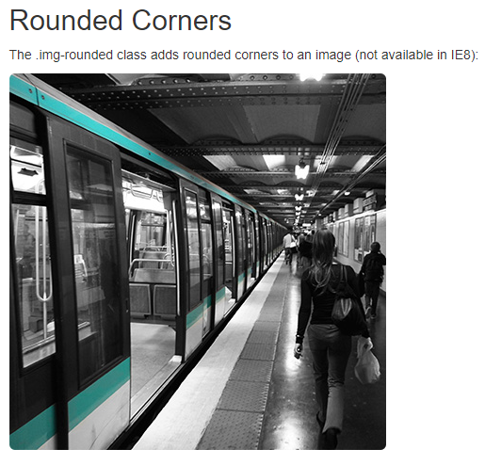
Bootstrap Images
East Tennessee State University
Department of Computing
CSCI 1720
Intermediate Web Design

Slide 3
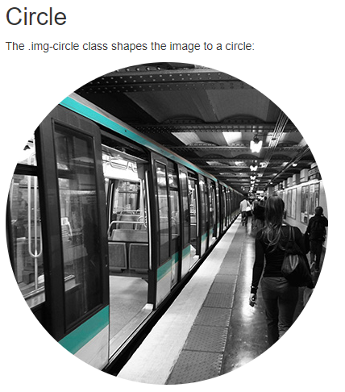
Bootstrap Images
East Tennessee State University
Department of Computing
CSCI 1720
Intermediate Web Design

Slide 4
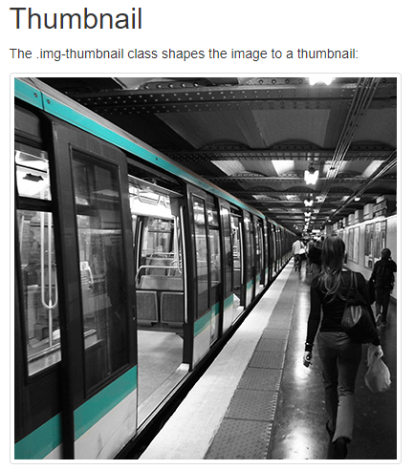
Bootstrap Images
East Tennessee State University
Department of Computing
CSCI 1720
Intermediate Web Design

Slide 5
Bootstrap Images – Responsive Images
Images come in all sizes. So do screens. Responsive images automatically adjust to fit the size of the screen
Create responsive images by adding the .img-fluid class to the <img> tag. The image will then scale nicely to the parent element
The .img-fluid class applies display: block; and
max-width: 100%; and height: auto; to the image
East Tennessee State University
Department of Computing
CSCI 1720
Intermediate Web Design

Slide 6
Bootstrap Jumbotron

Slide 7
Bootstrap Jumbotron
A jumbotron is a big box for calling extra attention to some special content or information
A jumbotron is displayed as a grey box with rounded corners. It also enlarges the font sizes of the text inside it
Tip: Inside a jumbotron you can put nearly any valid HTML, including other Bootstrap elements/classes
Use a <div> element with class .jumbotron to create a jumbotron
Place the jumbotron inside the <div class="container"> if you want the jumbotron to NOT extend to the edge of the screen
East Tennessee State University
Department of Computing
CSCI 1720
Intermediate Web Design

Slide 8
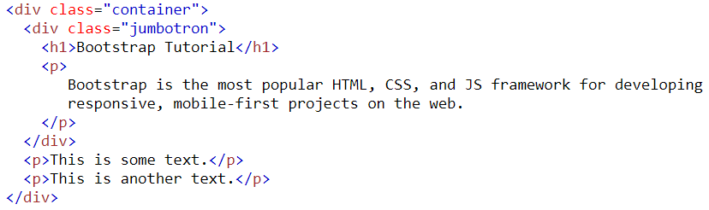
Bootstrap Jumbotron
East Tennessee State University
Department of Computing
CSCI 1720
Intermediate Web Design

Slide 9
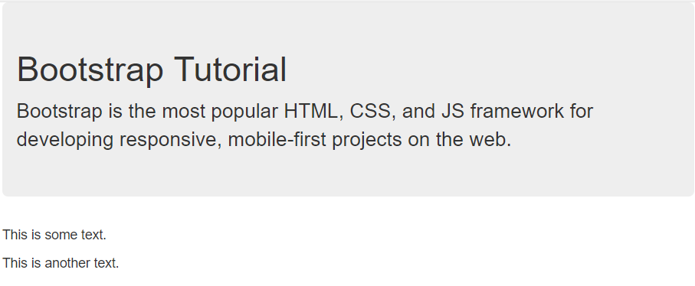
Bootstrap Jumbotron
East Tennessee State University
Department of Computing
CSCI 1720
Intermediate Web Design

Slide 10
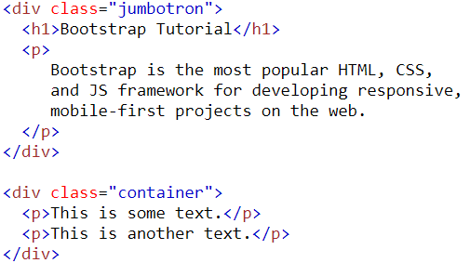
Bootstrap Jumbotron
Place the jumbotron outside the
<div class="container">
if you want the jumbotron to extend to the screen edges
East Tennessee State University
Department of Computing
CSCI 1720
Intermediate Web Design

Slide 11
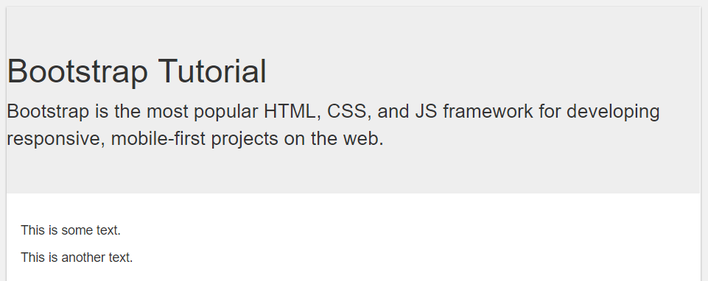
Bootstrap Jumbotron
East Tennessee State University
Department of Computing
CSCI 1720
Intermediate Web Design

Slide 12
Other Bootstrap Stuff

Slide 13

Other Bootstrap Stuff
The .well class adds a rounded border around an element with a gray background color and some padding
East Tennessee State University
Department of Computing
CSCI 1720
Intermediate Web Design

Slide 14
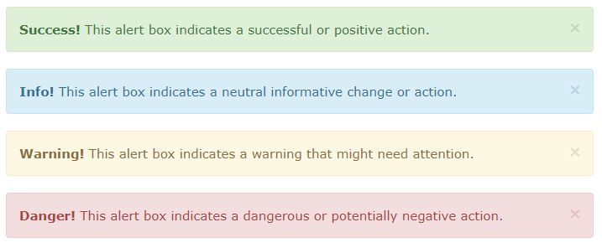
Other Bootstrap Stuff
Bootstrap provides an easy way to create predefined alert messages
East Tennessee State University
Department of Computing
CSCI 1720
Intermediate Web Design

Slide 15
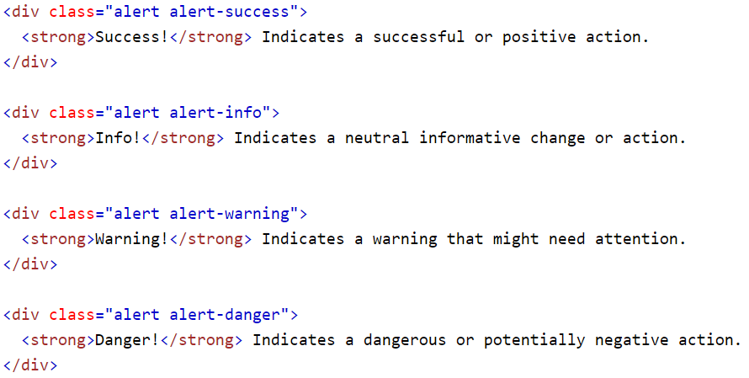
Other Bootstrap Stuff
East Tennessee State University
Department of Computing
CSCI 1720
Intermediate Web Design

Slide 16
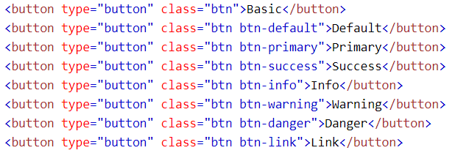
Other Bootstrap Stuff
Bootstrap provides different styles of buttons
East Tennessee State University
Department of Computing
CSCI 1720
Intermediate Web Design

Slide 17

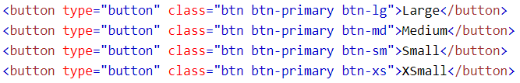
Other Bootstrap Stuff
Bootstrap provides four button sizes
East Tennessee State University
Department of Computing
CSCI 1720
Intermediate Web Design

Slide 18

Other Bootstrap Stuff
A button can be set to an active (appear pressed) or a disabled (unclickable) state:
The class .active makes a button appear pressed, and the class .disabled makes a button unclickable
East Tennessee State University
Department of Computing
CSCI 1720
Intermediate Web Design

Slide 19

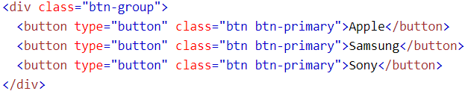
Other Bootstrap Stuff
Bootstrap allows you to group a series of buttons together (on a single line) in a button group:
Use a <div> element with class .btn-group to create a button group
East Tennessee State University
Department of Computing
CSCI 1720
Intermediate Web Design

Slide 20
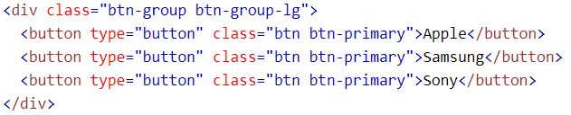
Other Bootstrap Stuff
Instead of applying button sizes to every button in a group, use class .btn-group-lg|sm|xs to size all buttons in the group
East Tennessee State University
Department of Computing
CSCI 1720
Intermediate Web Design

Slide 21
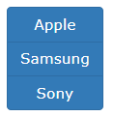
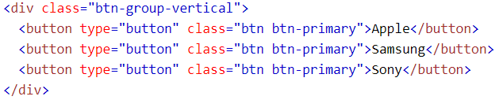
Other Bootstrap Stuff
Bootstrap also supports vertical button groups
Use the class .btn-group-vertical to create a vertical button group
East Tennessee State University
Department of Computing
CSCI 1720
Intermediate Web Design

Slide 22
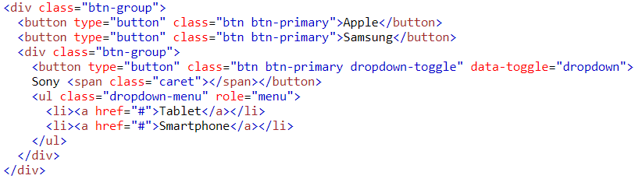
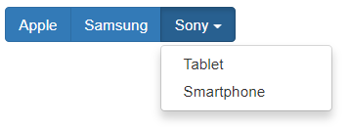
Other Bootstrap Stuff
Nest button groups to create dropdown menus
East Tennessee State University
Department of Computing
CSCI 1720
Intermediate Web Design

Slide 23

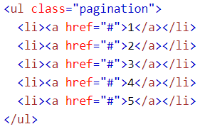
Other Bootstrap Stuff
If you have a web site with lots of pages, you may wish to add some sort of pagination to each page
A basic pagination in Bootstrap looks like this
East Tennessee State University
Department of Computing
CSCI 1720
Intermediate Web Design

Slide 24

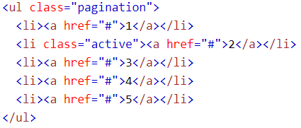
Other Bootstrap Stuff
The active state shows what is the current page:
Add class .active to let the user know which page he/she is on
East Tennessee State University
Department of Computing
CSCI 1720
Intermediate Web Design

Slide 25

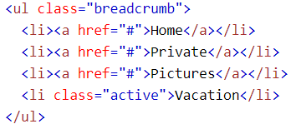
Other Bootstrap Stuff
Another form for pagination, is breadcrumbs:
The .breadcrumb class indicates the current page's location within a navigational hierarchy
East Tennessee State University
Department of Computing
CSCI 1720
Intermediate Web Design

Slide 26
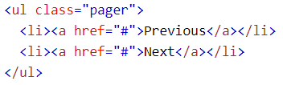

Other Bootstrap Stuff
Pager is also a form of pagination
Pager provides previous and next buttons (links)
To create previous/next buttons, add the .pager class to an <ul> element
East Tennessee State University
Department of Computing
CSCI 1720
Intermediate Web Design

Slide 27
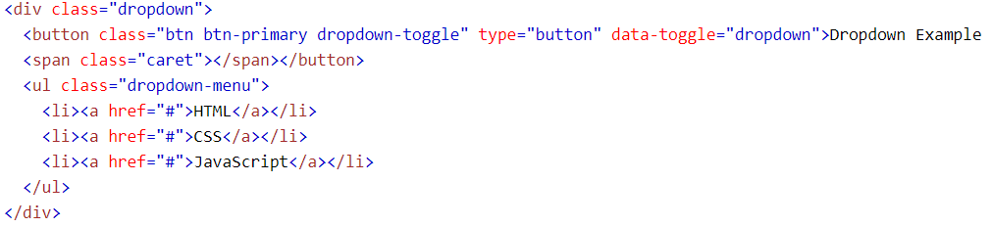
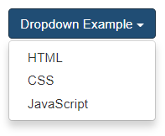
Other Bootstrap Stuff
A dropdown menu is a toggleable menu that allows the user to choose one value from a predefined list
East Tennessee State University
Department of Computing
CSCI 1720
Intermediate Web Design

Slide 28
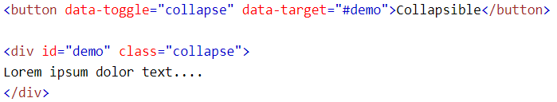

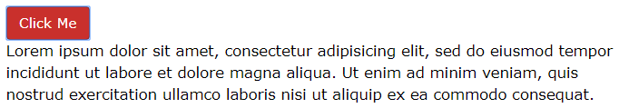
Other Bootstrap Stuff
Collapsibles are useful when you want to hide and show large amount of content
East Tennessee State University
Department of Computing
CSCI 1720
Intermediate Web Design

Slide 29
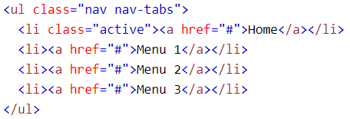

Other Bootstrap Stuff
Tabs are created with <ul class="nav nav-tabs">
Tip: Also mark the current page with <li class="active">
East Tennessee State University
Department of Computing
CSCI 1720
Intermediate Web Design

Slide 30
Other Bootstrap Stuff
To make the tabs toggleable, add the data-toggle="tab" attribute to each link
Then add a .tab-pane class with a unique ID for every tab and wrap them inside a <div> element with class .tab-content
If you want the tabs to fade in and out when clicking on them, add the .fade class to .tab-pane
This is different from the non-toggleable tabs in that all of the tabbed content is contained within a single page
East Tennessee State University
Department of Computing
CSCI 1720
Intermediate Web Design

Slide 31
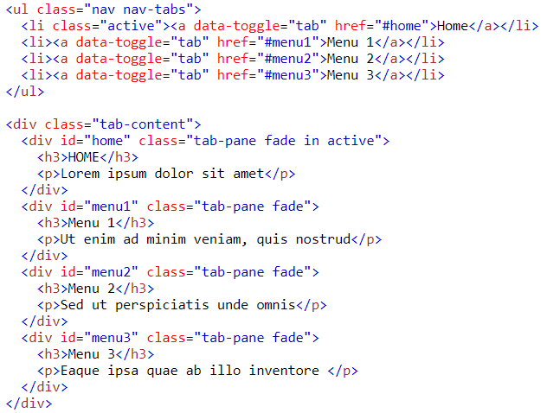
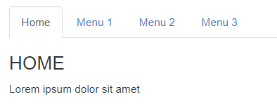
Other Bootstrap Stuff
East Tennessee State University
Department of Computing
CSCI 1720
Intermediate Web Design

Slide 32
Other Bootstrap Stuff
One of the cooler things you can do with Bootstrap is carousels
The Carousel plugin is a component for cycling through elements, like a carousel (slideshow)
The plugin is included as part of the bootstrap.min.js file you linked to in your template
They work best if all your images are the same aspect ratio (portrait or landscape) and the same dimensions (e.g., 640px X 480px)
The code is a little more complex, so let’s break it down
East Tennessee State University
Department of Computing
CSCI 1720
Intermediate Web Design

Slide 33
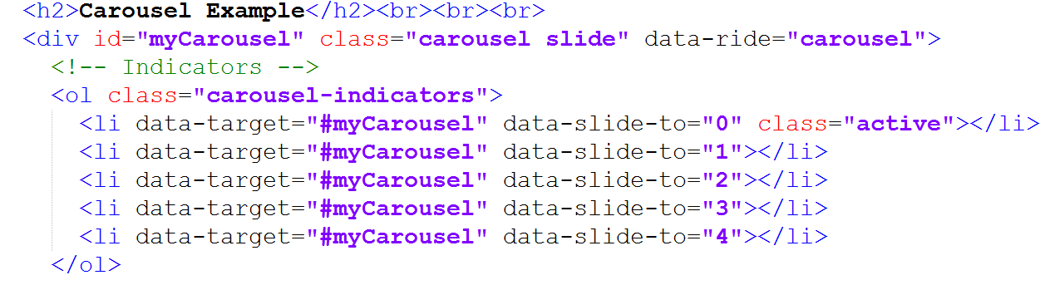
Other Bootstrap Stuff
1. Create the carousel div and indicators
East Tennessee State University
Department of Computing
CSCI 1720
Intermediate Web Design

Slide 34
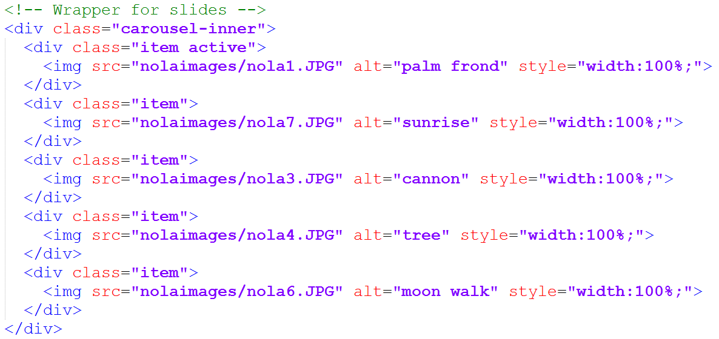
Other Bootstrap Stuff
2. Create a div for each image
Notice .JPG instead of .jpg. I usually use all lower-case
in file names, but the camera saved it this way and I
was feeling too lazy to rename them all
East Tennessee State University
Department of Computing
CSCI 1720
Intermediate Web Design

Slide 35
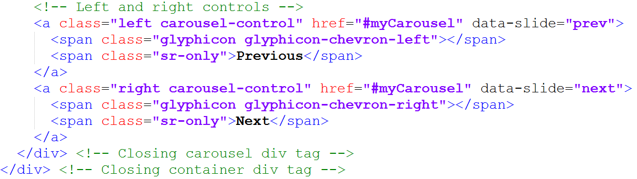
Other Bootstrap Stuff
3. Add the controls (note the glyphicons)
East Tennessee State University
Department of Computing
CSCI 1720
Intermediate Web Design

Slide 36
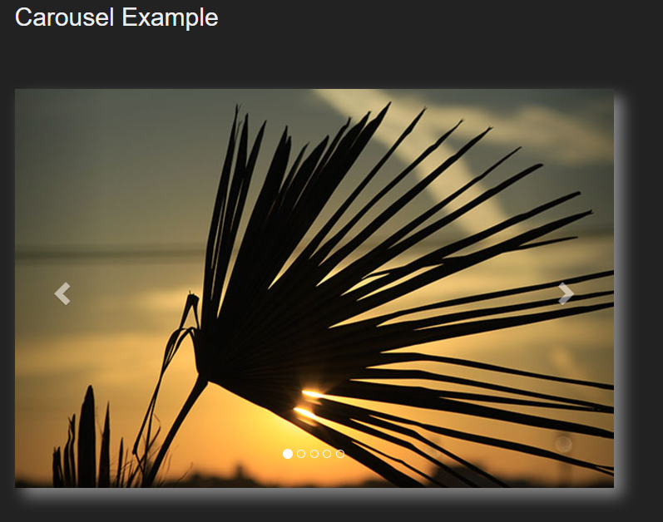
Other Bootstrap Stuff
3.
4. Save, and check it out!
See it in action:
bscarousel.php
2.
1.
East Tennessee State University
Department of Computing
CSCI 1720
Intermediate Web Design

Slide 37
Other Bootstrap Stuff
Finally, you can create a scrollspy, where you use Bootstrap in combination with internal links to enable a user to jump to different parts of a long page
Note: for this to work, the body selector must have a position: relative rule –
body {
position: relative;
}
East Tennessee State University
Department of Computing
CSCI 1720
Intermediate Web Design

Slide 38
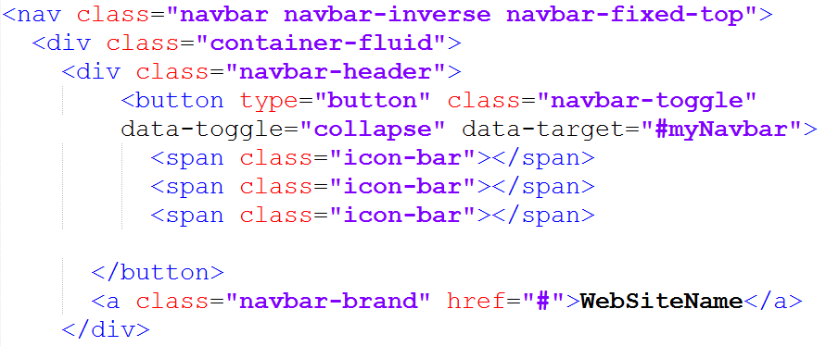
Other Bootstrap Stuff
1. Create a fluid navbar
East Tennessee State University
Department of Computing
CSCI 1720
Intermediate Web Design

Slide 39
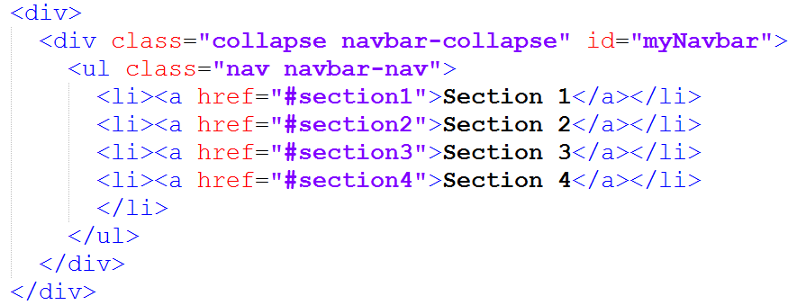
Other Bootstrap Stuff
2. Add links to each section of the page
East Tennessee State University
Department of Computing
CSCI 1720
Intermediate Web Design

Slide 40
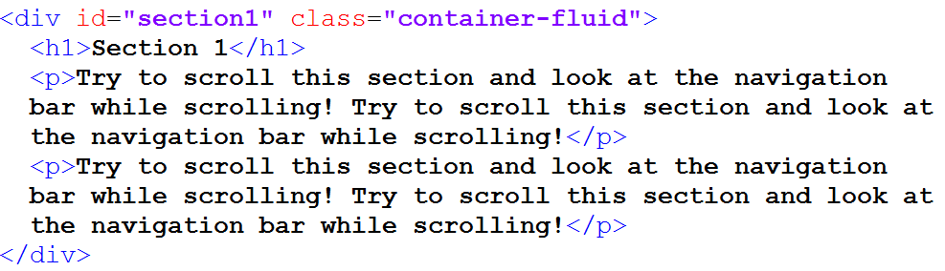
Other Bootstrap Stuff
3. Identify each section (div) in the page
East Tennessee State University
Department of Computing
CSCI 1720
Intermediate Web Design

Slide 41
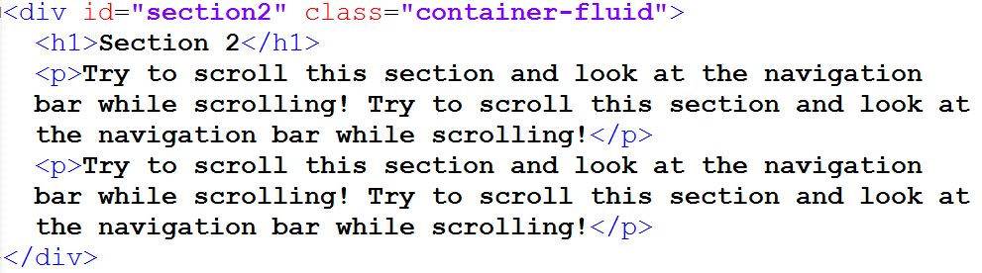
Other Bootstrap Stuff
3. Identify each section (div) in the page
(and so on…)
(and so on…)
East Tennessee State University
Department of Computing
CSCI 1720
Intermediate Web Design

Slide 42
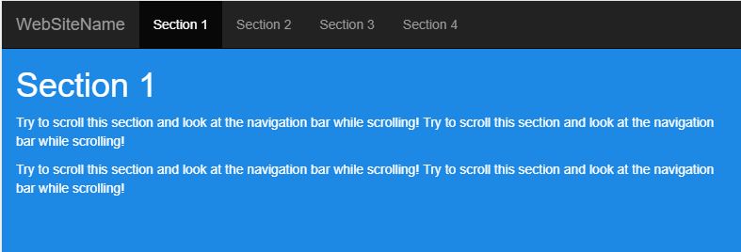
Other Bootstrap Stuff
3. Save, and preview
East Tennessee State University
Department of Computing
CSCI 1720
Intermediate Web Design

Slide 43
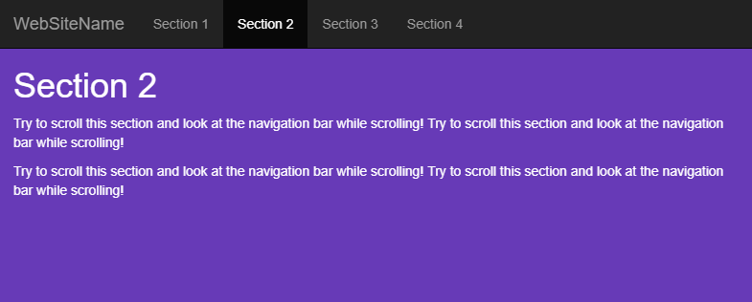
Other Bootstrap Stuff
3. Save, and preview
(Notice how the active link updates as you reach each section of the page)
East Tennessee State University
Department of Computing
CSCI 1720
Intermediate Web Design

Slide 44
Other Bootstrap Stuff
4. Note: we had to add a little jQuery to make the animated transitions work:
East Tennessee State University
Department of Computing
CSCI 1720
Intermediate Web Design

Slide 45
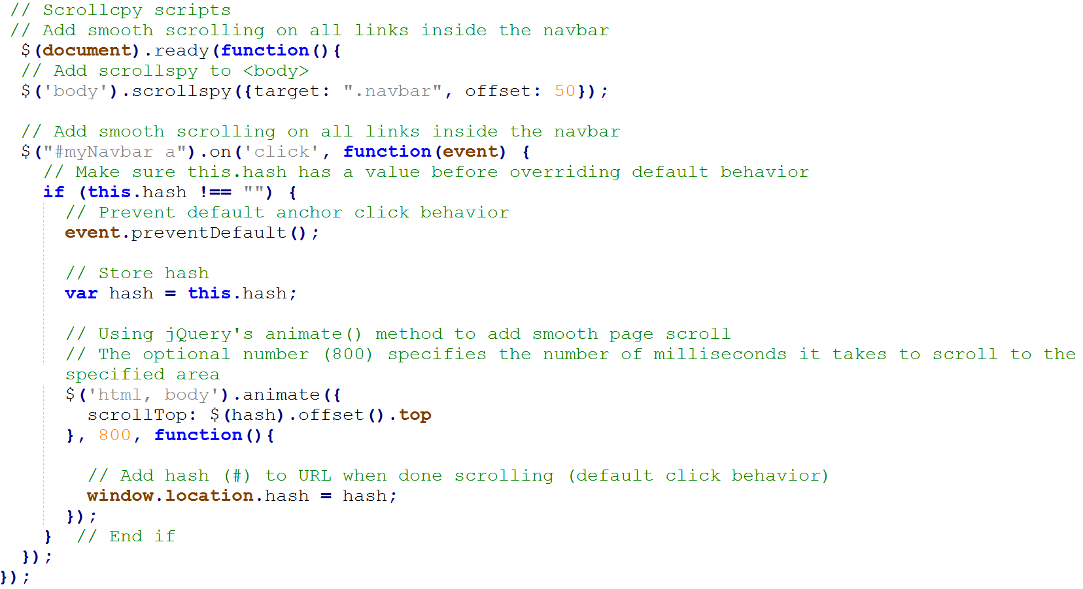
Other Bootstrap Stuff
East Tennessee State University
Department of Computing
CSCI 1720
Intermediate Web Design

Slide 46
Sources
https://www.w3schools.com/bootstrap/bootstrap_get_started.asp
http://getbootstrap.com/about/
https://hostingfacts.com/internet-facts-stats-2016/
https://developers.google.com/web/fundamentals/design-and-ui/responsive/
East Tennessee State University
Department of Computing
CSCI 1720
Intermediate Web Design

Slide 47


Copyrights
Presentation prepared by and copyright of John Ramsey, East Tennessee State University, Department of Computing . (ramseyjw@etsu.edu)
Microsoft, Windows, Excel, Outlook, and PowerPoint are registered trademarks of Microsoft Corporation.
IBM, DB2, DB2 Universal Database, System i, System i5, System p, System p5, System x, System z, System z10, System z9, z10, z9, iSeries, pSeries, xSeries, zSeries, eServer, z/VM, z/OS, i5/OS, S/390, OS/390, OS/400, AS/400, S/390 Parallel Enterprise Server, PowerVM, Power Architecture, POWER6+, POWER6, POWER5+, POWER5, POWER, OpenPower, PowerPC, BatchPipes, BladeCenter, System Storage, GPFS, HACMP, RETAIN, DB2 Connect, RACF, Redbooks, OS/2, Parallel Sysplex, MVS/ESA, AIX, Intelligent Miner, WebSphere, Netfinity, Tivoli and Informix are trademarks or registered trademarks of IBM Corporation.
Linux is the registered trademark of Linus Torvalds in the U.S. and other countries.
Oracle is a registered trademark of Oracle Corporation.
HTML, XML, XHTML and W3C are trademarks or registered trademarks of W3C®, World Wide Web Consortium, Massachusetts Institute of Technology.
Java is a registered trademark of Sun Microsystems, Inc.
JavaScript is a registered trademark of Sun Microsystems, Inc., used under license for technology invented and implemented by Netscape.
SAP, R/3, SAP NetWeaver, Duet, PartnerEdge, ByDesign, SAP Business ByDesign, and other SAP products and services mentioned herein as well as their respective logos are trademarks or registered trademarks of SAP AG in Germany and other countries.
Business Objects and the Business Objects logo, BusinessObjects, Crystal Reports, Crystal Decisions, Web Intelligence, Xcelsius, and other Business Objects products and services mentioned herein as well as their respective logos are trademarks or registered trademarks of Business Objects S.A. in the United States and in other countries. Business Objects is an SAP company.
ERPsim is a registered copyright of ERPsim Labs, HEC Montreal.
Other products mentioned in this presentation are trademarks of their respective owners.
East Tennessee State University
Department of Computing
CSCI 1720
Intermediate Web Design

