Slide 1

CSCI 1720
Intermediate Web Design
CSS 3 Advanced Functions
East Tennessee State University
Department of Computing
CSCI 1720
Intermediate Web Design

Slide 2
CSS 3
Some advanced features and more about some we already know

Slide 3
CSS 3 Outline
The CSS outline property allows you to define an outline area around an element's box
An outline is a line that is drawn just outside the border edge of the elements
Outlines are generally used to indicate focus or active states of the elements such as buttons, links, form fields, etc.
East Tennessee State University
Department of Computing
CSCI 1720
Intermediate Web Design

Slide 4
CSS 3 Outline vs. Border
An outline looks very similar to the border, but it differs from border in the following ways:
  Outlines do not take up space, because they always placed on top of the box of the element which may cause them to overlap other elements on the page
  Unlike borders, outlines won't allow us to set each edge to a different width, or set different colors and styles for each edge. An outline is the same on all sides
  Outlines do not have any impact on surrounding elements apart from overlapping
  Unlike borders, outlines do not change the size or position of the element
  Outlines may be non-rectangular, but you cannot create circular outlines
East Tennessee State University
Department of Computing
CSCI 1720
Intermediate Web Design

Slide 5
CSS 3 Outline vs. Border
If you put an outline on an element, it will take up the same amount of space on the web pages as if you didn't have an outline on that element
Because it overlaps margins (transparent area outside of the border) and surrounding elements
East Tennessee State University
Department of Computing
CSCI 1720
Intermediate Web Design

Slide 6
CSS 3 Outline Styles
The outline-style property sets the style of an element's outline such as: solid, dotted, etc.
The outline-style property can have one of the following values: none, solid, dashed, dotted, double, inset, outset, groove, and ridge
East Tennessee State University
Department of Computing
CSCI 1720
Intermediate Web Design

Slide 7
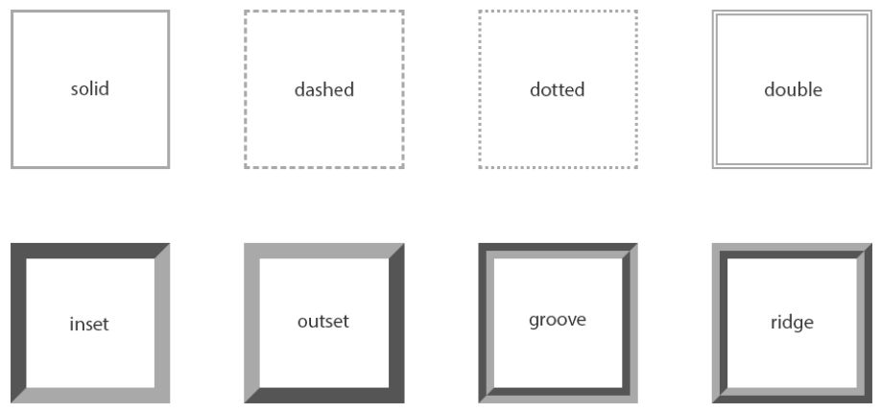
CSS 3 Outline Styles
East Tennessee State University
Department of Computing
CSCI 1720
Intermediate Web Design

Slide 8
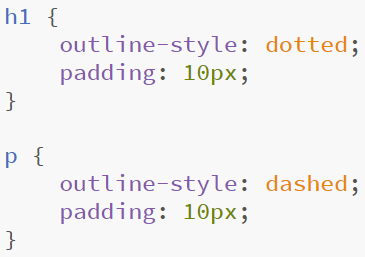
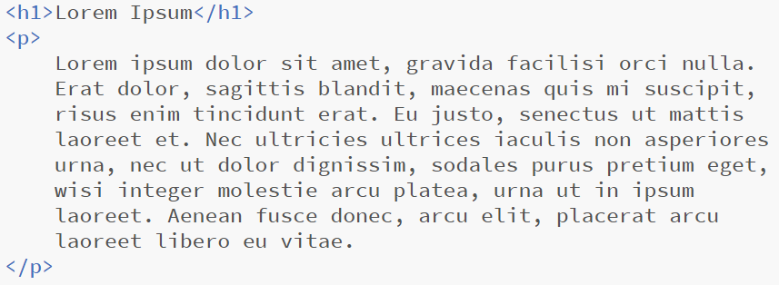
CSS 3 Outline Styles
East Tennessee State University
Department of Computing
CSCI 1720
Intermediate Web Design

Slide 9
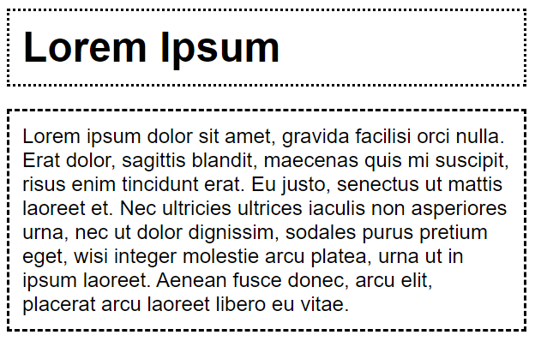
CSS 3 Outline Styles
East Tennessee State University
Department of Computing
CSCI 1720
Intermediate Web Design

Slide 10
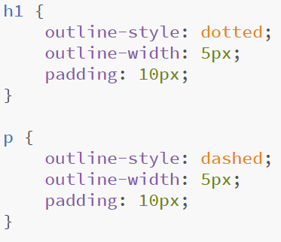
CSS 3 Outline Width
The outline-width property specifies the width of the outline to be added on an element
East Tennessee State University
Department of Computing
CSCI 1720
Intermediate Web Design

Slide 11
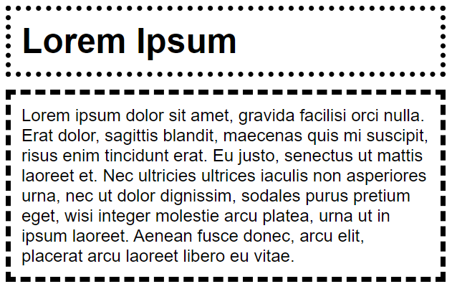
CSS 3 Outline Width
East Tennessee State University
Department of Computing
CSCI 1720
Intermediate Web Design

Slide 12
CSS 3 Outline Color
The outline-color property sets the color of the outline.
This property accepts the same values as those used for the color property
Won’t work if the outline-style property isn’t set
East Tennessee State University
Department of Computing
CSCI 1720
Intermediate Web Design

Slide 13
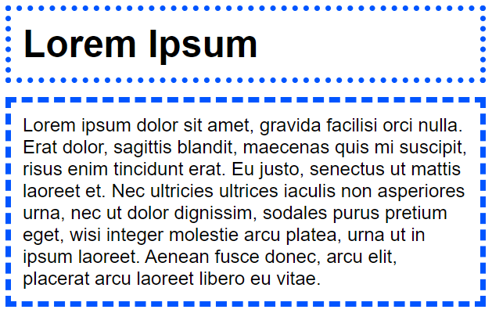
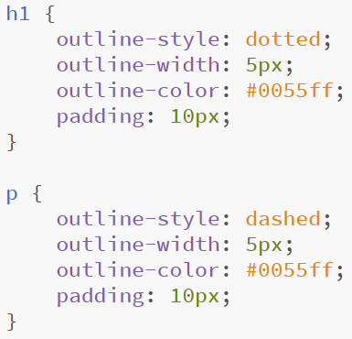
CSS 3 Outline Color
East Tennessee State University
Department of Computing
CSCI 1720
Intermediate Web Design

Slide 14
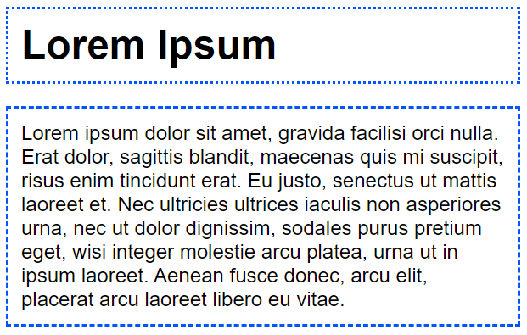
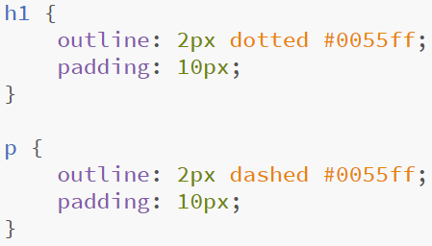
CSS 3 Outline Shorthand
Like the border (and other) property(-ies), the outline property can be written in shorthand:
East Tennessee State University
Department of Computing
CSCI 1720
Intermediate Web Design

Slide 15

CSS 3 Removing the Outline
The outline property is widely used to remove the outline around active links
However, it is recommended to apply some alternative style to indicate that the link has focus
East Tennessee State University
Department of Computing
CSCI 1720
Intermediate Web Design

Slide 16



CSS 3 Cursors
We can use the cursor property to modify the appearance of, well, the cursor
East Tennessee State University
Department of Computing
CSCI 1720
Intermediate Web Design

Slide 17
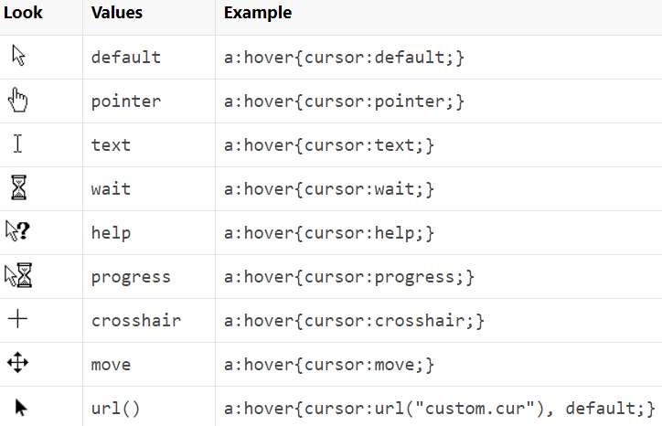
CSS 3 Cursors
East Tennessee State University
Department of Computing
CSCI 1720
Intermediate Web Design

Slide 18
CSS 3 Overflow
The overflow property specifies the behavior that occurs when an element's content overflows (doesn't fit) the element's box
There may be a situation when the content of an element might be larger than the dimensions of the box itself
For example given width and height properties did not allow enough room to accommodate the content of the element
CSS overflow property allows you to specify whether to clip content, render scroll bars or display overflow content of a block-level element
East Tennessee State University
Department of Computing
CSCI 1720
Intermediate Web Design

Slide 19
CSS 3 Overflow
Can take one of the following values: visible (default), hidden, scroll, and auto
CSS3 also defines the overflow-x and overflow-y properties which allow for independent control of the vertical and horizontal clipping
East Tennessee State University
Department of Computing
CSCI 1720
Intermediate Web Design

Slide 20
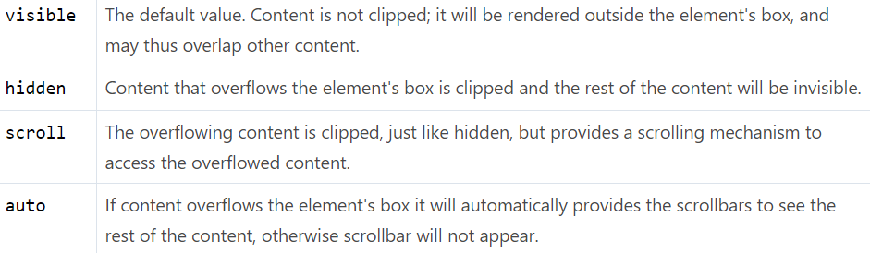
CSS 3 Overflow
East Tennessee State University
Department of Computing
CSCI 1720
Intermediate Web Design

Slide 21
CSS 3 Display
The CSS display property can be used to modify the display of an element on a web page
Remember, elements default to either block or inline display. We can modify this with CSS
We’ve done this already with images (inline) in order to make them centered in their container
One value that is useful for dynamic content is ‘none’
Using JavaScript, we can make an element appear or disappear, based on a given event
East Tennessee State University
Department of Computing
CSCI 1720
Intermediate Web Design

Slide 22
CSS 3 Display
The CSS display property can be used to modify the display of an element on a web page
The inline-block value of the display property causes an element to generate a block box that will be flowed with surrounding content i.e. in the same line as adjacent content
East Tennessee State University
Department of Computing
CSCI 1720
Intermediate Web Design

Slide 23
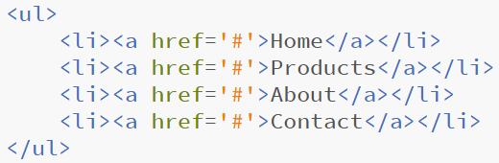
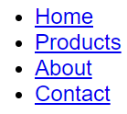
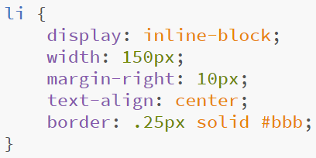
CSS 3 Display
East Tennessee State University
Department of Computing
CSCI 1720
Intermediate Web Design

Slide 24
CSS 3 Visibility
The CSS visibility property can also be used to modify the display of an element on a web page
The difference between visibility and display is that when modifying the visibility property, the element still takes up space on the page, even if it is hidden
Also, if a child element is set to visible, it will display, even if its parent element is hidden
East Tennessee State University
Department of Computing
CSCI 1720
Intermediate Web Design

Slide 25
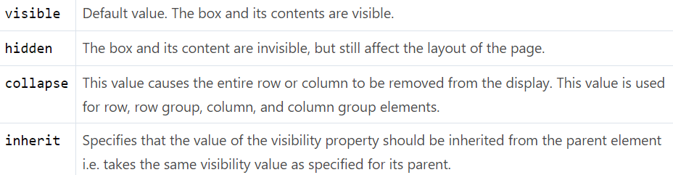
CSS 3 Visibility
The CSS visibility property can also be used to modify the display of an element on a web page
East Tennessee State University
Department of Computing
CSCI 1720
Intermediate Web Design

Slide 26
CSS 3 Visibility
The style rule visibility: collapse; however, removes the internal table elements, but it does not affect the layout of the table in any other way
The space normally occupied by the table elements will be filled by the subsequent siblings
If the style rule visibility: collapse; is specified for other elements rather than the table elements, it causes the same behavior as hidden
East Tennessee State University
Department of Computing
CSCI 1720
Intermediate Web Design

Slide 27
CSS Visibility vs Display
The display and visibility CSS properties appear to be the same thing, but they are in fact quite different and often confuse those new to web development
  visibility: hidden; hides the element, but it still takes up space in the layout. Child element of a hidden box will be visible if their visibility is set to visible.
  display: none; turns off the display and removes the element completely from the document. It does not take up any space, even though the HTML for it is still in the source code. All child elements also have their display turned off, even if their display property is set to something other than none
East Tennessee State University
Department of Computing
CSCI 1720
Intermediate Web Design

Slide 28
CSS Position
The position property defines how an element will be positioned on a page
Positioning elements appropriately on the web pages is a necessity for a good layout design
There are several methods in CSS that you can use for positioning elements
East Tennessee State University
Department of Computing
CSCI 1720
Intermediate Web Design

Slide 29
CSS Position
Static Positioning
A static positioned element is always positioned according to the normal flow of the page
HTML elements are positioned static by default
Static positioned elements are not affected by the top, bottom, left, right, and z-index properties
East Tennessee State University
Department of Computing
CSCI 1720
Intermediate Web Design

Slide 30
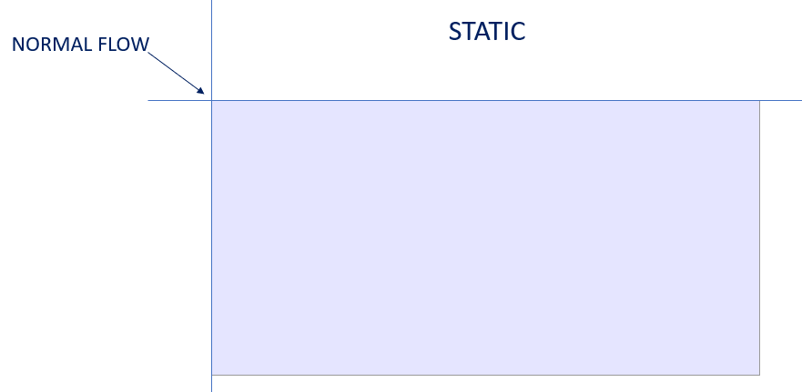
CSS Position
East Tennessee State University
Department of Computing
CSCI 1720
Intermediate Web Design

Slide 31
CSS Position
Relative Positioning
A relative positioned element is positioned relative to its normal position
In the relative positioning scheme the element's box position is calculated according to the normal flow
Then the box is shifted from this normal position according to the properties — top or bottom and/or left or right
A relatively positioned element can be moved and overlap other elements, but it keeps the space originally reserved for it in the normal flow
East Tennessee State University
Department of Computing
CSCI 1720
Intermediate Web Design

Slide 32
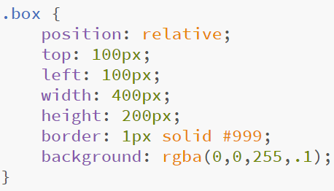

CSS Position
Relative Positioning
East Tennessee State University
Department of Computing
CSCI 1720
Intermediate Web Design

Slide 33
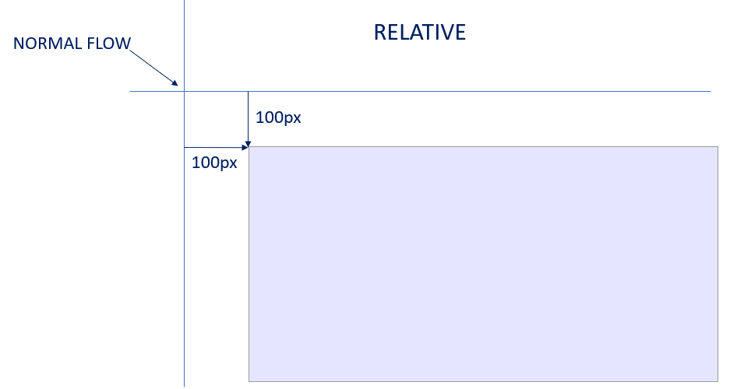
CSS Position
East Tennessee State University
Department of Computing
CSCI 1720
Intermediate Web Design

Slide 34
CSS Position
Absolute Positioning
An absolute-ly positioned element is positioned relative to the first parent element that has a position other than static
If no such element is found, it will be positioned on a page relative to the 'top-left' corner of the browser window
The box's offsets further can be specified using one or more of the properties top, right, bottom, and left
East Tennessee State University
Department of Computing
CSCI 1720
Intermediate Web Design

Slide 35
CSS Position
Absolute Positioning
Absolutely positioned elements are taken out of the normal flow entirely and thus take up no space when placing sibling elements
It can overlap other elements depending on the z-index property value
Also, an absolutely positioned element can have margins, and they do not collapse with any other margins.
East Tennessee State University
Department of Computing
CSCI 1720
Intermediate Web Design

Slide 36
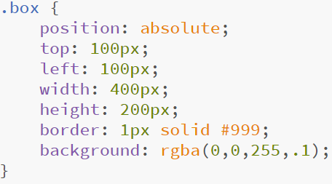
CSS Position
Absolute Positioning
East Tennessee State University
Department of Computing
CSCI 1720
Intermediate Web Design

Slide 37
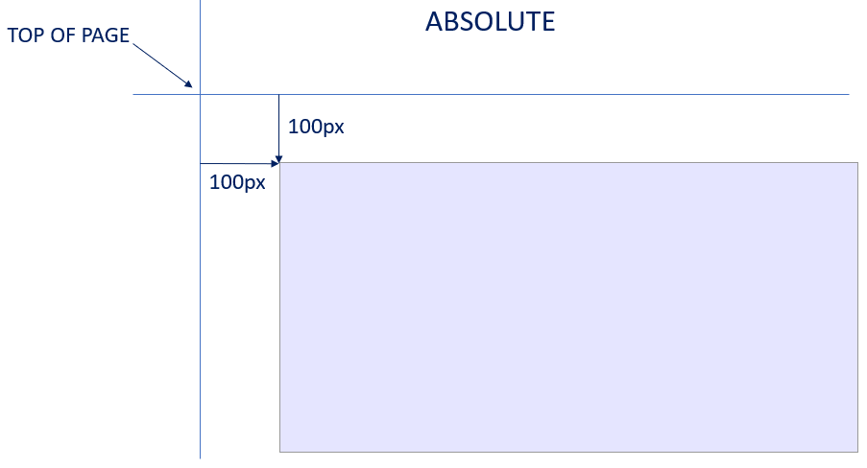
CSS Position
East Tennessee State University
Department of Computing
CSCI 1720
Intermediate Web Design

Slide 38
CSS Position
Fixed Positioning
Fixed positioning is a subcategory of absolute positioning
The only difference is, a fixed positioned element is fixed with respect to the browser's viewport and does not move when scrolled
East Tennessee State University
Department of Computing
CSCI 1720
Intermediate Web Design

Slide 39
CSS Layers
The CSS z-index property can be used in conjunction with the position property to create an effect of layers like Photoshop
Usually HTML pages are considered two-dimensional, because text, images and other elements are arranged on the page without overlapping
However, in addition to their horizontal and vertical positions, boxes can be stacked along the z-axis as well i.e. one on top of the other by using the CSS z-index property
East Tennessee State University
Department of Computing
CSCI 1720
Intermediate Web Design

Slide 40
CSS Layers
This property specifies the stack level of a box whose position value is one of absolute, fixed, or relative
The z-axis position of each layer is expressed as an integer representing the stacking order for rendering. An element with a larger z-index overlaps an element with a lower one
A z-index property can help you to create more complex webpage layouts
East Tennessee State University
Department of Computing
CSCI 1720
Intermediate Web Design

Slide 41
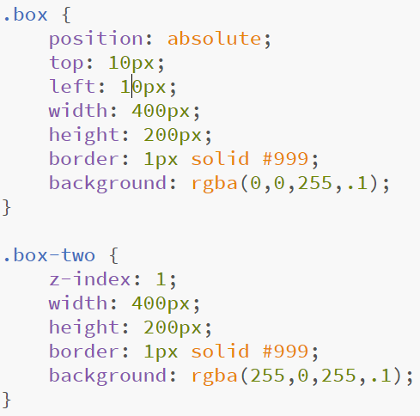
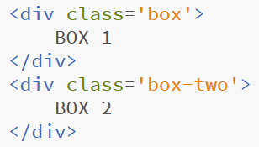
CSS Layers
East Tennessee State University
Department of Computing
CSCI 1720
Intermediate Web Design

Slide 42
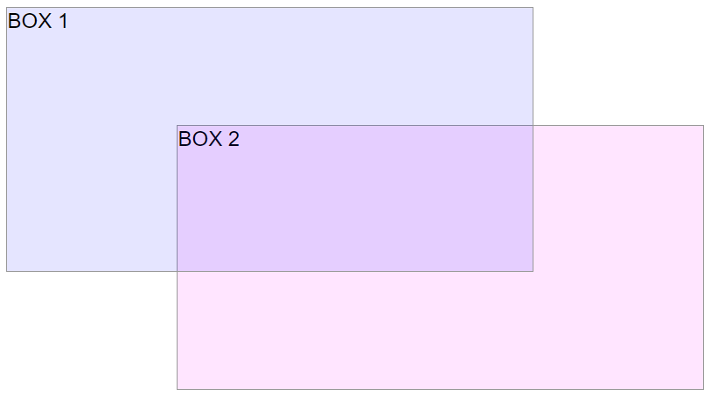
CSS Layers
East Tennessee State University
Department of Computing
CSCI 1720
Intermediate Web Design

Slide 43
CSS Pseudo-elements
The CSS pseudo-elements allow you to style the elements or parts of the elements without adding any IDs or classes to them
It will be really helpful in the situations when you just want to style the first letter of a paragraph to create the drop cap effect or you want to insert some content before or after an element, etc. only through style sheet
East Tennessee State University
Department of Computing
CSCI 1720
Intermediate Web Design

Slide 44

CSS Pseudo-elements
CSS3 introduced a new double-colon (::) syntax for pseudo-elements to distinguish between them and pseudo-classes
The new syntax of the pseudo-element can be given with:
East Tennessee State University
Department of Computing
CSCI 1720
Intermediate Web Design

Slide 45
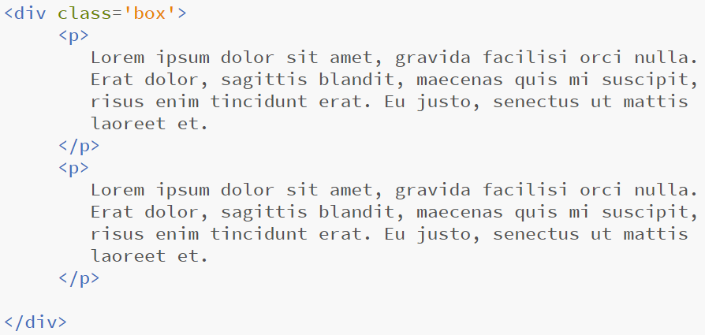
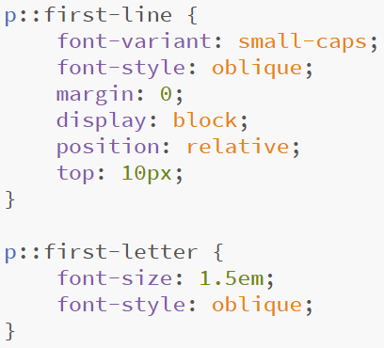
CSS Pseudo-elements
East Tennessee State University
Department of Computing
CSCI 1720
Intermediate Web Design

Slide 46
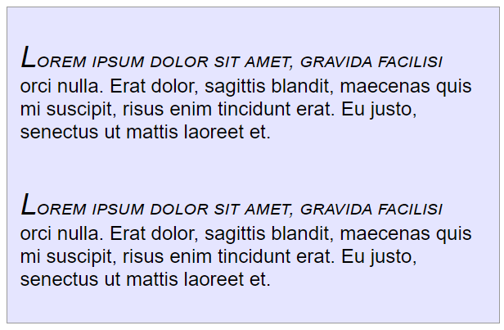
CSS Pseudo-elements
East Tennessee State University
Department of Computing
CSCI 1720
Intermediate Web Design

Slide 47

CSS Pseudo-elements
The ::before and ::after pseudo-elements can be used to add content before and/or after an element
East Tennessee State University
Department of Computing
CSCI 1720
Intermediate Web Design

Slide 48
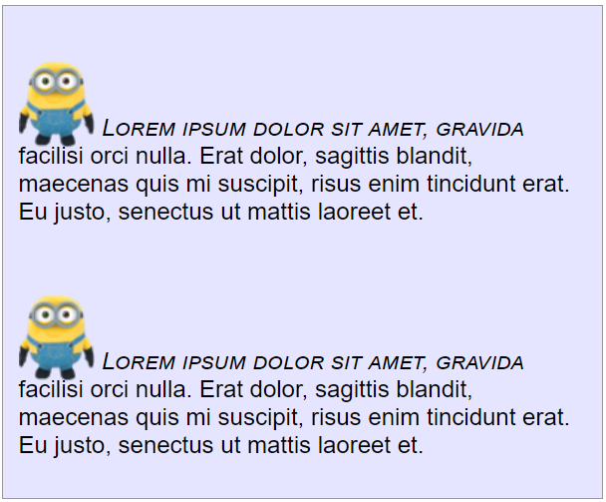
CSS Pseudo-elements
East Tennessee State University
Department of Computing
CSCI 1720
Intermediate Web Design

Slide 49
CSS Opacity
opacity is now a part of the CSS3 specifications, but it has been present for a long time
Older browsers have different ways of controlling the opacity or transparency
opacity can be applied to images, text, colors, and elements
East Tennessee State University
Department of Computing
CSCI 1720
Intermediate Web Design

Slide 50
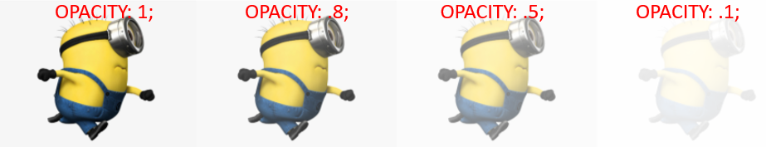
CSS Opacity
East Tennessee State University
Department of Computing
CSCI 1720
Intermediate Web Design

Slide 51
CSS Transforms
East Tennessee State University
Department of Computing
CSCI 1720
Intermediate Web Design

Slide 52
CSS Transforms
CSS 3 includes several functions that allow us to alter the appearance of an element
The all fall under the transform property
Most common are scale, translate, rotate, and skew
East Tennessee State University
Department of Computing
CSCI 1720
Intermediate Web Design

Slide 53
CSS Transforms - scale
scale will modify the element’s display size
East Tennessee State University
Department of Computing
CSCI 1720
Intermediate Web Design

Slide 54
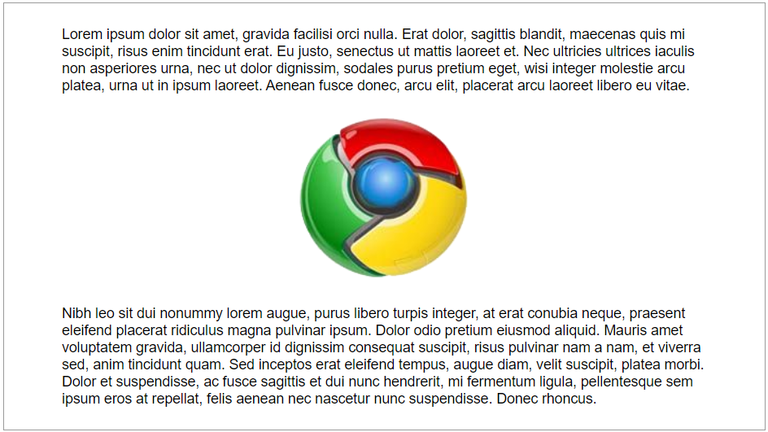
CSS Transforms - scale
UNSCALED
East Tennessee State University
Department of Computing
CSCI 1720
Intermediate Web Design

Slide 55
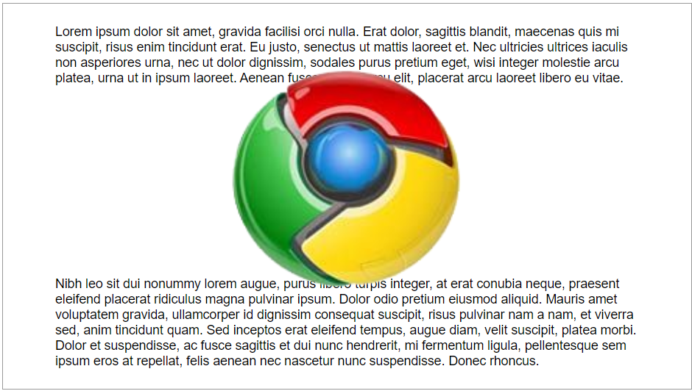

SCALED
East Tennessee State University
Department of Computing
CSCI 1720
Intermediate Web Design

Slide 56
CSS Transforms - translate
translate will modify the element’s position relative to where it would have displayed otherwise
We can use translate along the x- and y-axes, or use translateX and translateY for a single axis
East Tennessee State University
Department of Computing
CSCI 1720
Intermediate Web Design

Slide 57
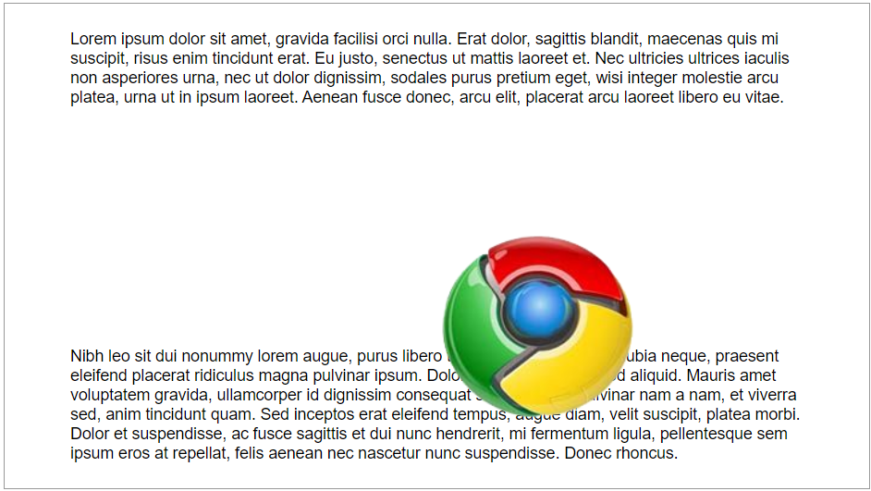

SCALED
East Tennessee State University
Department of Computing
CSCI 1720
Intermediate Web Design

Slide 58
CSS Transforms - rotate
rotate will modify the element’s orientation by rotating it
We have to specify how many degrees we want to rotate it
e.g.,
transform: rotate(30deg);
East Tennessee State University
Department of Computing
CSCI 1720
Intermediate Web Design

Slide 59

NOT ROTATED
East Tennessee State University
Department of Computing
CSCI 1720
Intermediate Web Design

Slide 60
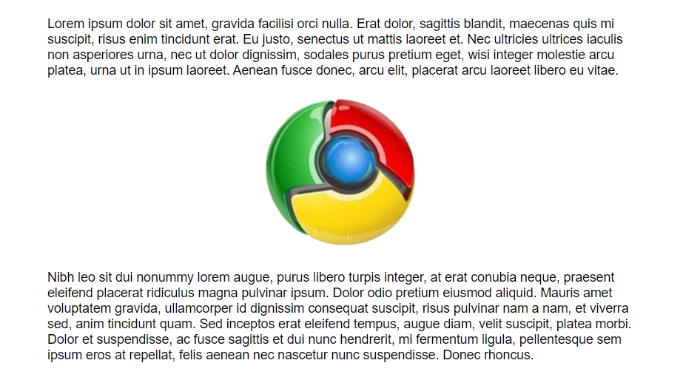

ROTATED 30º
East Tennessee State University
Department of Computing
CSCI 1720
Intermediate Web Design

Slide 61
CSS Transforms - skew
skew will modify the element’s orientation by skewing it along the x- or y-axis
We can specify the x- or y-axis with skewX and skewY
Or do both with skew
transform: skew(30deg, 30deg);
East Tennessee State University
Department of Computing
CSCI 1720
Intermediate Web Design

Slide 62
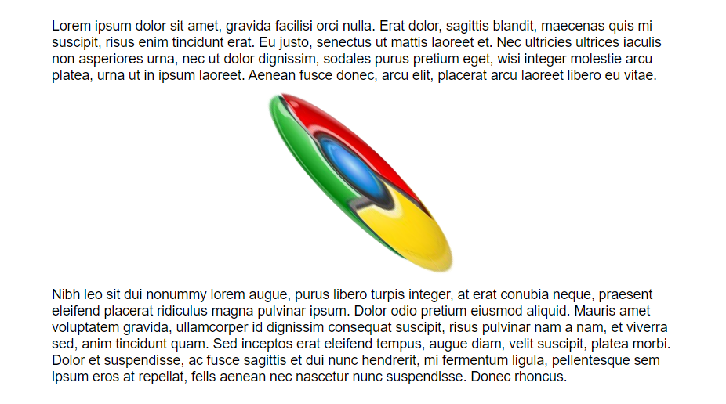

East Tennessee State University
Department of Computing
CSCI 1720
Intermediate Web Design

Slide 63
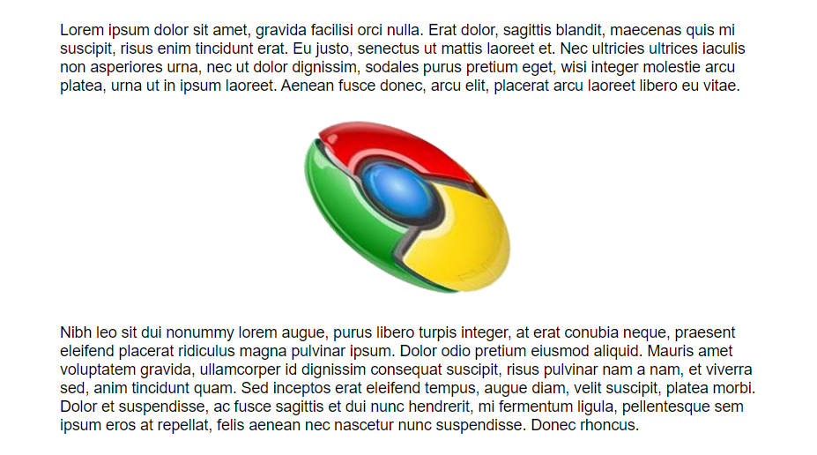

East Tennessee State University
Department of Computing
CSCI 1720
Intermediate Web Design

Slide 64
CSS Animation
East Tennessee State University
Department of Computing
CSCI 1720
Intermediate Web Design

Slide 65

CSS Animation
We can create animations with CSS3
This is a little more complex
The first step is to create an @keyframes directive and give it a name
East Tennessee State University
Department of Computing
CSCI 1720
Intermediate Web Design

Slide 66
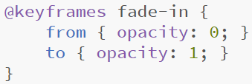
CSS Animation
Then, we add rules to define how the element will appear at a given point during the sequence
Easiest is from/to
*note: from and to can have more than one property/value set
East Tennessee State University
Department of Computing
CSCI 1720
Intermediate Web Design

Slide 67
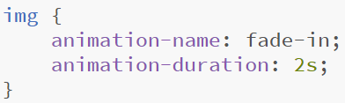
CSS Animation
Then, we can associate each element we want to animate with the @keyframes directive we created
We also have to specify a duration over which the animation will take place
East Tennessee State University
Department of Computing
CSCI 1720
Intermediate Web Design

Slide 68
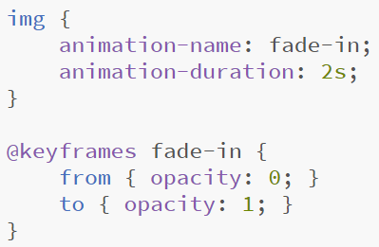
CSS Animation
East Tennessee State University
Department of Computing
CSCI 1720
Intermediate Web Design

Slide 69
CSS Animation
@keyframes directives can be used by multiple selectors on a page
East Tennessee State University
Department of Computing
CSCI 1720
Intermediate Web Design

Slide 70
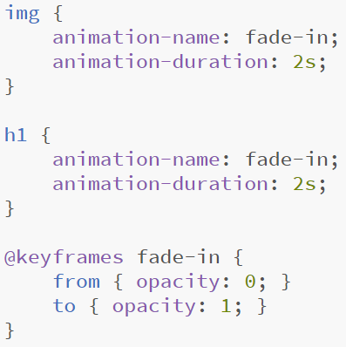
CSS Animation
East Tennessee State University
Department of Computing
CSCI 1720
Intermediate Web Design

Slide 71
CSS Animation
We can get more creative/fine-grained with the @keyframes directive by specifying percentages instead of from/to
East Tennessee State University
Department of Computing
CSCI 1720
Intermediate Web Design

Slide 72
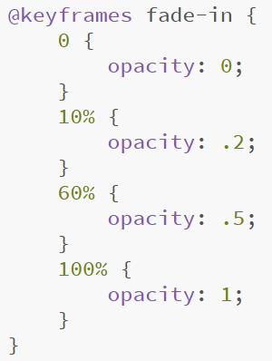
CSS Animation
East Tennessee State University
Department of Computing
CSCI 1720
Intermediate Web Design

Slide 73
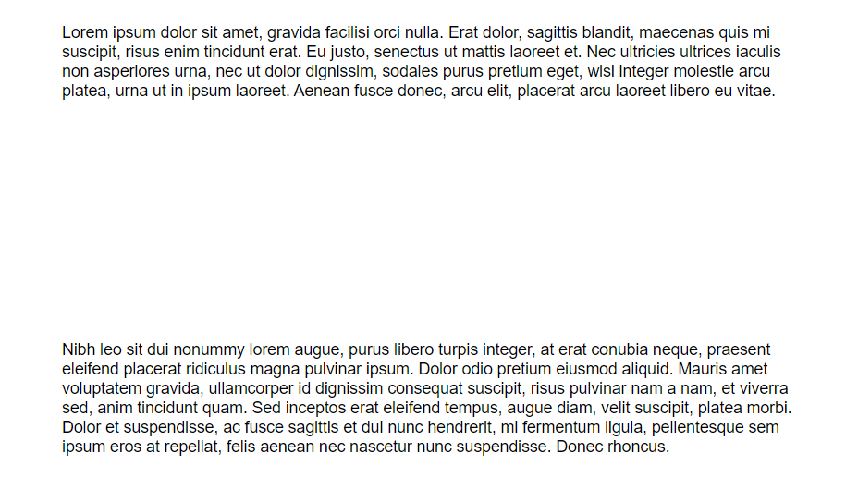

East Tennessee State University
Department of Computing
CSCI 1720
Intermediate Web Design

Slide 74
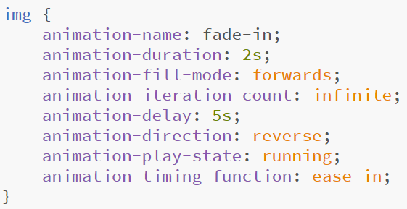
CSS Animation
There are several other animation properties we can use to further modify an animation, including
East Tennessee State University
Department of Computing
CSCI 1720
Intermediate Web Design

Slide 75
CSS Animation
Typically, despite these examples, animations are applied to specialized classes or IDs instead of general selectors
The browser will make a ‘best effort’ to smooth the transitions between different @keyframe states
A lot of times, at least in my experience, it takes a bit of fiddling with the numbers to get the effect you want
East Tennessee State University
Department of Computing
CSCI 1720
Intermediate Web Design

Slide 76

CSS Animation
JavaScript can also be used to create animations
Generally speaking, though, CSS Animations are more lightweight and require less processing from the client computer
CSS Animations are best suited for relatively simple tasks that can easily be handled by a browser
We’ll see this Thursday
East Tennessee State University
Department of Computing
CSCI 1720
Intermediate Web Design

Slide 77

QUESTIONS?
East Tennessee State University
Department of Computing
CSCI 1720
Intermediate Web Design

Slide 78


Copyrights
Presentation prepared by and copyright of John Ramsey, East Tennessee State University, Department of Computing . (ramseyjw@etsu.edu)
Microsoft, Windows, Excel, Outlook, and PowerPoint are registered trademarks of Microsoft Corporation.
IBM, DB2, DB2 Universal Database, System i, System i5, System p, System p5, System x, System z, System z10, System z9, z10, z9, iSeries, pSeries, xSeries, zSeries, eServer, z/VM, z/OS, i5/OS, S/390, OS/390, OS/400, AS/400, S/390 Parallel Enterprise Server, PowerVM, Power Architecture, POWER6+, POWER6, POWER5+, POWER5, POWER, OpenPower, PowerPC, BatchPipes, BladeCenter, System Storage, GPFS, HACMP, RETAIN, DB2 Connect, RACF, Redbooks, OS/2, Parallel Sysplex, MVS/ESA, AIX, Intelligent Miner, WebSphere, Netfinity, Tivoli and Informix are trademarks or registered trademarks of IBM Corporation.
Linux is the registered trademark of Linus Torvalds in the U.S. and other countries.
Oracle is a registered trademark of Oracle Corporation.
HTML, XML, XHTML and W3C are trademarks or registered trademarks of W3C®, World Wide Web Consortium, Massachusetts Institute of Technology.
Java is a registered trademark of Sun Microsystems, Inc.
JavaScript is a registered trademark of Sun Microsystems, Inc., used under license for technology invented and implemented by Netscape.
SAP, R/3, SAP NetWeaver, Duet, PartnerEdge, ByDesign, SAP Business ByDesign, and other SAP products and services mentioned herein as well as their respective logos are trademarks or registered trademarks of SAP AG in Germany and other countries.
Business Objects and the Business Objects logo, BusinessObjects, Crystal Reports, Crystal Decisions, Web Intelligence, Xcelsius, and other Business Objects products and services mentioned herein as well as their respective logos are trademarks or registered trademarks of Business Objects S.A. in the United States and in other countries. Business Objects is an SAP company.
ERPsim is a registered copyright of ERPsim Labs, HEC Montreal.
Other products mentioned in this presentation are trademarks of their respective owners.
East Tennessee State University
Department of Computing
CSCI 1720
Intermediate Web Design

