Slide 1
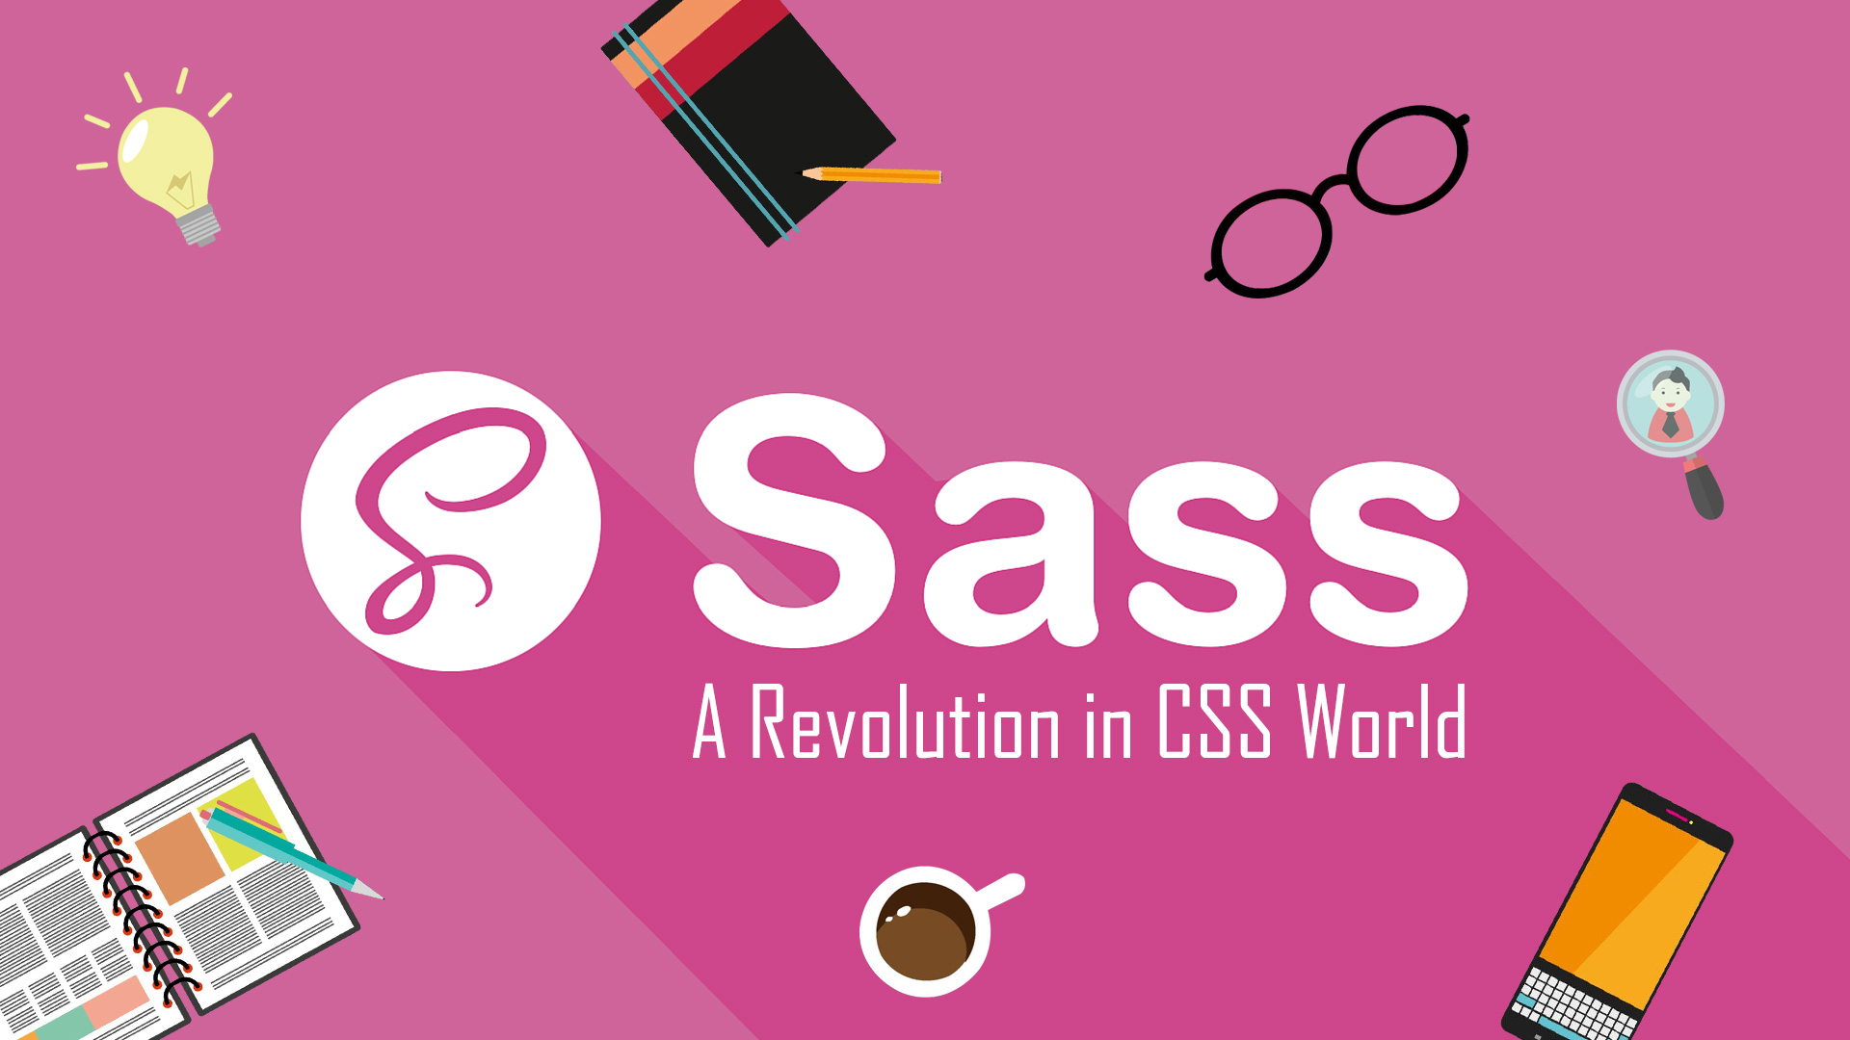

Slide 2

SASS Syntactically Awesome Stylesheets
East Tennessee State University Department of Computing
CSCI 1720 Intermediate Web Design

Slide 3
What is SASS?
SASS is a CSS preprocessor
Runs on Node.js
Extends the functionality of CSS
Eliminates (or, at least mitigates) many of the traditional CSS pain points
Source files are created by the user (more, later) and ‘compiled’ by SASS into the output CSS file
East Tennessee State University Department of Computing
CSCI 1720 Intermediate Web Design

Slide 4
Why Use SASS?
It is a pre-processing language which provides indented syntax (its own syntax) (LESS) or CSS-like structure (SCSS) that are processed into the site’s CSS
It provides some features, which are used for creating stylesheets that allows writing code more efficiently and is easier to maintain than vanilla CSS
East Tennessee State University Department of Computing
CSCI 1720 Intermediate Web Design

Slide 5
Why Use SASS?
It is a super set of CSS, which means it contains all the features of CSS and is an open source pre-processor, coded in JavaScript
It provides the document style in a good, structured format, better than vanilla CSS
It uses re-usable methods, logic statements and some of the built-in functions such as color manipulation, mathematics and parameter lists
East Tennessee State University Department of Computing
CSCI 1720 Intermediate Web Design

Slide 6
Features of SASS
It is more stable, powerful, and compatible with versions of CSS
It is known as syntactic sugar for CSS, which means it makes easier way for user to read or express the things more clearly
It uses its own syntax and compiles to readable CSS
You can easily write CSS in less code within less time
It is an open source [awesome!] pre-processor, which is interpreted into CSS
East Tennessee State University Department of Computing
CSCI 1720 Intermediate Web Design

Slide 7
Advantages of SASS
It allows writing clean CSS in a programming construct
It helps in writing CSS quickly
As SASS is compatible with all versions of CSS, we can use any available CSS libraries
It is possible to use nested syntax and useful functions such as color manipulation, mathematics and other values
East Tennessee State University Department of Computing
CSCI 1720 Intermediate Web Design

Slide 8
Disadvantages of SASS
It takes time for a developer to learn new features present in this pre-processor
If many people are working on the same site, then they should use the same preprocessor
Some people use SASS and some people use CSS to edit the files directly. Therefore, it becomes difficult to work on the site
There are chances of losing benefits of browser's built-in element inspector
East Tennessee State University Department of Computing
CSCI 1720 Intermediate Web Design

Slide 9
SASS Installation
East Tennessee State University Department of Computing
CSCI 1720 Intermediate Web Design

Slide 10
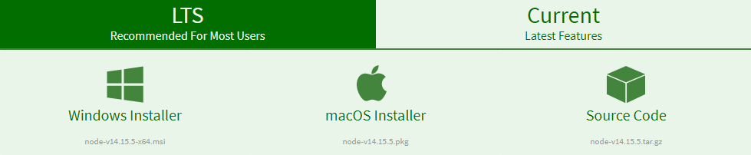
Installing SASS
SASS is now a Nodejs package
If you don’t have Nodejs installed on your PC, you’ll need to do that first
The download is at https://nodejs.org/en/download/
East Tennessee State University Department of Computing
CSCI 1720 Intermediate Web Design

Slide 11

Installing SASS
Once Nodejs is installed, open a command prompt
Enter node -v to ensure that Nodejs has been successfully installed
Enter npm install –g sass
East Tennessee State University Department of Computing
CSCI 1720 Intermediate Web Design

Slide 12

Installing SASS
Enter sass -–version to confirm successful installation
East Tennessee State University Department of Computing
CSCI 1720 Intermediate Web Design

Slide 13
NOTE: The CLI
One thing I’ve learned over the years is this:
You
CAN NOT!
make it as an IT Pro, if you’re not comfortable working from a Command Line Interface. Period.
East Tennessee State University Department of Computing
CSCI 1720 Intermediate Web Design

Slide 14
Installing SASS
It isn’t required that you install SASS on your own machine
I’ve confirmed that it does work on the lab computers, but is a little more convoluted
If you install to your laptop, the sass command will be installed on the system’s PATH and can be run from anywhere
East Tennessee State University Department of Computing
CSCI 1720 Intermediate Web Design

Slide 15
Installing SASS
So, if your project files are on your E:\ drive, for example, let’s say
E:\csci1720\labs\sass
On a lab machine, you’d have to navigate to
C:\ruby24-x64\bin
and run
sass --watch E:\csci1720\labs\sass\scss:E:\csci1720\labs\sass\css
East Tennessee State University Department of Computing
CSCI 1720 Intermediate Web Design

Slide 16
Installing SASS
command
switch
Colon
sass --watch E:\csci1720\labs\sass\scss:E:\csci1720\labs\sass\css
destination directory
source directory
East Tennessee State University Department of Computing
CSCI 1720 Intermediate Web Design

Slide 17
Installing SASS
If you’re working from your own machine, however, all you’d have to do (from the command prompt) is
cd E:\csci1720\sass
sass --watch scss:css
Then minimize the command prompt
While SASS is running, anytime you change your source code, SASS will detect it and recompile your CSS
East Tennessee State University Department of Computing
CSCI 1720 Intermediate Web Design
East Tennessee State University Department of Computing
CSCI 1720 Intermediate Web Design

Slide 18
Installing SASS
Actually, even easier!
In VSC, you can click ‘Terminal’ and ‘New Terminal,’ which will open a terminal display at the bottom of the editor
Then, all you have to do it enter
sass --watch scss:css
(Since you opened the terminal from VSC, you’ll already be in the correct directory. Ain’t life grand?)
East Tennessee State University Department of Computing
CSCI 1720 Intermediate Web Design
East Tennessee State University Department of Computing
CSCI 1720 Intermediate Web Design

Slide 19
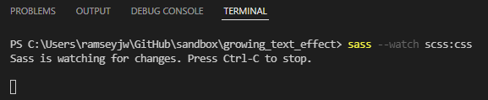
Installing SASS
East Tennessee State University Department of Computing
CSCI 1720 Intermediate Web Design
East Tennessee State University Department of Computing
CSCI 1720 Intermediate Web Design

Slide 20
Installing SASS
IMPORTANT POINT:
In a SASS environment, you never touch the CSS file!
East Tennessee State University Department of Computing
CSCI 1720 Intermediate Web Design

Slide 21
SCSS
Sassy CSS

Slide 22
SASS Source Code
There are two ways (languages, if you will) to create SASS source code
SASS (e.g., main.sass)
Uses indentation as delimiters
Instead of braces {}
I don’t like it
SCSS (e.g., main.scss)
Superset of CSS
Uses CSS syntax we’re familiar with
East Tennessee State University Department of Computing
CSCI 1720 Intermediate Web Design

Slide 23
SASS Source Code
There are two ways (languages, if you will) to create SASS source code
SCSS seems to be more popular
Makes sense, since any valid CSS is also valid SCSS
Syntax is much the same
East Tennessee State University Department of Computing
CSCI 1720 Intermediate Web Design

Slide 24
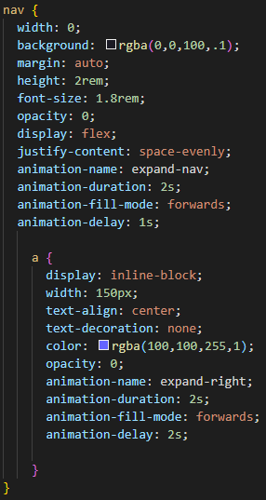
SASS Source Code
East Tennessee State University Department of Computing
CSCI 1720 Intermediate Web Design

Slide 25
SASS Variables
East Tennessee State University Department of Computing
CSCI 1720 Intermediate Web Design

Slide 26
SASS Variables
One of the (many) neat things about SASS is variables
Like variables in other languages, they allow easy global changes
Instead of having to find each instance, for example, of
color: #333;
In a long CSS file, you can change
$fontColor: #333; to $fontColor: #444;
in one place, and it’ll propagate throughout the entire resulting CSS file
East Tennessee State University Department of Computing
CSCI 1720 Intermediate Web Design

Slide 27
SASS Variables
Using the $ (dollar) symbol
Can be used to store colors, size, etc…
Usable to set default background-color, font-color, font-size, etc…
$link-color: #ffffff;
$v-link-color: #646363;
a {
color: $link-color;
} a:visited {
color: $v-link-color;
}
body a {
color: white; }
a:visited {
color: #646363; }
East Tennessee State University Department of Computing
CSCI 1720 Intermediate Web Design

Slide 28
SASS Variables
SASS variables can be inserted as CSS properties using #{}
$border-side:top;
$border-color:blue;
$border-style:ridge;
$border-width:15px;
…
border-#{$border-side} :
$border-width $border-style $border-color;
border-top : 15px ridge blue
East Tennessee State University Department of Computing
CSCI 1720 Intermediate Web Design

Slide 29
SASS Nesting
When writing HTML you've probably noticed that it has a clear nested and visual hierarchy
CSS, on the other hand, doesn’t
SASS will let you nest your CSS selectors in a way that follows the same visual hierarchy of your HTML
Be aware that overly nested rules will result in over-qualified CSS that could prove hard to maintain and is generally considered bad practice
East Tennessee State University Department of Computing
CSCI 1720 Intermediate Web Design

Slide 30
SASS Nesting
nav {
ul {
margin: 0;
padding: 0;
list-style: none;
}
li { display: inline-block; }
a {
display: block;
padding: 6px 12px;
text-decoration: none;
}
}
You'll notice that the ul, li, and a selectors are nested inside the nav selector
This is a great way to organize your CSS and make it more readable
When you generate the CSS you'll get something like this
East Tennessee State University Department of Computing
CSCI 1720 Intermediate Web Design

Slide 31
SASS Nesting
nav {
ul {
margin: 0;
padding: 0;
list-style: none;
}
li { display: inline-block; }
a {
display: block;
padding: 6px 12px;
text-decoration: none;
}
}
nav ul {
margin: 0;
padding: 0;
list-style: none;
}
nav li {
display: inline-block;
}
nav a {
display: block;
padding: 6px 12px;
text-decoration: none;
}
East Tennessee State University Department of Computing
CSCI 1720 Intermediate Web Design

Slide 32
SASS Nesting
img {
width: $pic-width;
&.img-left {
float: left;
margin-right: 2em;
}
&.img-right {
float: right;
margin-left: 2em;
}
}
You can generate selector- specific classes by nesting the code inside the selector
Using the ampersand is similar to the ‘this.’ directive in OO languages
So this code, when processed, produces this:
East Tennessee State University Department of Computing
CSCI 1720 Intermediate Web Design

Slide 33
SASS Nesting - Classes
img {
width: $pic-width;
&.img-left {
float: left;
margin-right: 2em;
}
&.img-right {
float: right;
margin-left: 2em;
}
}
img {
width: 15em; }
img.img-left {
float: left;
margin-right: 2em; }
img.img-right {
float: right;
margin-left: 2em; }
East Tennessee State University Department of Computing
CSCI 1720 Intermediate Web Design

Slide 34
A note on output styles
When developing with Sass sometimes there is a need to adjust the output style of the CSS. Sass’s default CSS style is good but might not be applicable for all situations.
Sass supports four different output styles
:nested
:compact
:expanded
:compressed
To understand what each of the above settings output consider the following snippet of code:
East Tennessee State University Department of Computing
CSCI 1720 Intermediate Web Design

Slide 35
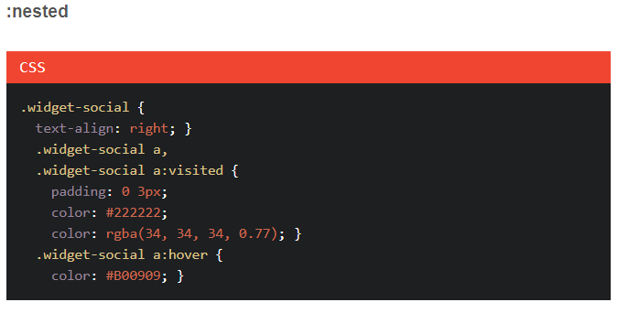
A note on output styles
East Tennessee State University Department of Computing
CSCI 1720 Intermediate Web Design

Slide 36
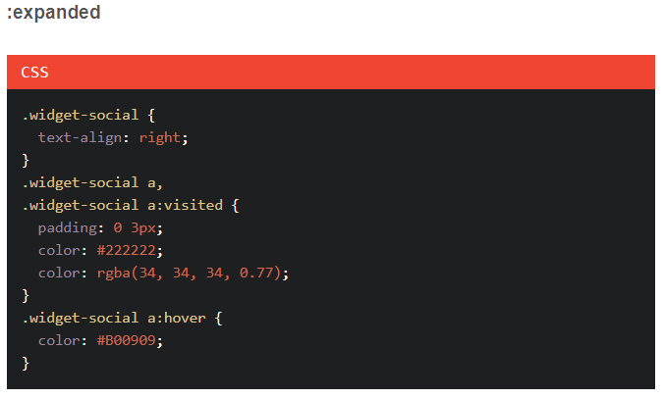
A note on output styles
East Tennessee State University Department of Computing
CSCI 1720 Intermediate Web Design

Slide 37
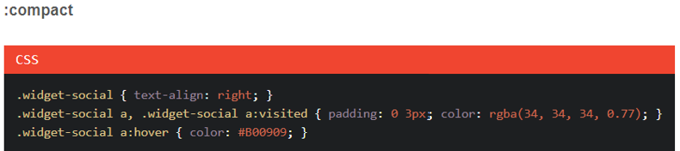
A note on output styles
East Tennessee State University Department of Computing
CSCI 1720 Intermediate Web Design

Slide 38
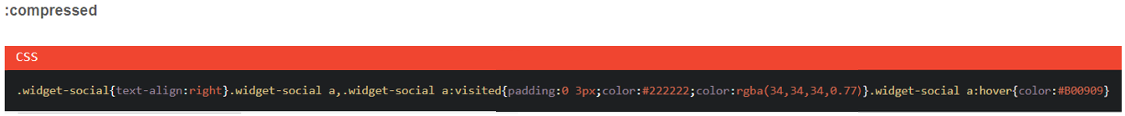
A note on output styles
East Tennessee State University Department of Computing
CSCI 1720 Intermediate Web Design

Slide 39
A note on output styles
ALL RIGHT!!
So why does this matter??
You tell me…
East Tennessee State University Department of Computing
CSCI 1720 Intermediate Web Design

Slide 40
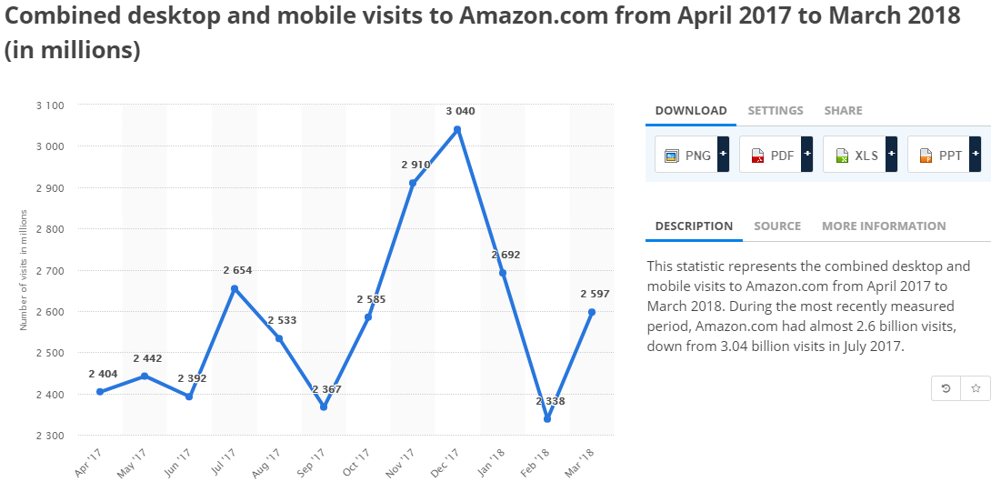
A note on output styles
East Tennessee State University Department of Computing
CSCI 1720 Intermediate Web Design

Slide 41
A note on output styles
I’m not good with math, but if I’ve figured it right, this boils down to 3,009,259 hits A SECOND!
Three … freakin … MILLION hits … a … SECOND!!!
So, as a web developer, what does that mean to you?
Here’s a hint: Whitespace
East Tennessee State University Department of Computing
CSCI 1720 Intermediate Web Design

Slide 42
Output:
This comes down to what you are using for compiling. If you’re running with the command-line you can just pass in the setting using the --style flag like so:
sass --watch style.scss:style.css --style compressed
East Tennessee State University Department of Computing
CSCI 1720 Intermediate Web Design

Slide 43
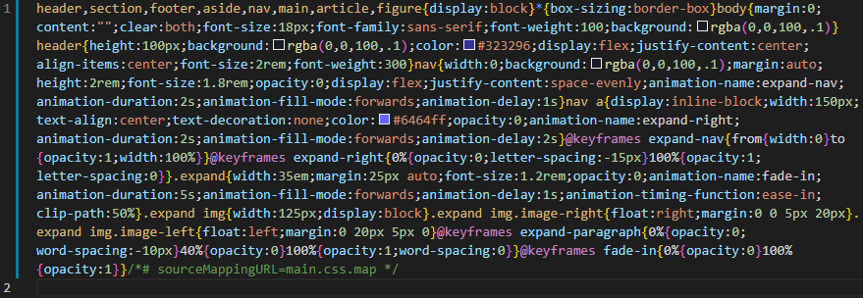
Output:
sass --watch style.scss:style.css --style compressed
East Tennessee State University Department of Computing
CSCI 1720 Intermediate Web Design

Slide 44
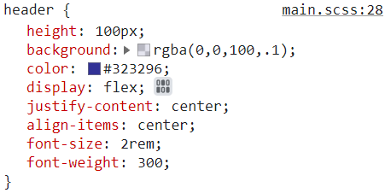
Output:
sass --watch style.scss:style.css --style compressed
What does this mean??
This is a file (we never need to do anything with it) that maps the CSS back to the SCSS code that generated it
Browsers’ Developer Tools can then use this mapping to help with troubleshooting
East Tennessee State University Department of Computing
CSCI 1720 Intermediate Web Design

Slide 45
SASS Partials
Break….take a breath…
East Tennessee State University Department of Computing
CSCI 1720 Intermediate Web Design

Slide 46
SASS Partials
You can create partial SASS files that contain little snippets of CSS that you can include in other SASS files
This is a great way to modularize your CSS and help keep things easier to maintain
A partial is simply a SASS file named with a leading underscore. You might name it something like _variables.scss
The underscore lets SASS know that the file is only a partial file and that it should not be generated into a CSS file
SASS partials are used with the @import directive
East Tennessee State University Department of Computing
CSCI 1720 Intermediate Web Design

Slide 47
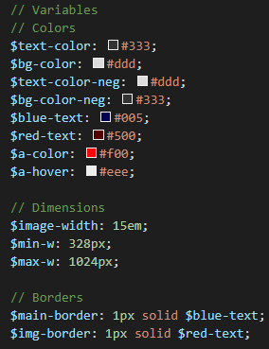
SASS Partials
File name: _variables.scss
East Tennessee State University Department of Computing
CSCI 1720 Intermediate Web Design

Slide 48
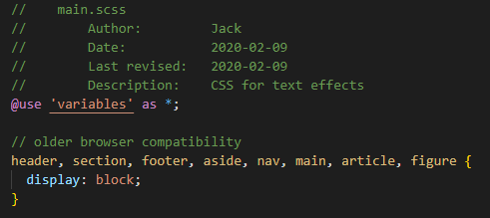
SASS Partials
Resulting code
We used to use @import instead of @use, but that’s now deprecated
East Tennessee State University Department of Computing
CSCI 1720 Intermediate Web Design

Slide 49
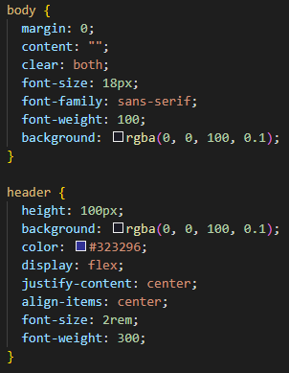
SASS Partials
Resulting code (main.css)
East Tennessee State University Department of Computing
CSCI 1720 Intermediate Web Design

Slide 50
SASS Mixins
East Tennessee State University Department of Computing
CSCI 1720 Intermediate Web Design

Slide 51
SASS Mixins
Mixins are kind of developer defined functions
The developer can make them for clear SASS
Two kinds of mixins
Parameterless
Get default styles every time
With parameters
Get style based on some parameters
Gradient, borders, etc…
East Tennessee State University Department of Computing
CSCI 1720 Intermediate Web Design

Slide 52
SASS
// Use @mixin mixin-name
// Then the styles are normal SASS
@mixin clearfix{
zoom:1;
content:"";
height:0; clear:both;
}
ul#main-nav{
@include clearfix;
…
}
East Tennessee State University Department of Computing
CSCI 1720 Intermediate Web Design

Slide 53
SASS Extend/Inheritance
East Tennessee State University Department of Computing
CSCI 1720 Intermediate Web Design

Slide 54
SASS Extend/Inheritance
This is one of the most useful features of SASS
Using @extend lets you share a set of CSS properties from one selector to another
It helps keep your SASS very DRY (“Don’t Repeat Yourself”)
In our example we're going to create a simple series of messaging for errors, warnings and successes
East Tennessee State University Department of Computing
CSCI 1720 Intermediate Web Design

Slide 55
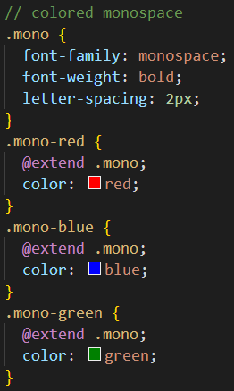
SASS Extend/Inheritance
What the above code does is allow you to take the CSS properties in .message and apply them to .success
The magic happens with the generated CSS, and this helps you avoid having to write multiple class names on HTML elements
This is what it looks like:
East Tennessee State University Department of Computing
CSCI 1720 Intermediate Web Design

Slide 56
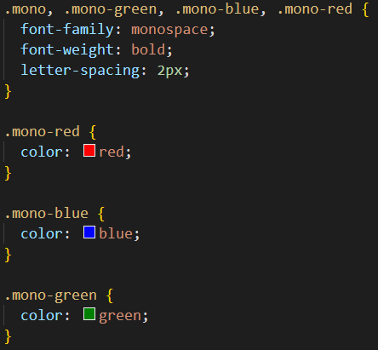
SASS Extend/Inheritance
East Tennessee State University Department of Computing
CSCI 1720 Intermediate Web Design

Slide 57
SASS Operators
East Tennessee State University Department of Computing
CSCI 1720 Intermediate Web Design

Slide 58
SASS Operators
Doing math in your CSS is very helpful
SASS has a handful of standard math operators like +, -, *, /, and %
In this example we're going to do some simple math to calculate widths for an aside & article
East Tennessee State University Department of Computing
CSCI 1720 Intermediate Web Design

Slide 59
SASS Operators
We've created a very simple fluid grid, based on 960px
Operations in SASS let us do something like take pixel values and convert them to percentages without much hassle
The generated CSS will look like:
.container { width: 100%; }
article {
float: left;
width: 600px / 960px * 100%;
}
aside {
float: right;
width: 300px / 960px * 100%;
}
East Tennessee State University Department of Computing
CSCI 1720 Intermediate Web Design

Slide 60
SASS Operators
.container {
width: 100%;
}
article {
float: left;
width: 62.5%;
}
aside {
float: right;
width: 31.25%;
}
East Tennessee State University Department of Computing
CSCI 1720 Intermediate Web Design

Slide 61
Lab this week
We’ll create a page using Sass for styling
East Tennessee State University Department of Computing
CSCI 1720 Intermediate Web Design

Slide 62


Copyrights
Presentation prepared by and copyright of John Ramsey, East Tennessee State University, Department of Computing . (ramseyjw@etsu.edu)
Microsoft, Windows, Excel, Outlook, and PowerPoint are registered trademarks of Microsoft Corporation.
IBM, DB2, DB2 Universal Database, System i, System i5, System p, System p5, System x, System z, System z10, System z9, z10, z9, iSeries, pSeries, xSeries, zSeries, eServer, z/VM, z/OS, i5/OS, S/390, OS/390, OS/400, AS/400, S/390 Parallel Enterprise Server, PowerVM, Power Architecture, POWER6+, POWER6, POWER5+, POWER5, POWER, OpenPower, PowerPC, BatchPipes, BladeCenter, System Storage, GPFS, HACMP, RETAIN, DB2 Connect, RACF, Redbooks, OS/2, Parallel Sysplex, MVS/ESA, AIX, Intelligent Miner, WebSphere, Netfinity, Tivoli and Informix are trademarks or registered trademarks of IBM Corporation.
Linux is the registered trademark of Linus Torvalds in the U.S. and other countries.
Oracle is a registered trademark of Oracle Corporation.
HTML, XML, XHTML and W3C are trademarks or registered trademarks of W3C®, World Wide Web Consortium, Massachusetts Institute of Technology.
Java is a registered trademark of Sun Microsystems, Inc.
JavaScript is a registered trademark of Sun Microsystems, Inc., used under license for technology invented and implemented by Netscape.
SAP, R/3, SAP NetWeaver, Duet, PartnerEdge, ByDesign, SAP Business ByDesign, and other SAP products and services mentioned herein as well as their respective logos are trademarks or registered trademarks of SAP AG in Germany and other countries.
Business Objects and the Business Objects logo, BusinessObjects, Crystal Reports, Crystal Decisions, Web Intelligence, Xcelsius, and other Business Objects products and services mentioned herein as well as their respective logos are trademarks or registered trademarks of Business Objects S.A. in the United States and in other countries. Business Objects is an SAP company.
ERPsim is a registered copyright of ERPsim Labs, HEC Montreal.
Other products mentioned in this presentation are trademarks of their respective owners.
East Tennessee State University Department of Computing
CSCI 1720 Intermediate Web Design

