Slide 1
Flexbox
CSCI 1720

Slide 2
CSS3 Flexbox
Flexible boxes, or flexbox, is a new layout mode in CSS3
Use of flexbox ensures that elements behave predictably when the page layout must accommodate different screen sizes and different display devices
For many applications, the flexible box model provides an improvement over the block model in that it does not use floats, nor do the flex container's margins collapse with the margins of its contents

Slide 3
CSS3 Flexbox - Concepts
Flexbox consists of flex containers and flex items
A flex container is declared by setting the display property of an element to either flex (rendered as a block) or inline-flex (rendered as inline)
Inside a flex container there is one or more flex items

Slide 4
CSS3 Flexbox - Concepts
Note: Everything outside a flex container and inside a flex item is rendered as usual
Flexbox defines how flex items are laid out inside a flex container
Flex items are positioned inside a flex container along a flex line
By default there is only one flex line per flex container

Slide 5
CSS3 Flexbox - Concepts
Cross Axis
Flex Container
Main Axis

Slide 6
CSS3 Flexbox - Concepts
Cross Axis
Flex Container
Flex Item
Flex Item
Flex Item
Main Axis

Slide 7
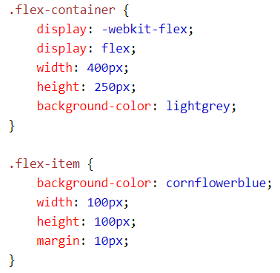
CSS3 Flexbox - Code
Why do we need this?
CSS:

Slide 8
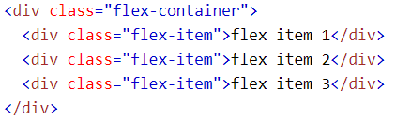
CSS3 Flexbox - Code
HTML:

Slide 9
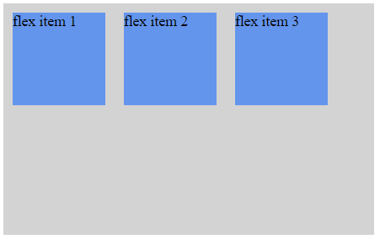
CSS3 Flexbox - Code
Result:

Slide 10
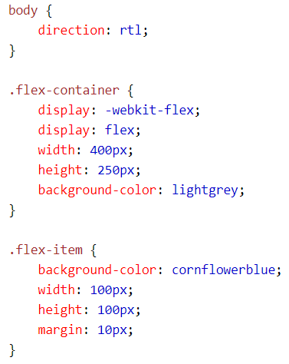
CSS3 Flexbox - Code
It is also possible to change the direction of the flex line
If we set the direction property to rtl (right-to-left), the text is drawn right to left, and also the flex line changes direction, which will change the page layout

Slide 11
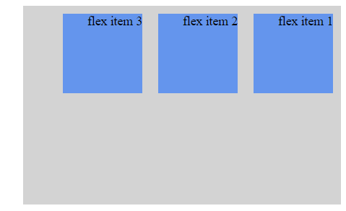
CSS3 Flexbox - Code
Result:

Slide 12
CSS3 Flexbox - Flex Direction
The flex-direction property specifies the direction of the flexible items inside the flex container. The default value of flex-direction is row (left-to-right, top-to-bottom)
The other values are as follows:
row-reverse - If the writing-mode (direction) is left to right, the flex items will be laid out right to left
column - If the writing system is horizontal, the flex items will be laid out vertically
column-reverse - Same as column, but reversed

Slide 13
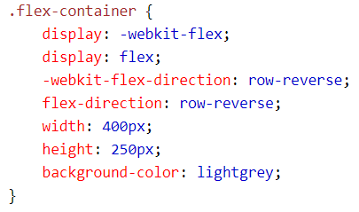

CSS3 Flexbox - Flex Direction
Example:
(Row-reverse)

Slide 14
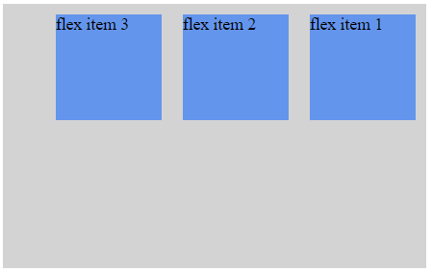
CSS3 Flexbox - Flex Direction
Example:

Slide 15
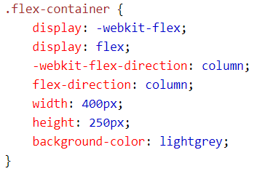
CSS3 Flexbox - Flex Direction
Example:
(Column)

Slide 16
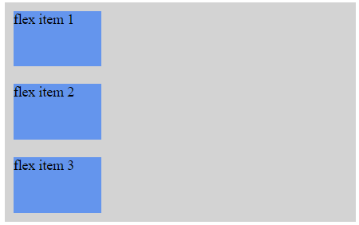
CSS3 Flexbox - Flex Direction
Example:

Slide 17
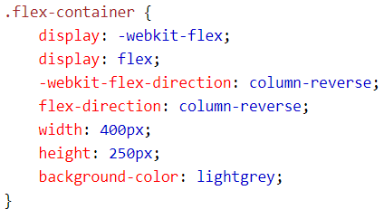
CSS3 Flexbox - Flex Direction
Example:
(Column-
reverse)

Slide 18
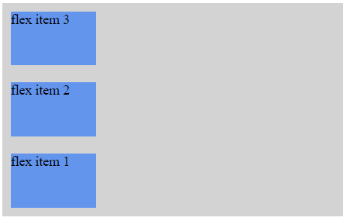
CSS3 Flexbox - Flex Direction
Example:

Slide 19
justify-content Property
The justify-content property horizontally aligns the flexible container's items when the items do not use all available space on the main-axis
The possible values are as follows:
flex-start - Default value. Items are positioned at the beginning of the container
flex-end - Items are positioned at the end of the container
center - Items are positioned at the center of the container
space-between - Items are positioned with space between the lines
space-around - Items are positioned with space before, between, and after the lines

Slide 20
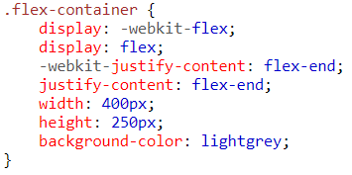
justify-content Property
Example:
(Flex-end)

Slide 21
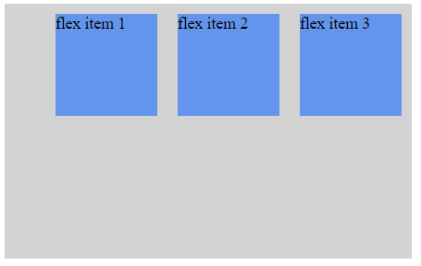
justify-content Property
Example
(Flex-end):

Slide 22
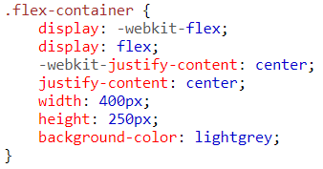
justify-content Property
Example:
(center)

Slide 23
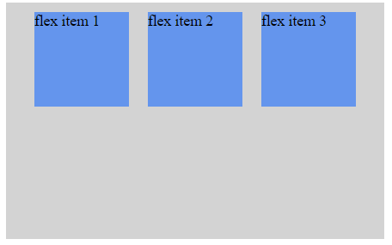
justify-content Property
Example:
(center)

Slide 24
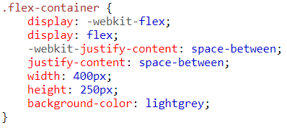
justify-content Property
Example:
(space-
between)

Slide 25
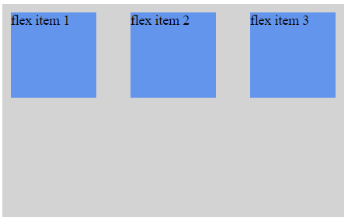
justify-content Property
Example:
(space-
between)

Slide 26
align-items Property
The align-items property vertically aligns the flexible container's items when the items do not use all available space on the cross-axis
The possible values are as follows:
stretch - Default value. Items are stretched to fit the container
flex-start - Items are positioned at the top of the container
flex-end - Items are positioned at the bottom of the container
center - Items are positioned at the center of the container (vertically)
baseline - Items are positioned at the baseline of the container

Slide 27
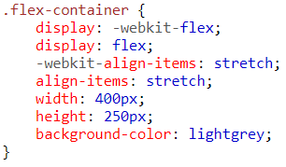
align-items Property
Example:
(Stretch)

Slide 28
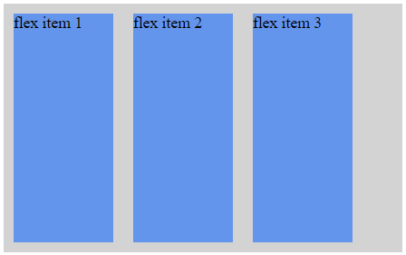
align-items Property
Example:
(Stretch)

Slide 29
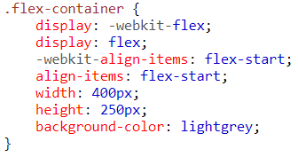
align-items Property
Example:
(Flex-start)

Slide 30
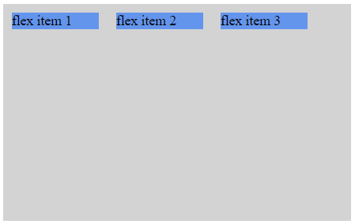
align-items Property
Example:
(Flex-start)

Slide 31
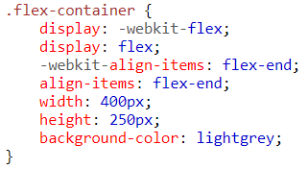
align-items Property
Example:
(Flex-end)

Slide 32
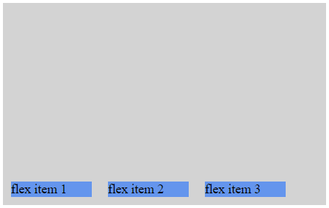
align-items Property
Example:
(Flex-end)

Slide 33
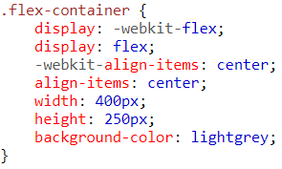
align-items Property
Example:
(Center)

Slide 34
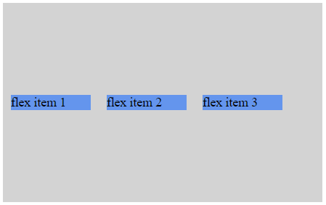
align-items Property
Example:
(Center)

Slide 35
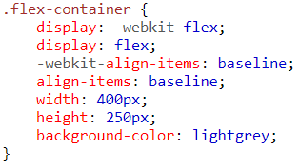
align-items Property
Example:
(Baseline)

Slide 36
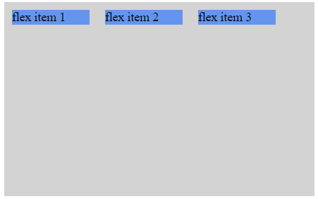
align-items Property
Example:
(Baseline)

Slide 37
flex-wrap Property
The flex-wrap property specifies whether the flex items should wrap or not, if there is not enough room for them on one flex line
The possible values are as follows:
nowrap - Default value. The flexible items will not wrap
wrap - The flexible items will wrap if necessary
wrap-reverse - The flexible items will wrap, if necessary, in reverse order

Slide 38
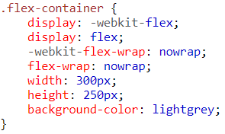
flex-wrap Property
Example:
(Nowrap)

Slide 39
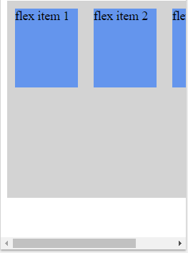
flex-wrap Property
Example:
(Nowrap)

Slide 40
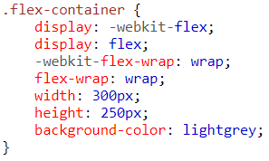
flex-wrap Property
Example:
(Wrap)

Slide 41
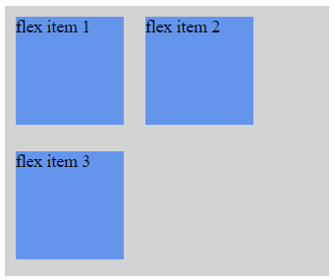
flex-wrap Property
Example:
(wrap)

Slide 42
align-content Property
The align-content property modifies the behavior of the flex-wrap property. It is similar to align-items, but instead of aligning flex items, it aligns flex lines
The possible values are as follows:
stretch - Default value. Lines stretch to take up the remaining space
flex-start - Lines are packed toward the start of the flex container
flex-end - Lines are packed toward the end of the flex container

Slide 43
align-content Property
The align-content property modifies the behavior of the flex-wrap property. It is similar to align-items, but instead of aligning flex items, it aligns flex lines
The possible values are as follows:
center - Lines are packed toward the center of the flex container
space-between - Lines are evenly distributed in the flex container
space-around - Lines are evenly distributed in the flex container, with half-size spaces on either end

Slide 44
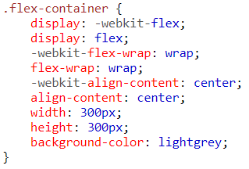
align-content Property
Example:
(Center)

Slide 45
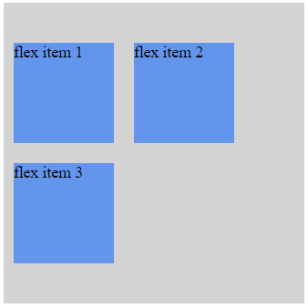
align-content Property
Example:
(Center)

Slide 46
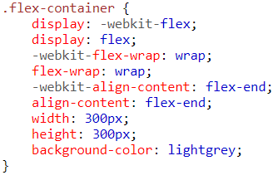
align-content Property
Example:
(Flex-end)

Slide 47
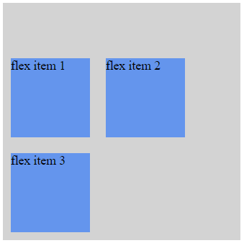
align-content Property
Example:
(Flex-end)

Slide 48
Flex Item Properties - Ordering
The order property specifies the order of a flexible item relative to the rest of the flexible items inside the same container

Slide 49
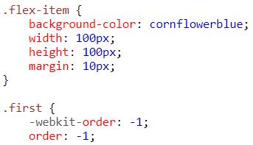
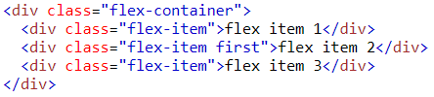
Flex Item Properties - Ordering
Example:
(Ordering)

Slide 50
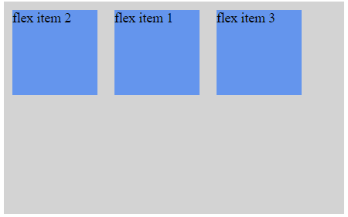
Item Properties - Ordering
Example:
(Ordering)

Slide 51
Flex Item Properties - Margin
Setting margin: auto; will absorb extra space
It can be used to push flex items into different positions

Slide 52
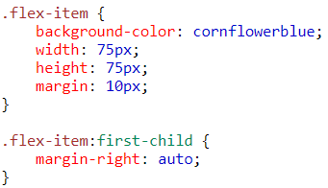
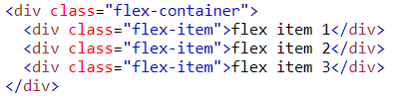
Flex Item Properties - Margin
Example:
(Margin)

Slide 53
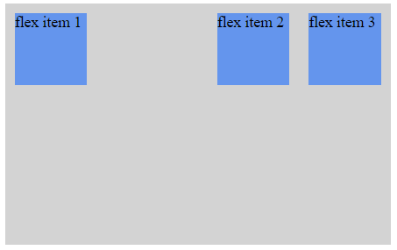
Flex Item Properties - Margin
Example:
(Margin)

Slide 54
Flex Item Properties - Perfect Centering
Setting margin: auto; will make the item perfectly centered in both axis

Slide 55
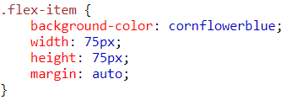

Flex Item Properties - Margin
Example:
(Margin)

Slide 56
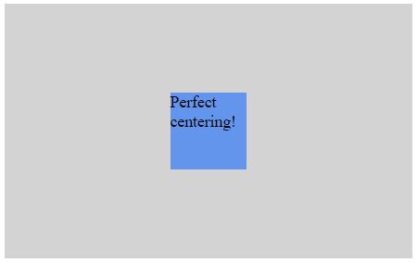
Flex Item Properties - Margin
Example:
(Margin)

Slide 57
Flex Item Properties - Align Self
The align-self property of flex items overrides the flex container's align-items property for that item
It has the same possible values as the align-items property

Slide 58
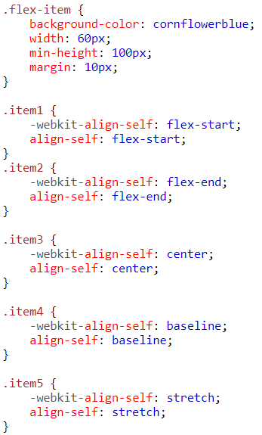
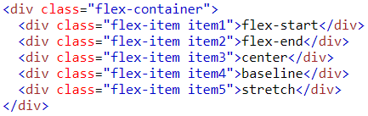
Flex Item Properties - Align Self
Example:
(Align self)

Slide 59
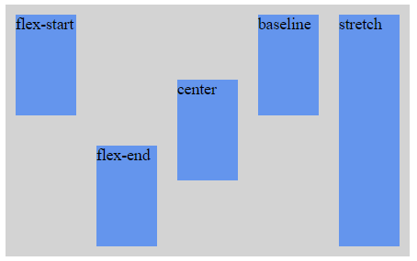
Flex Item Properties - Align Self
Example:
(Align self)

Slide 60
Flex Item Properties - Flex
The flex property specifies the length of the flex item, relative to the rest of the flex items inside the same container

Slide 61
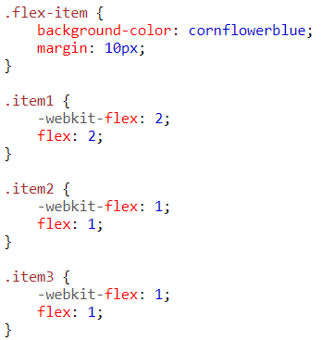

Flex Item Properties - Flex
Example:
(Flex)

Slide 62
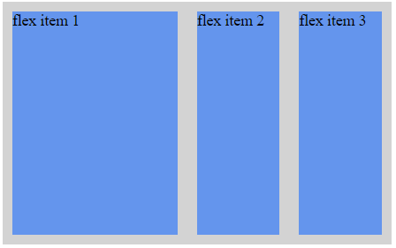
Flex Item Properties - Flex
Example:
(Flex)

Slide 63
CSS3 Flexbox Properties
Property | Description
display | Specifies the type of box used for an HTML element
flex-direction | Specifies the direction of the flexible items inside a flex container
justify-content | Horizontally aligns the flex items when the items do not use all available space on the main-axis
align-items | Vertically aligns the flex items when the items do not use all available space on the cross-axis
flex-wrap | Specifies whether the flex items should wrap or not, if there is not enough room for them on one flex line
align-content | Modifies the behavior of the flex-wrap property. It is similar to align-items, but instead of aligning flex items, it aligns flex lines
flex-flow | A shorthand property for flex-direction and flex-wrap
order | Specifies the order of a flexible item relative to the rest of the flex items inside the same container
align-self | Used on flex items. Overrides the container's align-items property
flex | Specifies the length of a flex item, relative to the rest of the flex items inside the same container

Slide 64
Sources
https://www.w3schools.com/css/css3_flexbox.asp

Slide 65


Copyrights
Presentation prepared by and copyright of John Ramsey, East Tennessee State University, Department of Computing . (ramseyjw@etsu.edu)
Microsoft, Windows, Excel, Outlook, and PowerPoint are registered trademarks of Microsoft Corporation.
IBM, DB2, DB2 Universal Database, System i, System i5, System p, System p5, System x, System z, System z10, System z9, z10, z9, iSeries, pSeries, xSeries, zSeries, eServer, z/VM, z/OS, i5/OS, S/390, OS/390, OS/400, AS/400, S/390 Parallel Enterprise Server, PowerVM, Power Architecture, POWER6+, POWER6, POWER5+, POWER5, POWER, OpenPower, PowerPC, BatchPipes, BladeCenter, System Storage, GPFS, HACMP, RETAIN, DB2 Connect, RACF, Redbooks, OS/2, Parallel Sysplex, MVS/ESA, AIX, Intelligent Miner, WebSphere, Netfinity, Tivoli and Informix are trademarks or registered trademarks of IBM Corporation.
Linux is the registered trademark of Linus Torvalds in the U.S. and other countries.
Oracle is a registered trademark of Oracle Corporation.
HTML, XML, XHTML and W3C are trademarks or registered trademarks of W3C®, World Wide Web Consortium, Massachusetts Institute of Technology.
Java is a registered trademark of Sun Microsystems, Inc.
JavaScript is a registered trademark of Sun Microsystems, Inc., used under license for technology invented and implemented by Netscape.
SAP, R/3, SAP NetWeaver, Duet, PartnerEdge, ByDesign, SAP Business ByDesign, and other SAP products and services mentioned herein as well as their respective logos are trademarks or registered trademarks of SAP AG in Germany and other countries.
Business Objects and the Business Objects logo, BusinessObjects, Crystal Reports, Crystal Decisions, Web Intelligence, Xcelsius, and other Business Objects products and services mentioned herein as well as their respective logos are trademarks or registered trademarks of Business Objects S.A. in the United States and in other countries. Business Objects is an SAP company.
ERPsim is a registered copyright of ERPsim Labs, HEC Montreal.
Other products mentioned in this presentation are trademarks of their respective owners.

