Slide 1
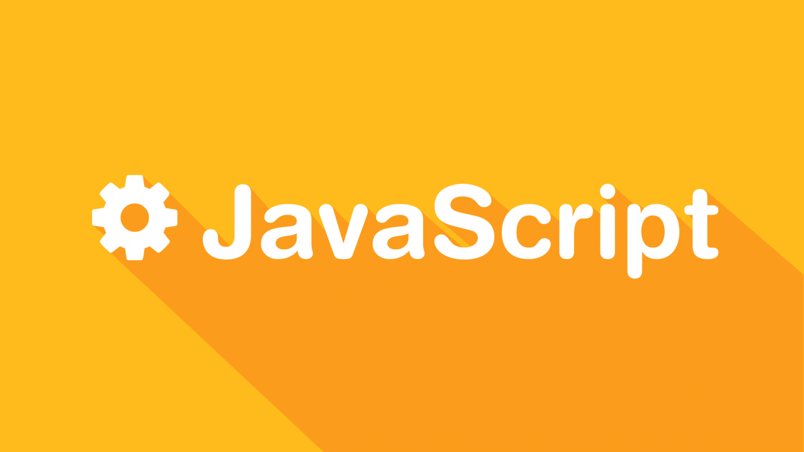

Slide 2
CSCI 1720
JavaScript – Part 1

Slide 3
JavaScript
A Little History

Slide 4
History
JavaScript, often abbreviated as JS, is a high-level, dynamic, weakly typed, object-based, and interpreted programming language
Alongside HTML and CSS, JavaScript is one of the three core technologies of World Wide Web content production
It is used to make webpages interactive and provide online programs, including video games

Slide 5
History
Although there are strong outward similarities between JavaScript and Java, including language name, syntax, and respective standard libraries, the two languages are distinct and differ greatly in design
Although it was developed under the name Mocha, the language was officially called LiveScript when it first shipped in beta releases of Netscape Navigator 2.0 in September 1995

Slide 6
History
It was renamed JavaScript when it was deployed in the Netscape Navigator 2.0 beta 3 in December
The final choice of name caused confusion, giving the impression that the language was a spin-off of the Java programming language
The choice has been characterized as a marketing ploy by Netscape to give JavaScript the cachet of what was then the hot new Web programming language

Slide 7
History
1994: Mosaic Netscape 0.9 released
By 1995, Netscape commanded ¾ of the browser market / became the main browser of the 1990s
Subsequently renamed Netscape Navigator (Mosaic became Netscape Communications)

Slide 8
History
Soon realized that the Web should be more dynamic
1995: NSC recruited Brendan Eich / wrote first version prototype in 10 days (May)
Microsoft got into the game with Jscript and included support for CSS and various extensions to HTML

Slide 9

History
The competition between Netscape and Microsoft led to non-standard implementations
November 1996, Netscape submitted JavaScript to Ecma* International to carve out a standard specification, which other browser vendors could then implement based on the work done at Netscape
* European Computer Manufacturers Association

Slide 10
History
Ecma International is an industry association founded in 1961 and dedicated to the standardization of Information and Communication Technology (ICT) and Consumer Electronics (CE). History
The aims of Ecma are:
To develop, in co-operation with the appropriate National, European and International organizations Standards and Technical Reports in order to facilitate and standardize the use of Information Communication Technology (ICT) and Consumer Electronics (CE)
To encourage the correct use of Standards by influencing the environment in which they are applied
To publish these Standards and Technical Reports in electronic and printed form; the publications can be freely copied by all interested parties without restrictions

Slide 11
History
The standards process continued in cycles, with the release of ECMAScript 2 in June 1998
The release of ECMAScript 3 followed in December 1999, which is the baseline for modern day JavaScript
At first, Microsoft seemed to participate and even implemented some of the proposals in their JScript .NET language
With all the haggling back and forth, the Open Source community became involved

Slide 12
History
2005: Open source libraries released supporting JavaScript (e.g., Prototype, jQuery, Dojo Toolkit, and others)
2008 Oslo Meeting: agreement in early 2009 to standardize
These are the high points…as you can imagine, a lot happened over 14 years, and beyond, to lead us to the JavaScript in use today

Slide 13
First Things First
The Document Object Model (DOM)

Slide 14
First Things First: Understanding the DOM
When a web page is loaded, the browser creates a Document Object Model (DOM) of the page
The HTML DOM model is constructed as a tree of Objects

Slide 15
First Things First: Understanding the DOM
With the object model, JavaScript gets all the power it needs to create dynamic HTML:
JavaScript can change all the HTML elements in the page
JavaScript can change all the HTML attributes in the page
JavaScript can change all the CSS styles in the page
JavaScript can remove existing HTML elements and attributes

Slide 16
First Things First: Understanding the DOM
With the object model, JavaScript gets all the power it needs to create dynamic HTML:
JavaScript can add new HTML elements and attributes
JavaScript can react to all existing HTML events in the page
JavaScript can create new HTML events in the page

Slide 17
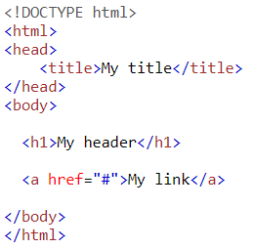
First Things First: Understanding the DOM
Document
Root Element (<html>)
Element (<head>)
Element (<body>)
Element (<title>)
Attribute (“href”)
Element (<a>)
Element (<h1>)
Text (“My title”)
Text (“My Link”)
Text (“My Header”)

Slide 18
First Things First: Understanding the DOM
Document
Root Element (<html>)
Element (<head>)
Element (<body>)
Element (<title>)
Attribute (“href”)
Element (<a>)
Element (<h1>)
Text (“My title”)
Text (“My Link”)
Text (“MyHeader”)

Slide 19
First Things First: Understanding the DOM
Document
Root Element (<html>)
Element (<head>)
Element (<body>)
Element (<title>)
Attribute (“href”)
Element (<a>)
Element (<h1>)
Text (“My title”)
Text (“My Link”)
Text (“MyHeader”)
This is how the browser ‘sees’ the web page
By assigning ids to elements, we can use JavaScript to access (and
modify) them

Slide 20
First Things First: Understanding the DOM
Document
Root Element (<html>)
Element (<head>)
Element (<body>)
Element (<title>)
Attribute (“href”)
Element (<a>)
Element (<h1>)
Text (“My title”)
Text (“My Link”)
Text (“MyHeader”)
It should also be evident that the DOM can grow to be extremely
complex as the complexity of a given page increases

Slide 21
Classes and IDs

Slide 22
Classes and IDs
We’ve seen throughout our exploration of CSS frameworks how important classes are to styling web pages
IDs are the primary way in which JavaScript accesses and dynamically modifies web pages and their elements
There is some bleed-over, however:
CSS can style IDs
JavaScript can access elements by class

Slide 23
Simple Example
One of the many JavaScript methods is getElementById()
This method is part of the document class and is thus invoked using dot (“.”) notation (One of the language’s similarities with Java), i.e.,
document.getElementById(“id”)
class
method
id

Slide 24
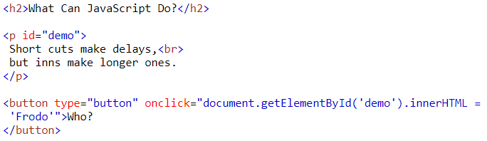
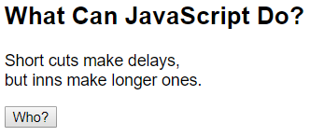
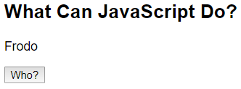
Simple Example

Slide 25
JavaScript - Including With HTML

Slide 26
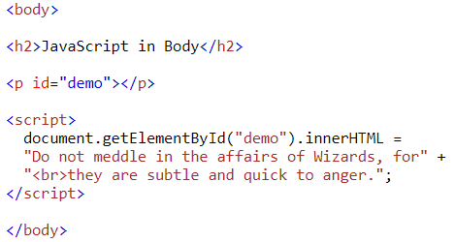
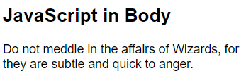
JS - Including With HTML
The <script> Element
In HTML, JavaScript code must be inserted between <script> and </script> tags

Slide 27
JS - Including With HTML
JavaScript Functions and Events
A JavaScript function is a block of JavaScript code, that can be executed when "called" for
For example, a function can be called when an event occurs, like when the user clicks a button
We will talk more about functions and events later

Slide 28
JS - Including With HTML
JavaScript in <head>
In this example, a JavaScript function is placed in the <head> section of an HTML page
The function is invoked (called) when a button is clicked

Slide 29
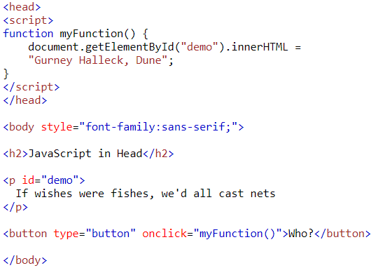
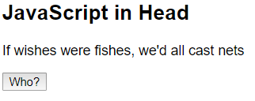
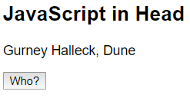
JS - Including With HTML - <head>

Slide 30
JS - Including With HTML
JavaScript in <body>
In this example, a JavaScript function is placed in the <body> section of an HTML page
The function is invoked (called) when a button is clicked

Slide 31
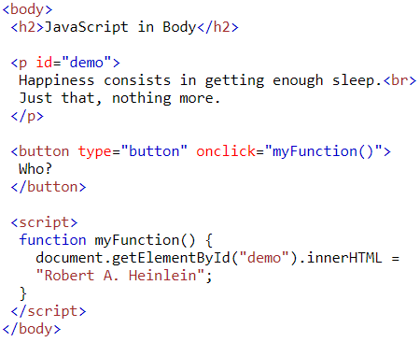
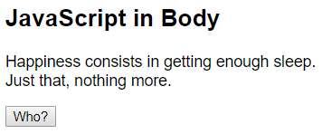
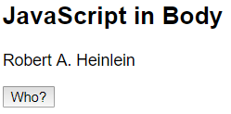
JS - Including With HTML - <body>

Slide 32
JS - Including With HTML
External JavaScript
Scripts can also be placed in external files
External scripts are practical when the same code is used in many different web pages
JavaScript files have the file extension .js
To use an external script, put the name of the script file in the src (source) attribute of a <script> tag

Slide 33
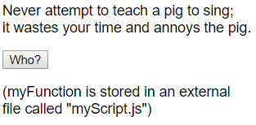
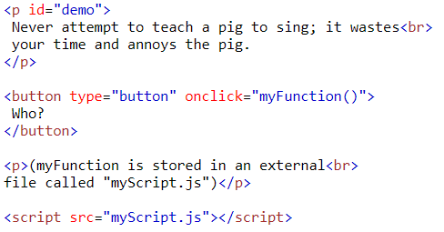

JS - Including With HTML - External Example

Slide 34
JS - Including With HTML
External scripts can be referenced with a full URL or with a path relative to the current web page
This example uses a relative URL to link to a script

Slide 35
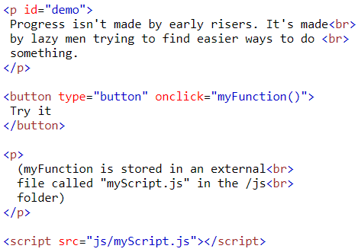
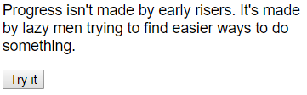

JS - Including With HTML - External

Slide 36

JS - Including With HTML
External JavaScript Advantages
Separates HTML and code
Makes HTML and JavaScript easier to read and maintain
Cached JavaScript files can speed up page loads
To add several script files to one page - use several script tags

Slide 37
JavaScript Output

Slide 38
JS Output
JavaScript can "display" data in different ways:
Writing into an HTML element, using innerHTML
Writing into the HTML output using document.write()
Writing into an alert box, using window.alert()
Writing into the browser console, using console.log()

Slide 39
JS Output - innerHTML
To access an HTML element, JavaScript can use the document.getElementById(“id”) method
The id attribute identifies the HTML element
The innerHTML property defines the HTML content
Changing the innerHTML property of an HTML element is a common way to display data in HTML

Slide 40
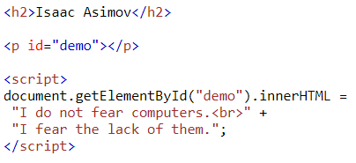
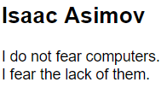
JS Output - innerHTML Example

Slide 41
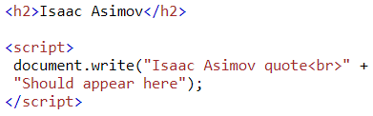
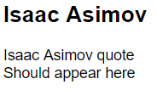
JS Output - document.write()
For testing purposes, it is convenient to use document.write()

Slide 42
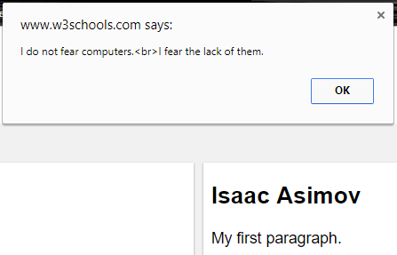
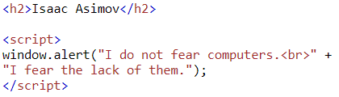
JS Output - window.alert()
You can use an alert box to display data
Note: The alert box appears as a drop-down box at the top of the browser window. The button must be clicked in order to return to the page (Pressing ‘Enter’ also works)

Slide 43
JavaScript Syntax

Slide 44
JS Syntax
JavaScript syntax is the set of rules, how JavaScript programs are constructed
A computer program is a list of instructions to be executed by the computer
In a programming language, these program instructions are called statements
JavaScript is a programming language
JavaScript statements are separated by semicolons

Slide 45
JS Syntax - Statements
JavaScript statements are composed of Values, Operators, Expressions, Keywords, and Comments
The JavaScript syntax defines two types of values: Fixed values and variable values
Fixed values are called literals
Variable values are called variables

Slide 46
JS Syntax - Statements
JavaScript statements are composed of Values, Operators, Expressions, Keywords, and Comments
The JavaScript syntax defines two types of values: Fixed values and variable values
Fixed values are called literals
Numbers are written with or without decimals: 10.50 / 1001
Strings are text, using either single or double quotes:
“Hello JS!” / ‘Hello JS!’

Slide 47
JS Syntax - Statements
In a programming language, variables are used to store data values
JavaScript uses the var keyword to declare variables
An equals sign is used to assign values to variables

Slide 48
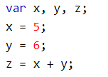
JS Syntax
Variable Declaration
Variable Assignment
In HTML, JavaScript programs are executed by the web browser

Slide 49
JS Syntax - Statements
JavaScript uses arithmetic operators ( + - * / ) to compute values
(Again this is identical to how Java and other programming languages depict operators)
The equals sign (=) is referred to as the assignment operator; it ‘assigns’ a value to a variable

Slide 50
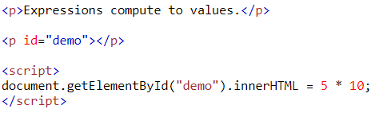

JS Syntax - Statements
An expression is a combination of values, variables, and operators, which computes to a value
The computation is called an evaluation
For example, 5 * 10 evaluates to 50

Slide 51
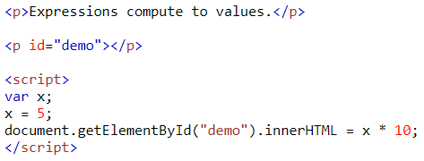

JS Syntax - Statements
An expression is a combination of values, variables, and operators, which computes to a value
The computation can also include variables

Slide 52
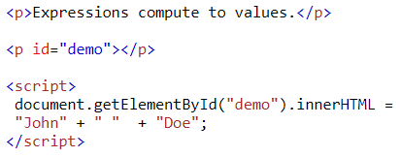

JS Syntax - Statements
An expression is a combination of values, variables, and operators, which computes to a value
The values can be of various types, such as numbers and strings
For example, "John" + " " + "Doe", evaluates to "John Doe"

Slide 53

JS Syntax - Keywords
JavaScript keywords are used to identify actions to be performed
The var keyword tells the browser to create variables
You can’t use a keyword as
a variable name

Slide 54
JS Syntax – Keywords
abstract | arguments | await* | boolean
break | byte | case | catch
char | class* | const | continue
debugger | default | delete | do
double | else | enum* | eval
export* | extends* | false | final
finally | float | for | function
None of these words can be
used as a variable name
Some may be legitimately
part of a name, however:
goto | if | implements | import*
in | instanceof | int | interface
let* | long | native | new
null | package | private | protected
public | return | short | static
super* | switch | synchronized | this
throw | throws | transient | true
try | typeof | var | void
volatile | while | with | yield
var in; NO!
var inTable; OK

Slide 55

JS Syntax - Comments
Not all JavaScript statements are "executed"
Code after double slashes // or between /* and */ is treated as a comment
Comments are ignored, and will not be executed
Somebody,
please
, tell me why this is important

Slide 56
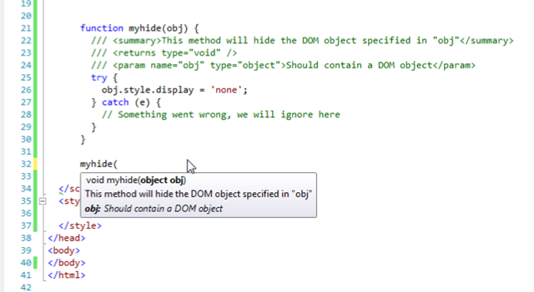
JS Syntax - Comments
Quick!
What does this do?

Slide 57
JS Syntax - Identifiers
Identifiers are names
In JavaScript, identifiers are used to name variables (and keywords, and functions, and labels)
The rules for legal names are much the same in most programming languages
In JavaScript, the first character must be a letter, or an underscore (_), or a dollar sign ($)
Subsequent characters may be letters, digits, underscores, or dollar signs
Numbers are not allowed as the first character (Why?)

Slide 58

JS Syntax - Case Sensitivity
All JavaScript identifiers are case sensitive
The variables lastName and lastname, are two different variables

Slide 59
JS Syntax - Camel Case
Historically, programmers have used different ways of joining multiple words into one variable name
Hyphens:
first-name, last-name, master-card, inter-city
*Hyphens are not allowed in JavaScript. They are reserved as the subtraction operator
Underscore:
first_name, last_name, master_card, inter_city

Slide 60

JS Syntax - Camel Case
Upper Camel Case (Pascal Case):
FirstName, LastName, MasterCard, InterCity

Slide 61

JS Syntax - Camel Case
Lower Camel Case:
JavaScript programmers tend to use camel case that starts with a lowercase letter
firstName, userLastName, masterCard, homeCity

Slide 62
JavaScript Statements

Slide 63
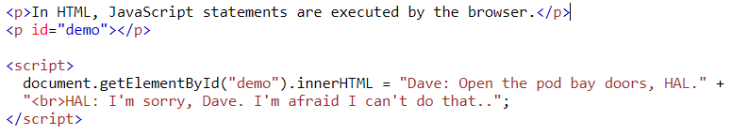

JS Statements
In HTML, JavaScript statements are instructions to be executed by the web browser
Statement
Execution

Slide 64
JS Programs
Most JavaScript programs contain many JavaScript statements
The statements are executed, one by one, in the same order as they are written
(Note: function calls)

Slide 65
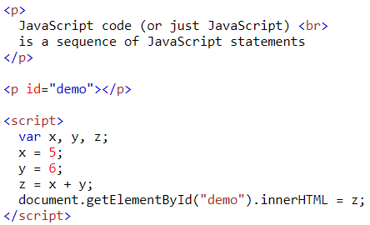

JS Programs
In this example x, y, and z are given values, and finally z is displayed

Slide 66
JavaScript Variables

Slide 67


JS Variables
JavaScript variables are containers for storing data values
In this example, x, y, and z, are variables
Much like Algebra

Slide 68

JS Variables
In programming, just like in algebra, we use variables (like price1) to hold values
In programming, just like in algebra, we use variables in expressions (total = price1 + price2)
From the example above, you can calculate the total to be 11

Slide 69
JS Identifiers
All JavaScript variables must be identified with unique names
These unique names are called identifiers
Identifiers can be short names (like x and y) or more descriptive names (age, sum, totalVolume)
The general rules for constructing names for variables (unique identifiers) are:
Names can contain letters, digits, underscores, and dollar signs.
Names can begin with a letter
Names can also begin with $ and _
Names are case sensitive (y and Y are different variables)
Reserved words (like JavaScript keywords) cannot be used as names

Slide 70
JS Assignment Operator
In JavaScript, the equal sign (=) is an "assignment" operator, not an "equal to" operator
This is different from algebra. The following does not make sense in algebra
In JavaScript, however, it makes perfect sense: it assigns the value of x + 5 to x
(It calculates the value of x + 5 and puts the result into x. The value of x is incremented by 5.)

Slide 71
JS Data Types
JavaScript variables can hold numbers like 100 and text values like "John Doe"
In programming, text values are called text strings
JavaScript can handle many types of data, but for now, just think of numbers and strings
Strings are written inside double or single quotes. Numbers are written without quotes
If you put a number in quotes, it will be treated as a text string

Slide 72

JS Data Types
In this example,
The value 3.14 is assigned to a variable named ‘pi’
The value “John Doe” is assigned to a variable named ‘person’
The value “Yes I am!” is assigned to a variable named ‘answer’

Slide 73
JS Data Types
Creating a variable in JavaScript is called declaring a variable
You declare a JavaScript variable with the var keyword
After the declaration, the variable has no value (Technically it has the value of undefined)
To assign a value to the variable, use the equal sign

Slide 74
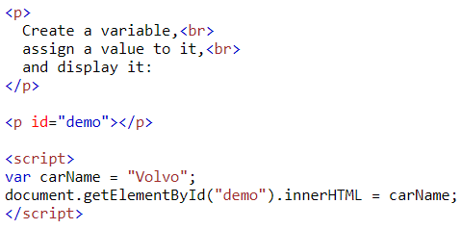
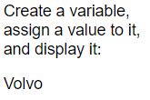
JS Data Types
You can also assign a value to the variable when you declare it

Slide 75
JS Data Types
You can declare many variables in one statement
Start the statement with var and separate the variables by comma

Slide 76
JS Data Types
In computer programs, variables are often declared without a value
The value can be something that has to be calculated, or something that will be provided later, like user input
A variable declared without a value will have the value undefined
If you re-declare a JavaScript variable, it will not lose its value

Slide 77
Questions
?

Slide 78
Sources
https://www.w3schools.com/js/js_htmldom.asp
https://www.w3schools.com/js/default.asp
http://lotrproject.com/quotes/
https://www.brainyquote.com/quotes/quotes/i/isaacasimo100104.html
https://www.goodreads.com/author/quotes/205.Robert_A_Heinlein
https://en.wikiquote.org/wiki/Dune
http://www.imdb.com/title/tt0062622/quotes

Slide 79


Copyrights
Presentation prepared by and copyright of John Ramsey, East Tennessee State University, Department of Computing . (ramseyjw@etsu.edu)
Microsoft, Windows, Excel, Outlook, and PowerPoint are registered trademarks of Microsoft Corporation.
IBM, DB2, DB2 Universal Database, System i, System i5, System p, System p5, System x, System z, System z10, System z9, z10, z9, iSeries, pSeries, xSeries, zSeries, eServer, z/VM, z/OS, i5/OS, S/390, OS/390, OS/400, AS/400, S/390 Parallel Enterprise Server, PowerVM, Power Architecture, POWER6+, POWER6, POWER5+, POWER5, POWER, OpenPower, PowerPC, BatchPipes, BladeCenter, System Storage, GPFS, HACMP, RETAIN, DB2 Connect, RACF, Redbooks, OS/2, Parallel Sysplex, MVS/ESA, AIX, Intelligent Miner, WebSphere, Netfinity, Tivoli and Informix are trademarks or registered trademarks of IBM Corporation.
Linux is the registered trademark of Linus Torvalds in the U.S. and other countries.
Oracle is a registered trademark of Oracle Corporation.
HTML, XML, XHTML and W3C are trademarks or registered trademarks of W3C®, World Wide Web Consortium, Massachusetts Institute of Technology.
Java is a registered trademark of Sun Microsystems, Inc.
JavaScript is a registered trademark of Sun Microsystems, Inc., used under license for technology invented and implemented by Netscape.
SAP, R/3, SAP NetWeaver, Duet, PartnerEdge, ByDesign, SAP Business ByDesign, and other SAP products and services mentioned herein as well as their respective logos are trademarks or registered trademarks of SAP AG in Germany and other countries.
Business Objects and the Business Objects logo, BusinessObjects, Crystal Reports, Crystal Decisions, Web Intelligence, Xcelsius, and other Business Objects products and services mentioned herein as well as their respective logos are trademarks or registered trademarks of Business Objects S.A. in the United States and in other countries. Business Objects is an SAP company.
ERPsim is a registered copyright of ERPsim Labs, HEC Montreal.
Other products mentioned in this presentation are trademarks of their respective owners.

