Slide 1
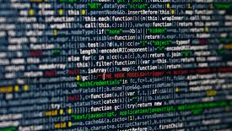
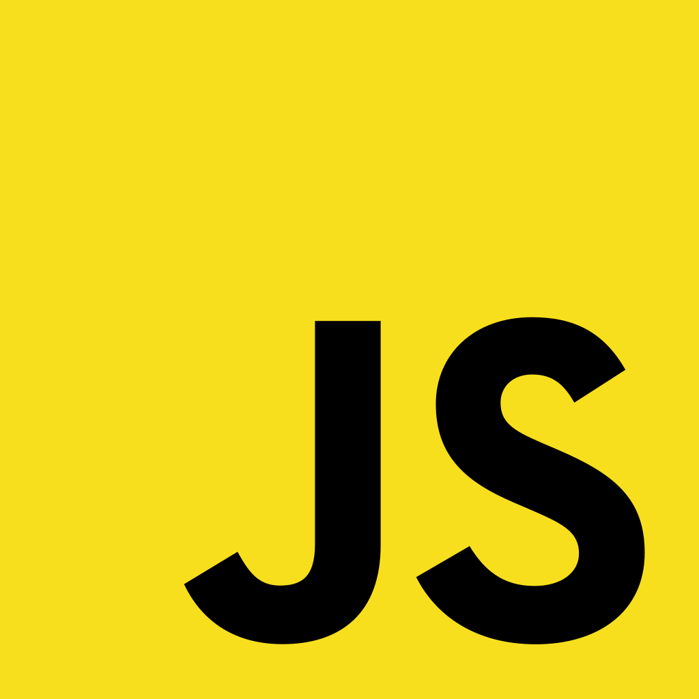

Slide 2
CSCI 1720
JavaScript – Part 2

Slide 3
JavaScript Operators

Slide 4
JS Operators
JavaScript operators are identical to Java’s
+ Addition - Subtraction * Multiplication / Division % Modulus ++ Increment -- Decrement

Slide 5
JS Assignment Operators
JavaScript operators are identical to Java’s Operator Example Same as
= x = y x = y += x += y x = x + y -= x -= y x = x - y *= x *= y x = x * y /= x /= y x = x / y %= x %= y x = x % y

Slide 6
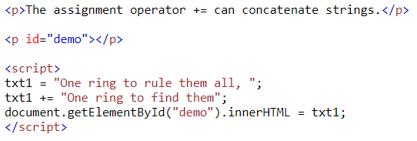

JS String Operators
The += assignment operator can also be used to add (concatenate) strings

Slide 7
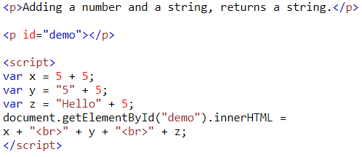
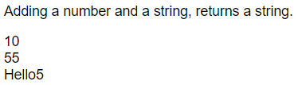
JS Adding Strings and Numbers
Adding two numbers, will return the sum, but adding a number and a string will return a string

Slide 8
JS Comparison Operators
JavaScript operators are identical to Java’s, with a couple of additional ones Operator ___Description___________
== equal to === equal value & equal type != not equal !== not equal value or type > greater than < less than >= greater than or equal to <= less than or equal to

Slide 9
JS Logical Operators
JavaScript operators are identical to Java’s, with a couple of additional ones Operator Description
&& logical and || logical or ! Logical not

Slide 10
JavaScript Data Types

Slide 11


JS Data Types
JavaScript variables can hold many data types: numbers, strings, objects and more (Remember, var is deprecated. Use let instead)
In programming, data types is an important concept
To be able to operate on variables, it is important to know something about the type
Without data types, a computer cannot safely solve this

Slide 12
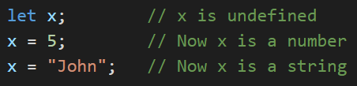
JS Data Types
JavaScript has dynamic types
This means that the same variable can be used to hold different data types

Slide 13


JS Data Types
JavaScript has only one type of numbers
Numbers can be written with, or without decimals
Extra large or extra small numbers can be written with scientific (exponential) notation

Slide 14

JS Data Types
Booleans can only have two values: true or false

Slide 15
JS Data Types
JavaScript arrays are written with square brackets
Array items are separated by commas
The following code declares (creates) an array called cars, containing three items (car names)

Slide 16
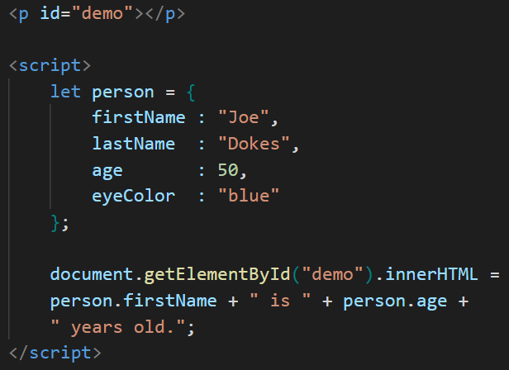

JS Data Types
JavaScript objects are written with braces
Object properties are written as name:value pairs, separated by commas

Slide 17
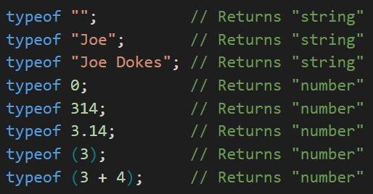
JS Data Types – typeof Operator
You can use the JavaScript typeof operator to find the type of a JavaScript variable
The typeof operator returns the type of a variable or an expression

Slide 18
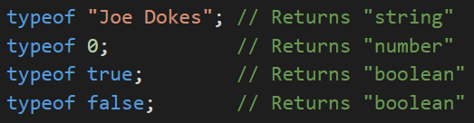
JS Data Types – Primitive Data
A primitive data value is a single simple data value with no additional properties and methods
The typeof operator can return one of these primitive types:
string number Boolean null undefined

Slide 19
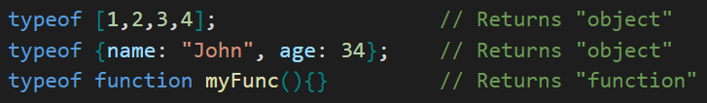
JS Data Types
The typeof operator can return one of two complex types:
function object
The typeof operator returns object for arrays because in JavaScript arrays are objects

Slide 20
JS Data Types
In JavaScript, a variable without a value, has the value undefined
The typeof is also undefined

Slide 21
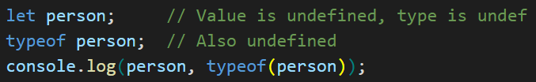

JS Data Types
In JavaScript, a variable without a value, has the value undefined
The typeof is also undefined
An empty value has nothing to do with undefined
An empty string variable has both a value and a type

Slide 22
JS Data Types
In JavaScript null is "nothing“
It is supposed to be something that doesn't exist
Unfortunately, in JavaScript, the data type of null is an object
You can consider it a bug in JavaScript that typeof null is an object. It should be null
You can empty an object by setting it to null
You can also empty an object by setting it to undefined

Slide 23
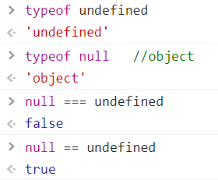
JS Data Types
Difference Between Undefined and Null

Slide 24
JavaScript Functions

Slide 25
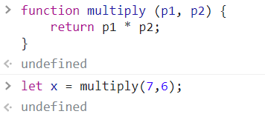
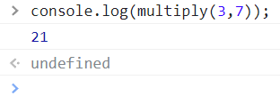
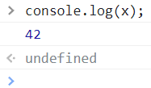
JS Functions
A JavaScript function is a block of code designed to perform a particular task
A JavaScript function is executed when something invokes it (calls it)

Slide 26

JS Function Syntax
A JavaScript function is defined with the function keyword, followed by a name, followed by parentheses ()
Function names can contain letters, digits, underscores, and dollar signs (same rules as variables)
The parentheses may include parameter names separated by commas (parameter1, parameter2, ...)
The code to be executed, by the function, is placed inside brackets: {}

Slide 27
JS Function Syntax
Function parameters are the names listed in the function definition
Function arguments are the real values received by the function when it is invoked
Inside the function, the arguments (the parameters) behave as local variables
A Function is much the same as a Procedure or a Subroutine, in other programming languages

Slide 28
JS Function Invocation
The code inside the function will execute when "something" invokes (calls) the function:
When an event occurs (when a user clicks a button) When it is invoked (called) from JavaScript code Automatically (self invoked)

Slide 29
JS Function Return
JavaScript reaches a return statement, the function will stop executing
If the function was invoked from a statement, JavaScript will "return" to execute the code after the invoking statement
Functions often compute a return value. The return value is returned back to the caller

Slide 30
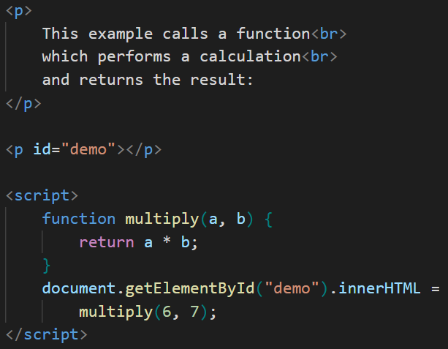
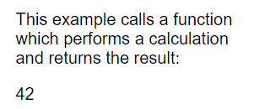
JS Function Example
DEFINE
CALL

Slide 31

JS – Why Functions?
You can reuse code: Define the code once, and use it many times
You can use the same code many times with different arguments, to produce different results
Functions can be used the same way as you use variables, in all types of formulas, assignments, and calculations

Slide 32
JavaScript Scope

Slide 33
JS Scope
Scope is the set of variables you have access to
In JavaScript, objects and functions are also variables
In JavaScript, scope is the set of variables, objects, and functions you have access to
JavaScript has function scope: The scope changes inside functions

Slide 34
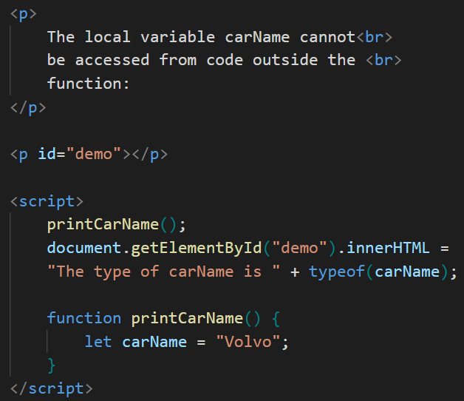
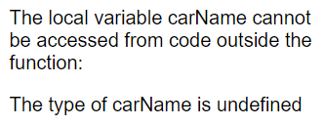
JS Scope
Variables declared within a JavaScript function, are LOCAL to the function
Local variables have local scope: They can only be accessed within the function

Slide 35
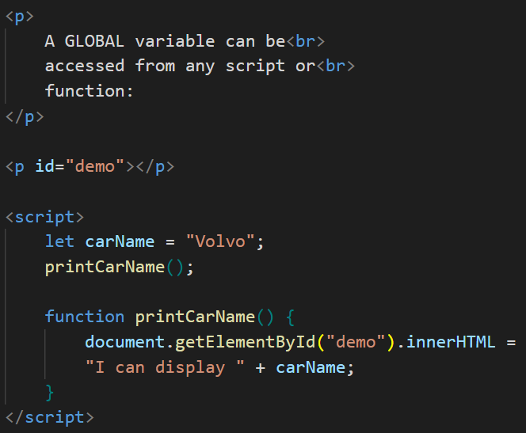
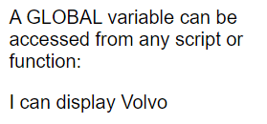
JS Scope
A variable declared outside a function, becomes GLOBAL
A global variable has global scope: All scripts and functions on a web page can access it

Slide 36
JS Scope
Do NOT create global variables unless you intend to
Global variables, in any programming language, are generally a bad idea

Slide 37
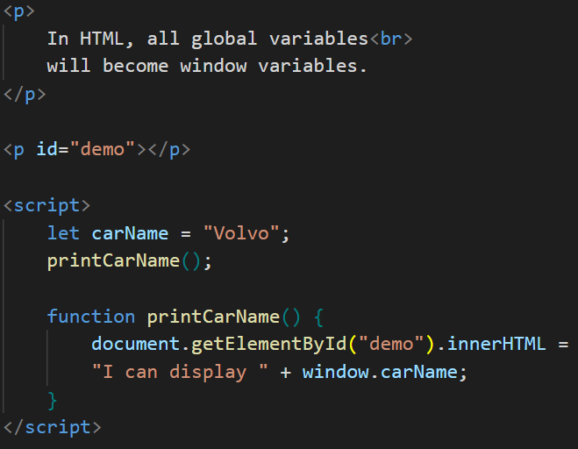

JS Scope
With JavaScript, the global scope is the complete JavaScript environment
In HTML, the global scope is the window object; all global variables belong to it

Slide 38
JS Scope
Your global variables (or functions) can overwrite window variables (or functions)
Any function, including the window object, can overwrite your global variables and functions
The lifetime of a JavaScript variable starts when it is declared
Local variables are deleted when the function is completed
In a web browser, global variables are deleted when you close the browser window (or tab), but remains available to new pages loaded into the same window

Slide 39
JavaScript Conditions

Slide 40
JS Conditions
Very often when you write code, you want to perform different actions for different decisions
You can use conditional statements in your code to do this

Slide 41
JS Conditions
In JavaScript we have the following conditional statements:
Use if to specify a block of code to be executed, if a specified condition is true
Use else to specify a block of code to be executed, if the same condition is false
Use else if to specify a new condition to test, if the first condition is false
Use switch to specify many alternative blocks of code to be executed

Slide 42
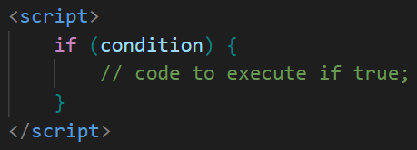
JS Conditions -- if
Use the if statement to specify a block of JavaScript code to be executed if a condition is true
Note that if is in lowercase letters. Uppercase letters (If or IF) will generate a JavaScript error

Slide 43
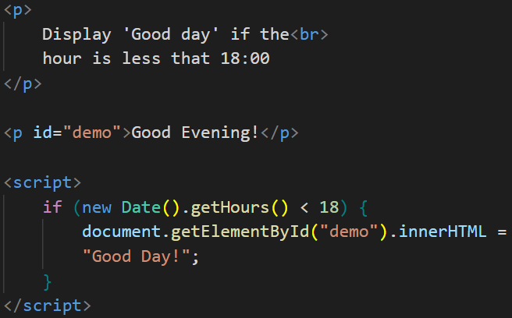
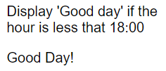
JS Conditions -- if

Slide 44
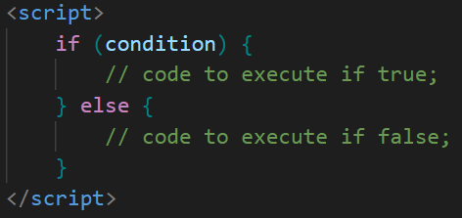
JS Conditions – if - else
Use the else statement to specify a block of code to be executed if the condition is false

Slide 45
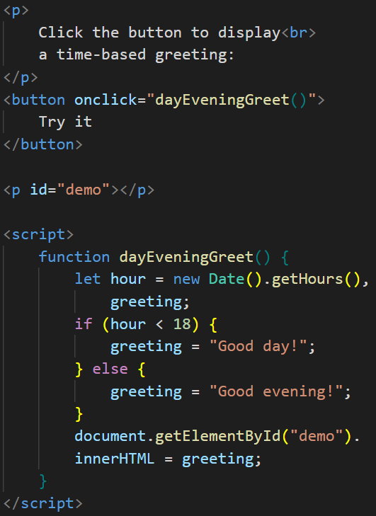
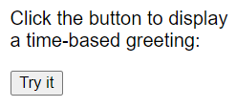
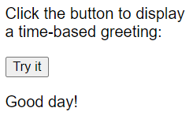
JS Conditions – if - else

Slide 46
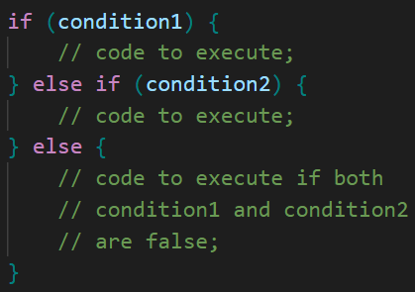
JS Conditions – else if
Use the else if statement to specify a new condition if the first condition is false

Slide 47
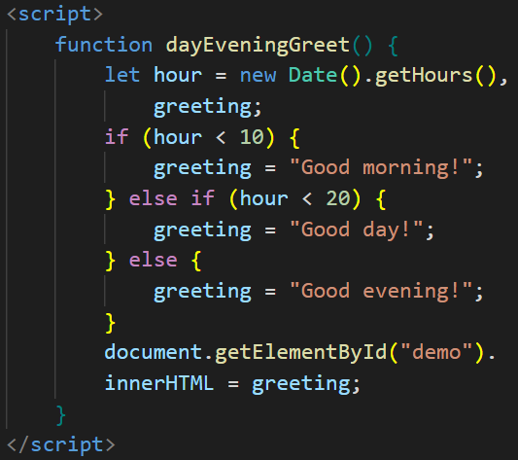
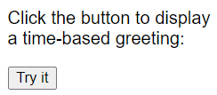
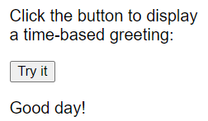
JS Conditions – else if

Slide 48
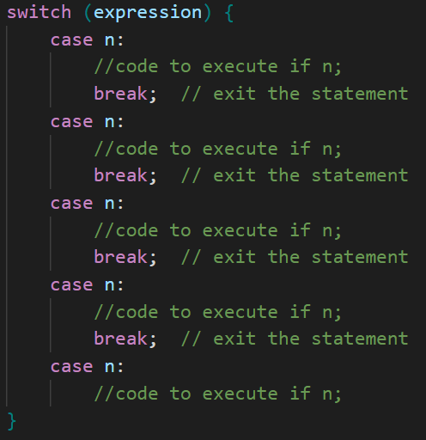
JS Conditions – switch
Use the switch statement to select one of many blocks of code to be executed
Notice that all the
cases – except the
last one – have
break statements.
Why?

Slide 49
JS Conditions – the break Keyword
When JavaScript reaches a break keyword, it breaks out of the switch block
This will stop the execution of more code and case testing inside the block
When a match is found, and the job is done, it's time for a break. There is no need for more testing
A break can save a lot of execution time because it "ignores" the execution of all the rest of the code in the switch block
It is not necessary to break the last case in a switch block. The block breaks (ends) there anyway

Slide 50
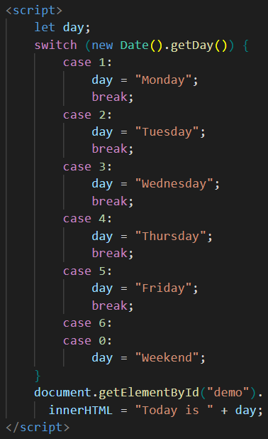

JS Conditions – switch
What’s going on here?

Slide 51
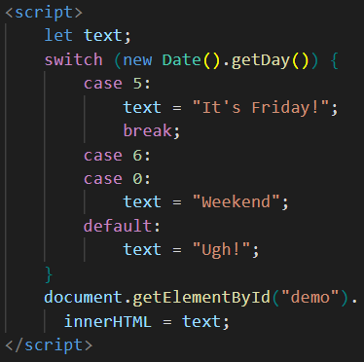

JS Conditions – switch default Case
The default case does not have to be the last case in a switch block

Slide 52
JavaScript Loops

Slide 53
JS Loops
Loops can execute a block of code a number of times
Loops are handy, if you want to run the same code over and over again, each time with a different value
JavaScript supports different kinds of loops:
for - loops through a block of code a number of times
for/in - loops through the properties of an object
while - loops through a block of code while a specified condition is true
do/while - also loops through a block of code while a specified condition is true

Slide 54
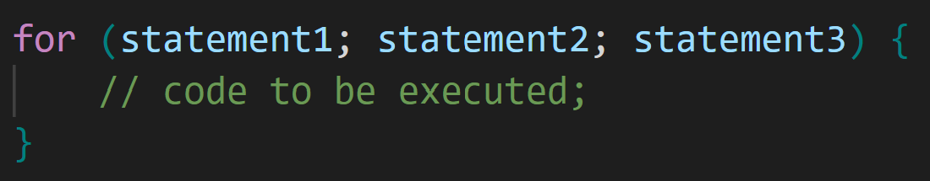
JS Loops – for
The for loop is often the tool you will use when you want to create a loop
The for loop has the following syntax:
Statement 1 is executed before the loop (the code block) starts
Statement 2 defines the condition for running the loop (the code block)
Statement 3 is executed each time after the loop (the code block) has been executed

Slide 55
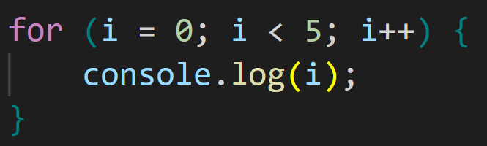
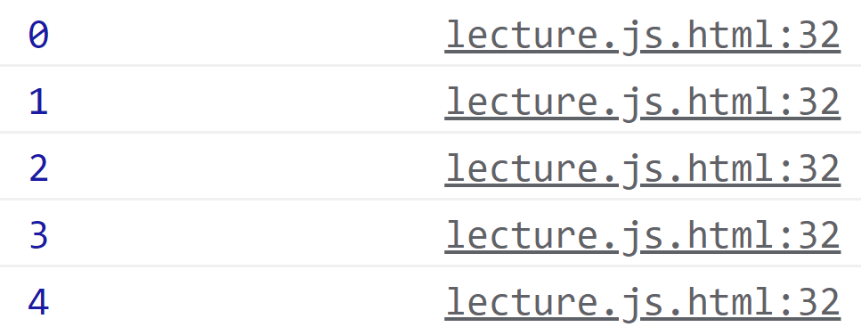
JS Loops – for

Slide 56
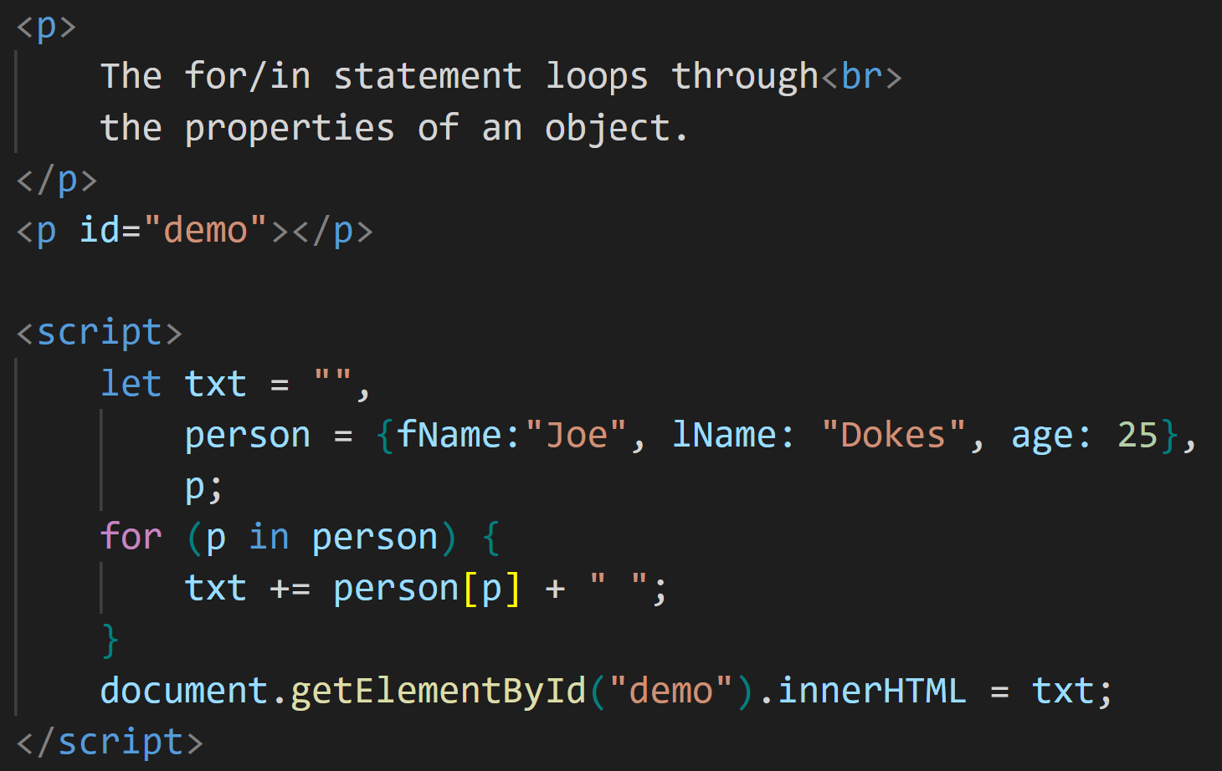
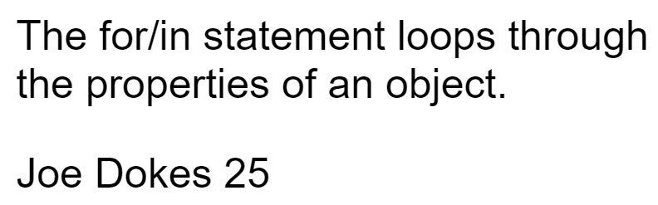
JS Loops – for/in
The JavaScript for/in statement loops through the properties of an object

Slide 57
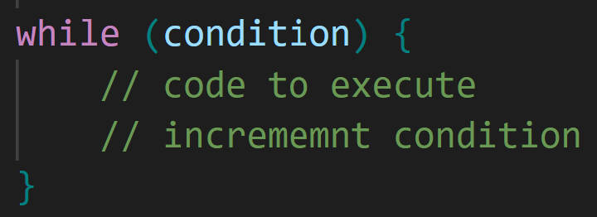
JS Loops – while
Loops can execute a block of code as long as a specified condition is true
The while loop loops through a block of code as long as a specified condition is true
If you forget to increase the variable used in the condition, the loop will never end. This will crash your browser

Slide 58
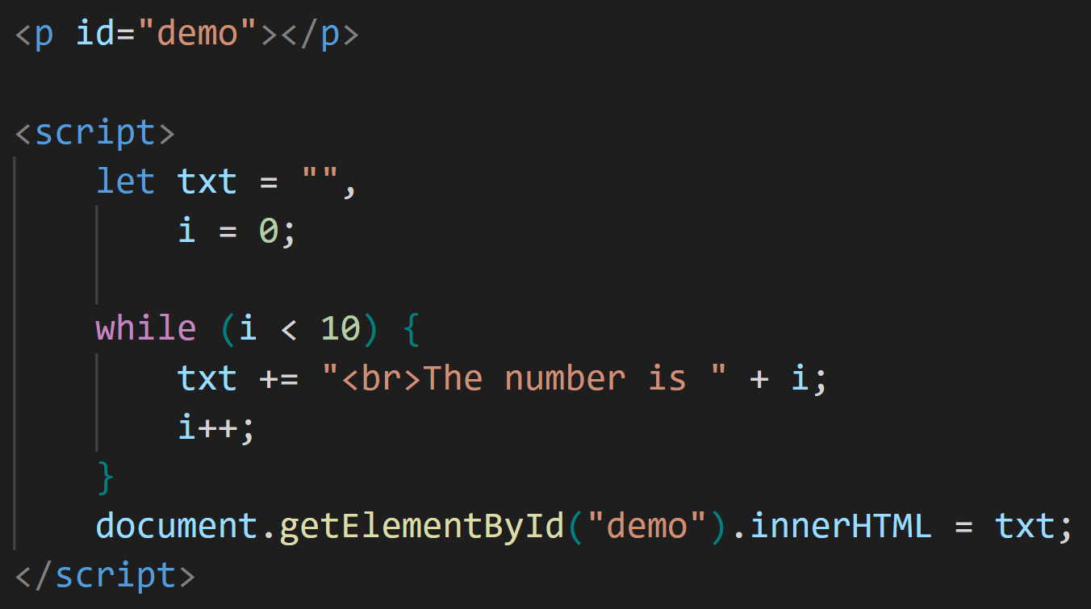
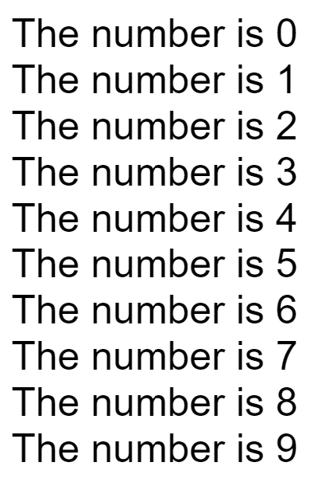
JS Loops – while

Slide 59
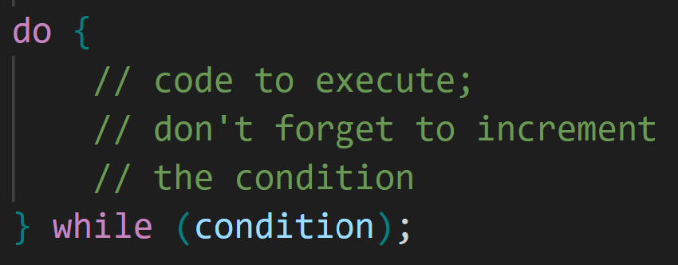
JS Loops – do/while
The do/while loop is a variant of the while loop
This loop will execute the code block once, before checking if the condition is true, then it will repeat the loop as long as the condition is true
If you forget to increase the variable used in the condition, the loop will never end. This will crash your browser

Slide 60
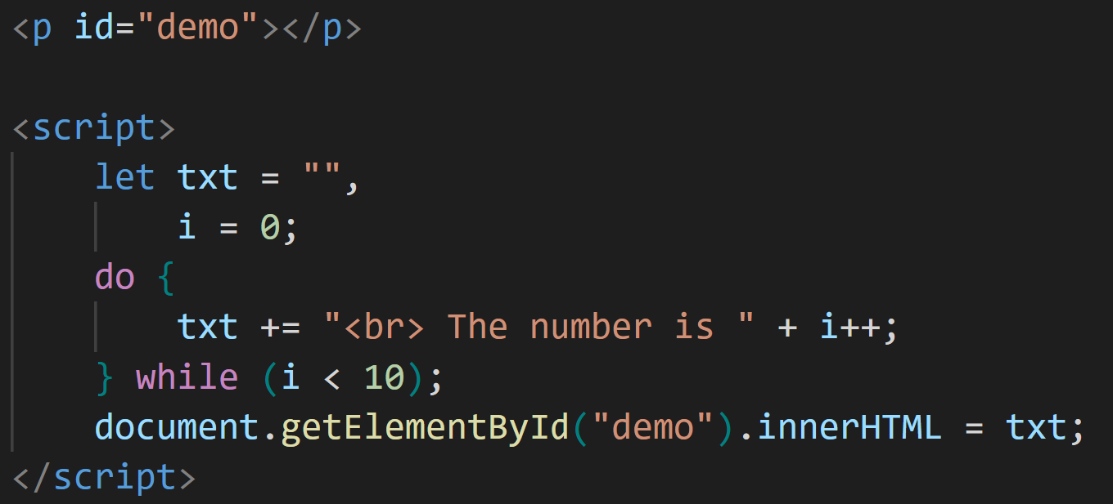
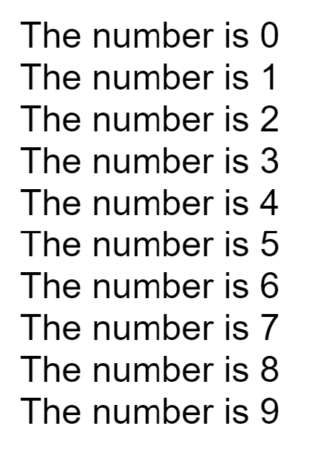
JS Loops – while

Slide 61
JavaScript Events

Slide 62
JS Events
HTML events are things that happen to HTML elements
When JavaScript is used in HTML pages, JavaScript can react on these events
An HTML event can be something the browser does, or something a user does
Here are some examples of HTML events:
An HTML web page has finished loading An HTML input field was changed An HTML button was clicked

Slide 63
JS Events
Often, when events happen, you want to do something
JavaScript lets you execute code when events are detected
HTML allows event handler attributes, with JavaScript code, to be added to HTML elements
With single quotes:
<element event='some JavaScript'>
With double quotes:
<element event="some JavaScript">

Slide 64


JS Events

Slide 65



JS Events
Code changes the content of its own element (using this.innerHTML)

Slide 66
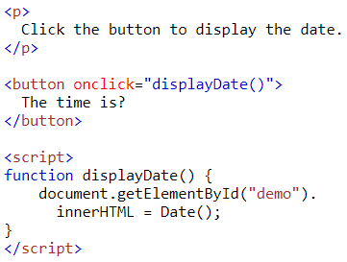

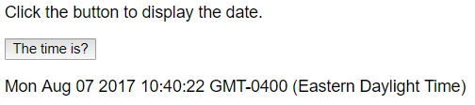
JS Events
JavaScript code is often several lines long
It is more common to see event attributes calling functions

Slide 67
JS Events
Here is a list of some common HTML events
Event | Description
onchange | An HTML element has been changed
onclick | The user clicks an HTML element
onmouseover | The user moves the mouse over an HTML element
onmouseout | The user moves the mouse away from an HTML element
onkeydown | The user pushes a keyboard key
onload | The browser has finished loading the page

Slide 68
JS – What Can JavaScript Do?
Event handlers can be used to handle, and verify, user input, user actions, and browser actions:
Things that should be done every time a page loads
Things that should be done when the page is closed
Action that should be performed when a user clicks a button
Content that should be verified when a user inputs data

Slide 69
JS – What Can JavaScript Do?
Many different methods can be used to let JavaScript work with events:
HTML event attributes can execute JavaScript code directly
HTML event attributes can call JavaScript functions
You can assign your own event handler functions to HTML elements
You can prevent events from being sent or being handled

Slide 70
JavaScript Event Listeners

Slide 71
JS Event Listeners
A more elegant way to react to events on a web site by creating event listeners
Removes the ‘trigger’ from the HTML and puts it in the JS
Similar to the ones we’ve seen, with some differences

Slide 72
JS Event Listeners
This appears in your JavaScript code, not the HTML

Slide 73
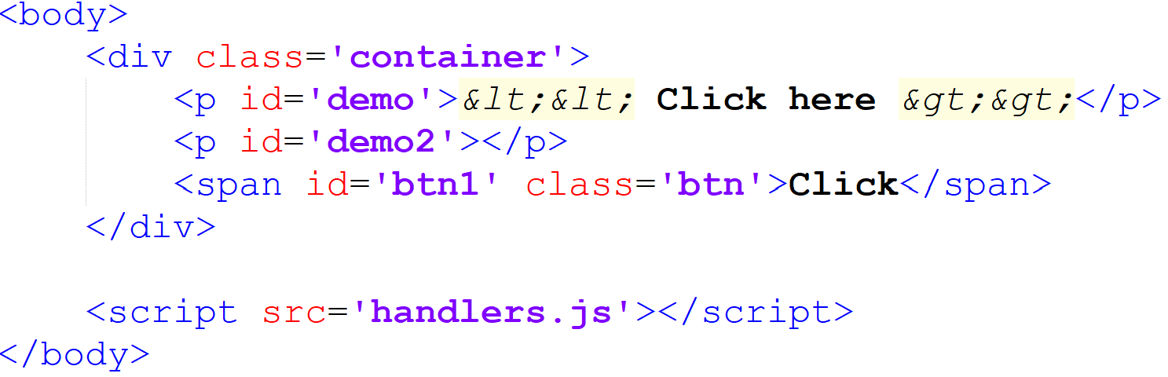
JS Event Listeners
This appears in your JavaScript code, not the HTML

Slide 74

JS Event Listeners
This appears in your JavaScript code, not the HTML

Slide 75


JS Event Listeners

Slide 76
JS Event Listeners
This appears in your JavaScript code, not the HTML

Slide 77

JS Event Listeners

Slide 78


JS Event Listeners

Slide 79
JS Event Listeners - Document
There are a variety of event listeners built in to JavaScript (in addition to ‘click’)
animationcancel event
animationend event
animationiteration event
animationstart event
copy event
cut event
DOMContentLoaded event
dragend event
dragenter event
dragleave event
dragover event
dragstart event
drag event
drop event
fullscreenchange event
fullscreenerror event
gotpointercapture event
keydown event
keypress event
keyup event
lostpointercapture event
paste event
pointercancel event
pointerdown event
pointerenter event
pointerleave event
pointerlockchange event
pointerlockerror event
pointermove event
pointerout event
pointerover event
pointerup event
readystatechange event
scroll event
selectionchange event
selectstart event
touchcancel event
touchend event
touchmove event
touchstart event
transitioncancel event
transitionend event
transitionrun event
transitionstart event
visibilitychange event
wheel event

Slide 80
JS Event Listeners - Element
There are a variety of event listeners built in to JavaScript (in addition to ‘click’)
afterscriptexecute event
auxclick event
beforescriptexecute event
blur event
click event
compositionend event
compositionstart event
compositionupdate event
contextmenu event
copy event
cut event
dblclick event
DOMActivate event
DOMMouseScroll event
error event
focusin event
focusout event
focus event
fullscreenchange event
fullscreenerror event
gesturechange event
gestureend event
gesturestart event
keydown event
keypress event
keyup event
mousedown event
mouseenter event
mouseleave event
mousemove event
mouseout event
mouseover event
mouseup event
mousewheel event
msContentZoom event
MSGestureChange event
MSGestureEnd event
MSGestureHold event
MSGestureStart event
MSGestureTap event
MSInertiaStart event
overflow event
paste event
scroll event
select event
show event
touchcancel event
touchend event
touchmove event
touchstart event
underflow event
wheel event

Slide 81
JS Event Listeners - Window
There are a variety of event listeners built in to JavaScript (in addition to ‘click’)
afterprint event
animationcancel event
animationend event
animationiteration event
animationstart event
appinstalled event
beforeprint event
beforeunload event
blur event
copy event
cut event
devicemotion event
deviceorientation event
DOMContentLoaded event
error event
focus event
gamepadconnected event
gamepaddisconnected event
hashchange event
languagechange event
load event
messageerror event
message event
offline event
online event
orientationchange event
pagehide event
pageshow event
paste event
popstate event
rejectionhandled event
resize event
storage event
transitioncancel event
transitionend event
transitionrun event
transitionstart event
unhandledrejection event
unload event
vrdisplayactivate event
vrdisplayblur event
vrdisplayconnect event
vrdisplaydeactivate event
vrdisplaydisconnect event
vrdisplayfocus event
vrdisplaypointerrestricted event
vrdisplaypresentchange event

Slide 82
JS Event Listeners
This list doesn’t include all of the built in events, but should illustrate the variety of things you can do with JavaScript

Slide 84

Questions?

Slide 85
Sources
https://www.w3schools.com/js/js_htmldom.asp
https://www.w3schools.com/js/default.asp
http://lotrproject.com/quotes/
https://www.brainyquote.com/quotes/quotes/i/isaacasimo100104.html
https://www.goodreads.com/author/quotes/205.Robert_A_Heinlein
https://en.wikiquote.org/wiki/Dune
http://www.imdb.com/title/tt0062622/quotes
https://developer.mozilla.org/en-US/docs/Web/Events

Slide 86


Copyrights
Presentation prepared by and copyright of John Ramsey, East Tennessee State University, Department of Computing . (ramseyjw@etsu.edu)
Microsoft, Windows, Excel, Outlook, and PowerPoint are registered trademarks of Microsoft Corporation.
IBM, DB2, DB2 Universal Database, System i, System i5, System p, System p5, System x, System z, System z10, System z9, z10, z9, iSeries, pSeries, xSeries, zSeries, eServer, z/VM, z/OS, i5/OS, S/390, OS/390, OS/400, AS/400, S/390 Parallel Enterprise Server, PowerVM, Power Architecture, POWER6+, POWER6, POWER5+, POWER5, POWER, OpenPower, PowerPC, BatchPipes, BladeCenter, System Storage, GPFS, HACMP, RETAIN, DB2 Connect, RACF, Redbooks, OS/2, Parallel Sysplex, MVS/ESA, AIX, Intelligent Miner, WebSphere, Netfinity, Tivoli and Informix are trademarks or registered trademarks of IBM Corporation.
Linux is the registered trademark of Linus Torvalds in the U.S. and other countries.
Oracle is a registered trademark of Oracle Corporation.
HTML, XML, XHTML and W3C are trademarks or registered trademarks of W3C®, World Wide Web Consortium, Massachusetts Institute of Technology.
Java is a registered trademark of Sun Microsystems, Inc.
JavaScript is a registered trademark of Sun Microsystems, Inc., used under license for technology invented and implemented by Netscape.
SAP, R/3, SAP NetWeaver, Duet, PartnerEdge, ByDesign, SAP Business ByDesign, and other SAP products and services mentioned herein as well as their respective logos are trademarks or registered trademarks of SAP AG in Germany and other countries.
Business Objects and the Business Objects logo, BusinessObjects, Crystal Reports, Crystal Decisions, Web Intelligence, Xcelsius, and other Business Objects products and services mentioned herein as well as their respective logos are trademarks or registered trademarks of Business Objects S.A. in the United States and in other countries. Business Objects is an SAP company.
ERPsim is a registered copyright of ERPsim Labs, HEC Montreal.
Other products mentioned in this presentation are trademarks of their respective owners.

