Slide 1


JSON
CSCI 1720
East Tennessee State University
Department of Computing
CSCI 1720
Intermediate Web Design

Slide 2
JS Objects
East Tennessee State University
Department of Computing
CSCI 1720
Intermediate Web Design

Slide 3
JS Objects
In order to understand JavaScript Object Notation, it’s best to have at least a basic understanding of JS objects
JSON is a subset of JS objects used to transfer data in a structured, standardized format
So, what about objects?
East Tennessee State University
Department of Computing
CSCI 1720
Intermediate Web Design

Slide 4
JS Objects
An ‘object’ is one of JavaScript’s supported data types
It is an associative array of key:value pairs
Keys are developer-defined values that describe parts of an object
Values represent information associated with the object that may be unique to a given instantiation of that object
East Tennessee State University
Department of Computing
CSCI 1720
Intermediate Web Design

Slide 5
JS Objects
For example:
  We have an object named ‘Cars’
  One of the properties (key:value pairs) is ‘make’
  We have two ‘Cars’ objects
  The ‘make’ for car1 might be ‘Ford’; for car2 ‘Porsche’
  Each of these objects are independent
  Each contains the same ‘kind’ of data, but with different values for that data
  https://csci1720.net/lecture/JSON-examples/json1.html
East Tennessee State University
Department of Computing
CSCI 1720
Intermediate Web Design

Slide 6
JS Objects
For example:
  Each contains the same ‘kind’ of data, but with different values for that data
  We can change the ‘make’ of car1 (and probably should) to ‘Chevrolet’
  Action is specific to car1; car2 is not affected
  We could delete car2, but car1 would still persist
East Tennessee State University
Department of Computing
CSCI 1720
Intermediate Web Design

Slide 7
JS Objects
Data Types
Values assigned to keys can have several data types
  Primitives
  Arrays
  Objects
  Arrays of objects
  Functions
East Tennessee State University
Department of Computing
CSCI 1720
Intermediate Web Design

Slide 8
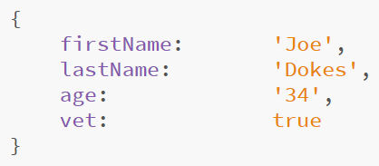
JS Objects
Data Types
Primitives
East Tennessee State University
Department of Computing
CSCI 1720
Intermediate Web Design

Slide 9
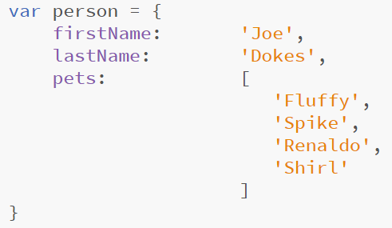
JS Objects
Data Types
Arrays
East Tennessee State University
Department of Computing
CSCI 1720
Intermediate Web Design

Slide 10
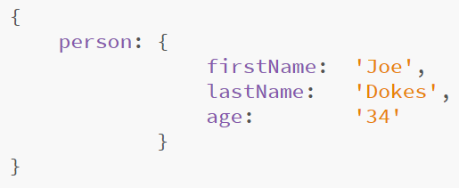
JS Objects
Data Types
Objects
East Tennessee State University
Department of Computing
CSCI 1720
Intermediate Web Design

Slide 11
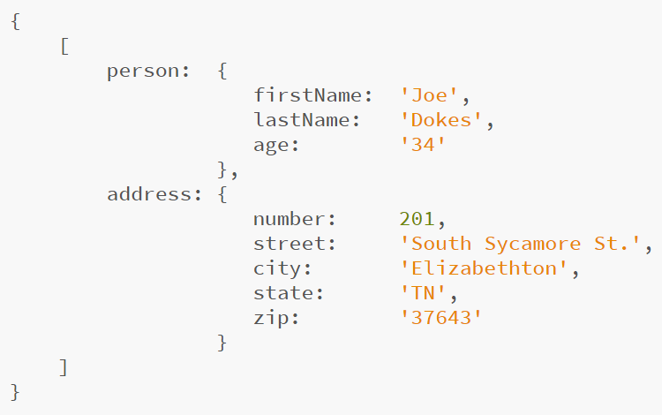
JS Objects
Data Types
Array of Objects
East Tennessee State University
Department of Computing
CSCI 1720
Intermediate Web Design

Slide 12
JS Objects
Data Types
Functions
In JS, a function can be assigned to a variable, in general
When it is used in a JS object, it becomes the equivalent to a Java object method
East Tennessee State University
Department of Computing
CSCI 1720
Intermediate Web Design

Slide 13
JS Objects
Data Types
Functions
Functions (we’ll just call them methods from now on) serve to access and manipulate object data
We could, for example, create a method that will return a “person’s” full name, concatenated from the ‘firstName’ and ‘lastName’ values
https://csci1720.net/lecture/JSON-examples/json4.html
East Tennessee State University
Department of Computing
CSCI 1720
Intermediate Web Design

Slide 14
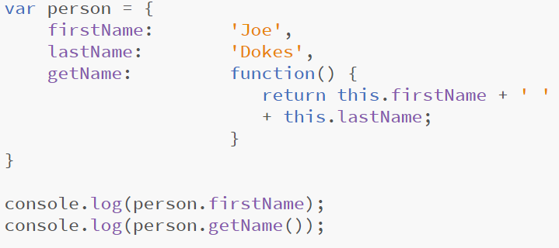
JS Objects
Data Types
Functions
East Tennessee State University
Department of Computing
CSCI 1720
Intermediate Web Design

Slide 15
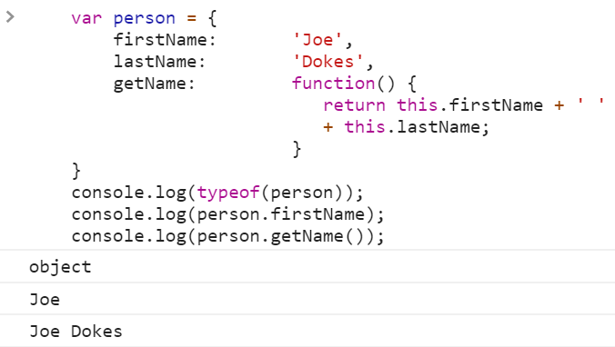
JS Objects
Data Types
Functions
East Tennessee State University
Department of Computing
CSCI 1720
Intermediate Web Design

Slide 16
JS Objects
That’s the basics of JS objects
There are a number of built-in methods associated with all objects
As we’ve seen, we can define custom methods as well
Other examples of object use:
    https://csci1720.net/lecture/JSON-examples/json8.html
    https://csci1720.net/lecture/JSON-examples/json9.html
So how does this relate to JSON?
Let’s look first at an older technology
East Tennessee State University
Department of Computing
CSCI 1720
Intermediate Web Design

Slide 17
Old School: XML
East Tennessee State University
Department of Computing
CSCI 1720
Intermediate Web Design

Slide 18
eXtensible Markup Language
XML is an older way of structuring data for sharing
MUCH more verbose than JSON
Makes use of ‘custom’ HTML tags and elements
Compliant with HTML
Platform independent
Still widely used (e.g., RSS feeds)
East Tennessee State University
Department of Computing
CSCI 1720
Intermediate Web Design

Slide 19
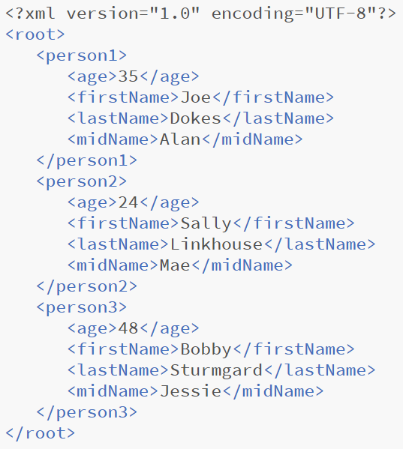
XML
https://csci1720.net/lecture/JSON-examples/json7.html
East Tennessee State University
Department of Computing
CSCI 1720
Intermediate Web Design

Slide 20
eXtensible Markup Language
If you looked at the last slide and immediately thought, “Ugh.”, welcome to the club
It is structured and can be parsed as needed
But … Wow
JSON, as we’ll see, is a lot easier
JSON is replacing XML as the language of choice for data structuring and sharing
East Tennessee State University
Department of Computing
CSCI 1720
Intermediate Web Design

Slide 21
JSON
East Tennessee State University
Department of Computing
CSCI 1720
Intermediate Web Design

Slide 22
JavaScript Object Notation
JSON stands for JavaScript Object Notation
It was designed for human-readable data interchange
It has been extended from the JavaScript scripting language
The filename extension is .json
East Tennessee State University
Department of Computing
CSCI 1720
Intermediate Web Design

Slide 23
JavaScript Object Notation
It is used with JavaScript based applications that include browser extensions and websites
JSON format is used for serializing and transmitting structured data over a network connection
It is primarily used to transmit data between a server and web applications
Web services and APIs use JSON format to provide public data
It can be used with modern programming languages, not just JS
East Tennessee State University
Department of Computing
CSCI 1720
Intermediate Web Design

Slide 24
JavaScript Object Notation
Essentially, JSON is a JS object without methods
The only difference, otherwise, is that keys are enclosed with quotes
Unlike many other times we deal with strings, double quotes are required for well-formed JSON
Values that are numeric and/or Booleans do not have to be quoted
JSON does not (with one obscure exception) allow comments
East Tennessee State University
Department of Computing
CSCI 1720
Intermediate Web Design

Slide 25
JavaScript Object Notation
Syntax
  Considered a subset of JavaScript syntax
  Data is represented in name/value pairs
  Braces ({ }) hold objects
  Each name is followed by : (colon), the name/value pairs are separated by , (comma)
  Square brackets hold arrays and objects within the array are separated by , (commas)
East Tennessee State University
Department of Computing
CSCI 1720
Intermediate Web Design

Slide 26
JavaScript Object Notation
JSON is easy to read and write
Lightweight text-based (string) interchange format
Language/platform independent
https://csci1720.net/lecture/JSON-examples/json5.html
East Tennessee State University
Department of Computing
CSCI 1720
Intermediate Web Design

Slide 27
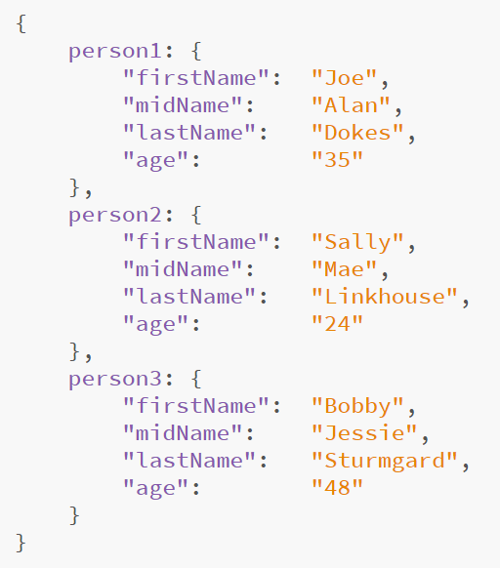
Example
Note that ‘age’ is defined as a string instead of an integer
All JSON data is string-based
It’s easy enough to convert strings to integers or floats as needed
East Tennessee State University
Department of Computing
CSCI 1720
Intermediate Web Design

Slide 28
JavaScript Object Notation
Data Types
Number | Double-precision floating-point format in JavaScript
String | Quoted Unicode with backslash escaping
Boolean | true or false
Array | Ordered sequence of values
Value | String, number, Boolean, null
Object | Unordered collection of key:value pairs
East Tennessee State University
Department of Computing
CSCI 1720
Intermediate Web Design

Slide 29
JavaScript Object Notation
stringify & parse
Useful methods with JSON -
  JSON.stringify() converts a JS object into JSON format
  JSON.parse() converts well-formed text strings into an array of JSON objects
East Tennessee State University
Department of Computing
CSCI 1720
Intermediate Web Design

Slide 30
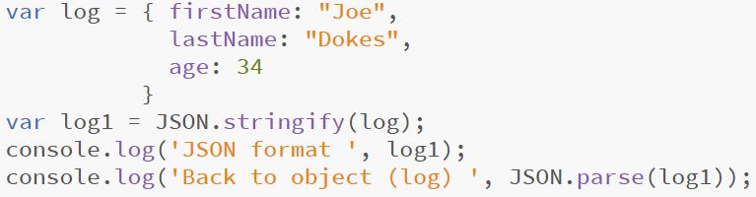
JavaScript Object Notation
East Tennessee State University
Department of Computing
CSCI 1720
Intermediate Web Design

Slide 31
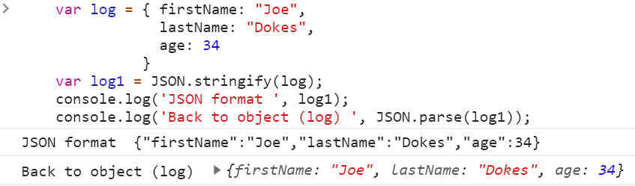
JavaScript Object Notation
East Tennessee State University
Department of Computing
CSCI 1720
Intermediate Web Design

Slide 32
JSON Conclusion
Much of our profession involves efficiently handling data
‘data’ can be in any format
JSON provides a standardized way in which we can structure and share data
‘standardized’ means that, as long as you conform to the established standard, anyone can make use of a given data set
You’ll see JSON in other classes at ETSU
East Tennessee State University
Department of Computing
CSCI 1720
Intermediate Web Design

Slide 33
Asynchronous JS
East Tennessee State University
Department of Computing
CSCI 1720
Intermediate Web Design

Slide 34

Synchronous JS
In order to understand asynchronous JS, let’s first look at what JS, by default, is
JS is a synchronous (or single-threaded) environment
thread === ‘ordered sequence of statements’
thus,
Runs one (1) statement at a time
East Tennessee State University
Department of Computing
CSCI 1720
Intermediate Web Design

Slide 35
Synchronous JS
STATEMENT 1
STATEMENT 2
STATEMENT 3
STATEMENT 4
STATEMENT 5
East Tennessee State University
Department of Computing
CSCI 1720
Intermediate Web Design

Slide 36
Synchronous JS
In the RW, we often need to execute functions that take a little time to complete
These are referred to as ‘blocking statements’
JS doesn’t like to wait
When JS encounters such a function, again by default, it will execute it and charge on to the next statement without waiting to see if it finished
This can lead to some wonky behavior/results
East Tennessee State University
Department of Computing
CSCI 1720
Intermediate Web Design

Slide 37

Synchronous JS
STATEMENT 1
TAKES TIME
STATEMENT 2
STATEMENT 3
STATEMENT 4
STATEMENT 5
East Tennessee State University
Department of Computing
CSCI 1720
Intermediate Web Design

Slide 38
Synchronous JS
STATEMENT 1
TAKES TIME
STATEMENT 2
STATEMENT 3
TAKES TIME
STATEMENT 4
STATEMENT 5
East Tennessee State University
Department of Computing
CSCI 1720
Intermediate Web Design

Slide 39
Asynchronous JS
Start something now & finish it later
Network requests:
Database
API
East Tennessee State University
Department of Computing
CSCI 1720
Intermediate Web Design

Slide 40
Synchronous JS
STATEMENT 1
TAKES TIME
STATEMENT 2
STATEMENT 3
TAKES A CALLBACK FUNCTION
AND EXECUTES IT WHEN THE
DATA COMES BACK
USES ASYNC FUNCTION
HANDLES REQUEST
OUTSIDE OF THE SCOPE
OF THE SINGLE THREAD
IN ANOTHER PART OF THE
BROWSER’S ENVIRONMENT
STATEMENT 4
STATEMENT 5
CALLBACK
East Tennessee State University
Department of Computing
CSCI 1720
Intermediate Web Design

Slide 41
Synchronous JS
All Videos: https://csci1720.net/lecture/video/lecture13-json/index.php
https://csci1720.net/lecture/video/lecture13-json/003.mp4
East Tennessee State University
Department of Computing
CSCI 1720
Intermediate Web Design

Slide 42
Asynchronous JS
https://csci1720.net/lecture/video/lecture13-json/004.mp4
East Tennessee State University
Department of Computing
CSCI 1720
Intermediate Web Design

Slide 43
HTTP Requests
Make HTTP requests to get data from another server
We make these requests to API endpoints
URLs that an API or server exposes to us so that we can obtain the data
East Tennessee State University
Department of Computing
CSCI 1720
Intermediate Web Design

Slide 44
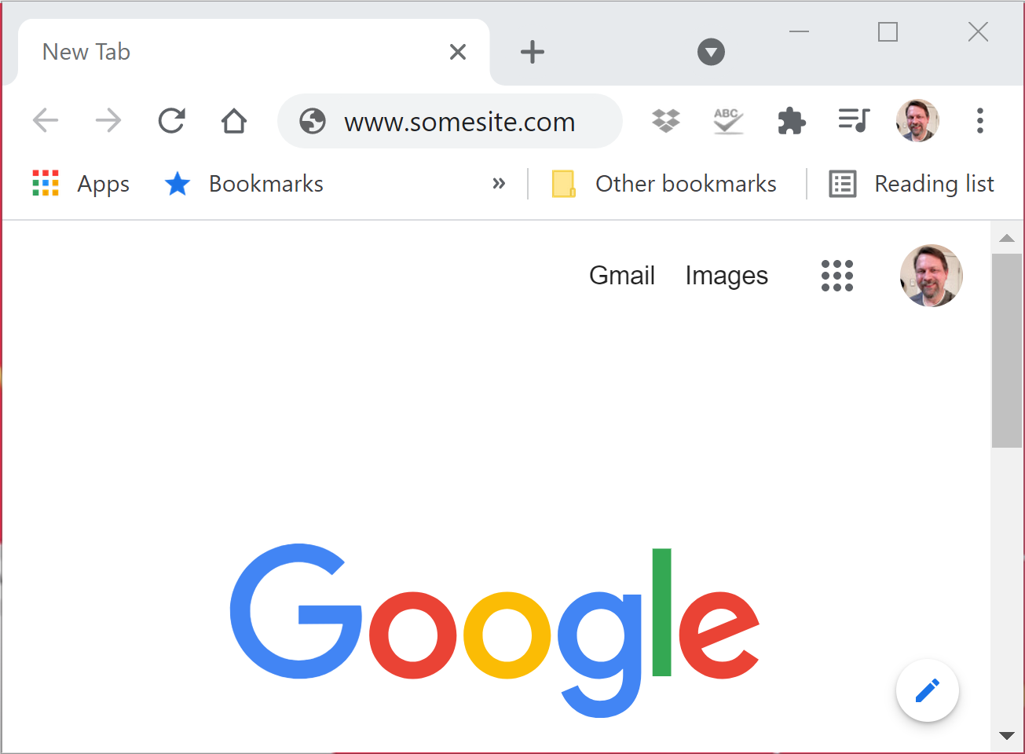
API Endpoints
HTTP REQUEST
HTTP RESPONSE
East Tennessee State University
Department of Computing
CSCI 1720
Intermediate Web Design

Slide 45
XMLHttpRequest
In this example, we’re using an Application Programming Interface (API), typicode.com
We’ll make a call to typicode, which will return dummy data in JSON format
Like a database request, an API call takes a little time to complete
https://csci1720.net/lecture/video/lecture13-json/006.mp4
East Tennessee State University
Department of Computing
CSCI 1720
Intermediate Web Design

Slide 46
XMLHttpRequest
Data is typically returned from an API in JSON format
So, to demonstrate asynchronous requests, we’re going to use an API endpoint at https://jsonplaceholder.typicode.com/todos
To make the request, we have to set up an XMLHttpRequest object, open it, and send it
East Tennessee State University
Department of Computing
CSCI 1720
Intermediate Web Design

Slide 47
XMLHttpRequest
https://csci1720.net/lecture/video/lecture13-json/007.mp4
East Tennessee State University
Department of Computing
CSCI 1720
Intermediate Web Design

Slide 48
XMLHttpRequest
So, at this point, we’ve made and sent the request and received the response
But we still don’t know when the request is complete or how to access that data
We need a little more code
East Tennessee State University
Department of Computing
CSCI 1720
Intermediate Web Design

Slide 49
XMLHttpRequest
We can track the progress of the request using an event listener
Specifically,
readystatechange
There are four states logged by the readystatechange event
East Tennessee State University
Department of Computing
CSCI 1720
Intermediate Web Design

Slide 50
XMLHttpRequest
https://csci1720.net/lecture/video/lecture13-json/008.mp4
East Tennessee State University
Department of Computing
CSCI 1720
Intermediate Web Design

Slide 51
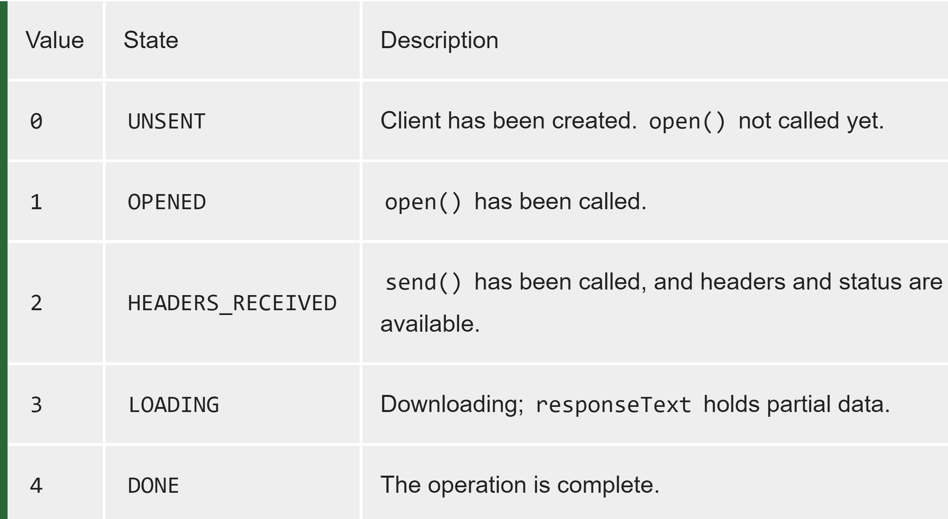
XMLHttpRequest
East Tennessee State University
Department of Computing
CSCI 1720
Intermediate Web Design

Slide 52
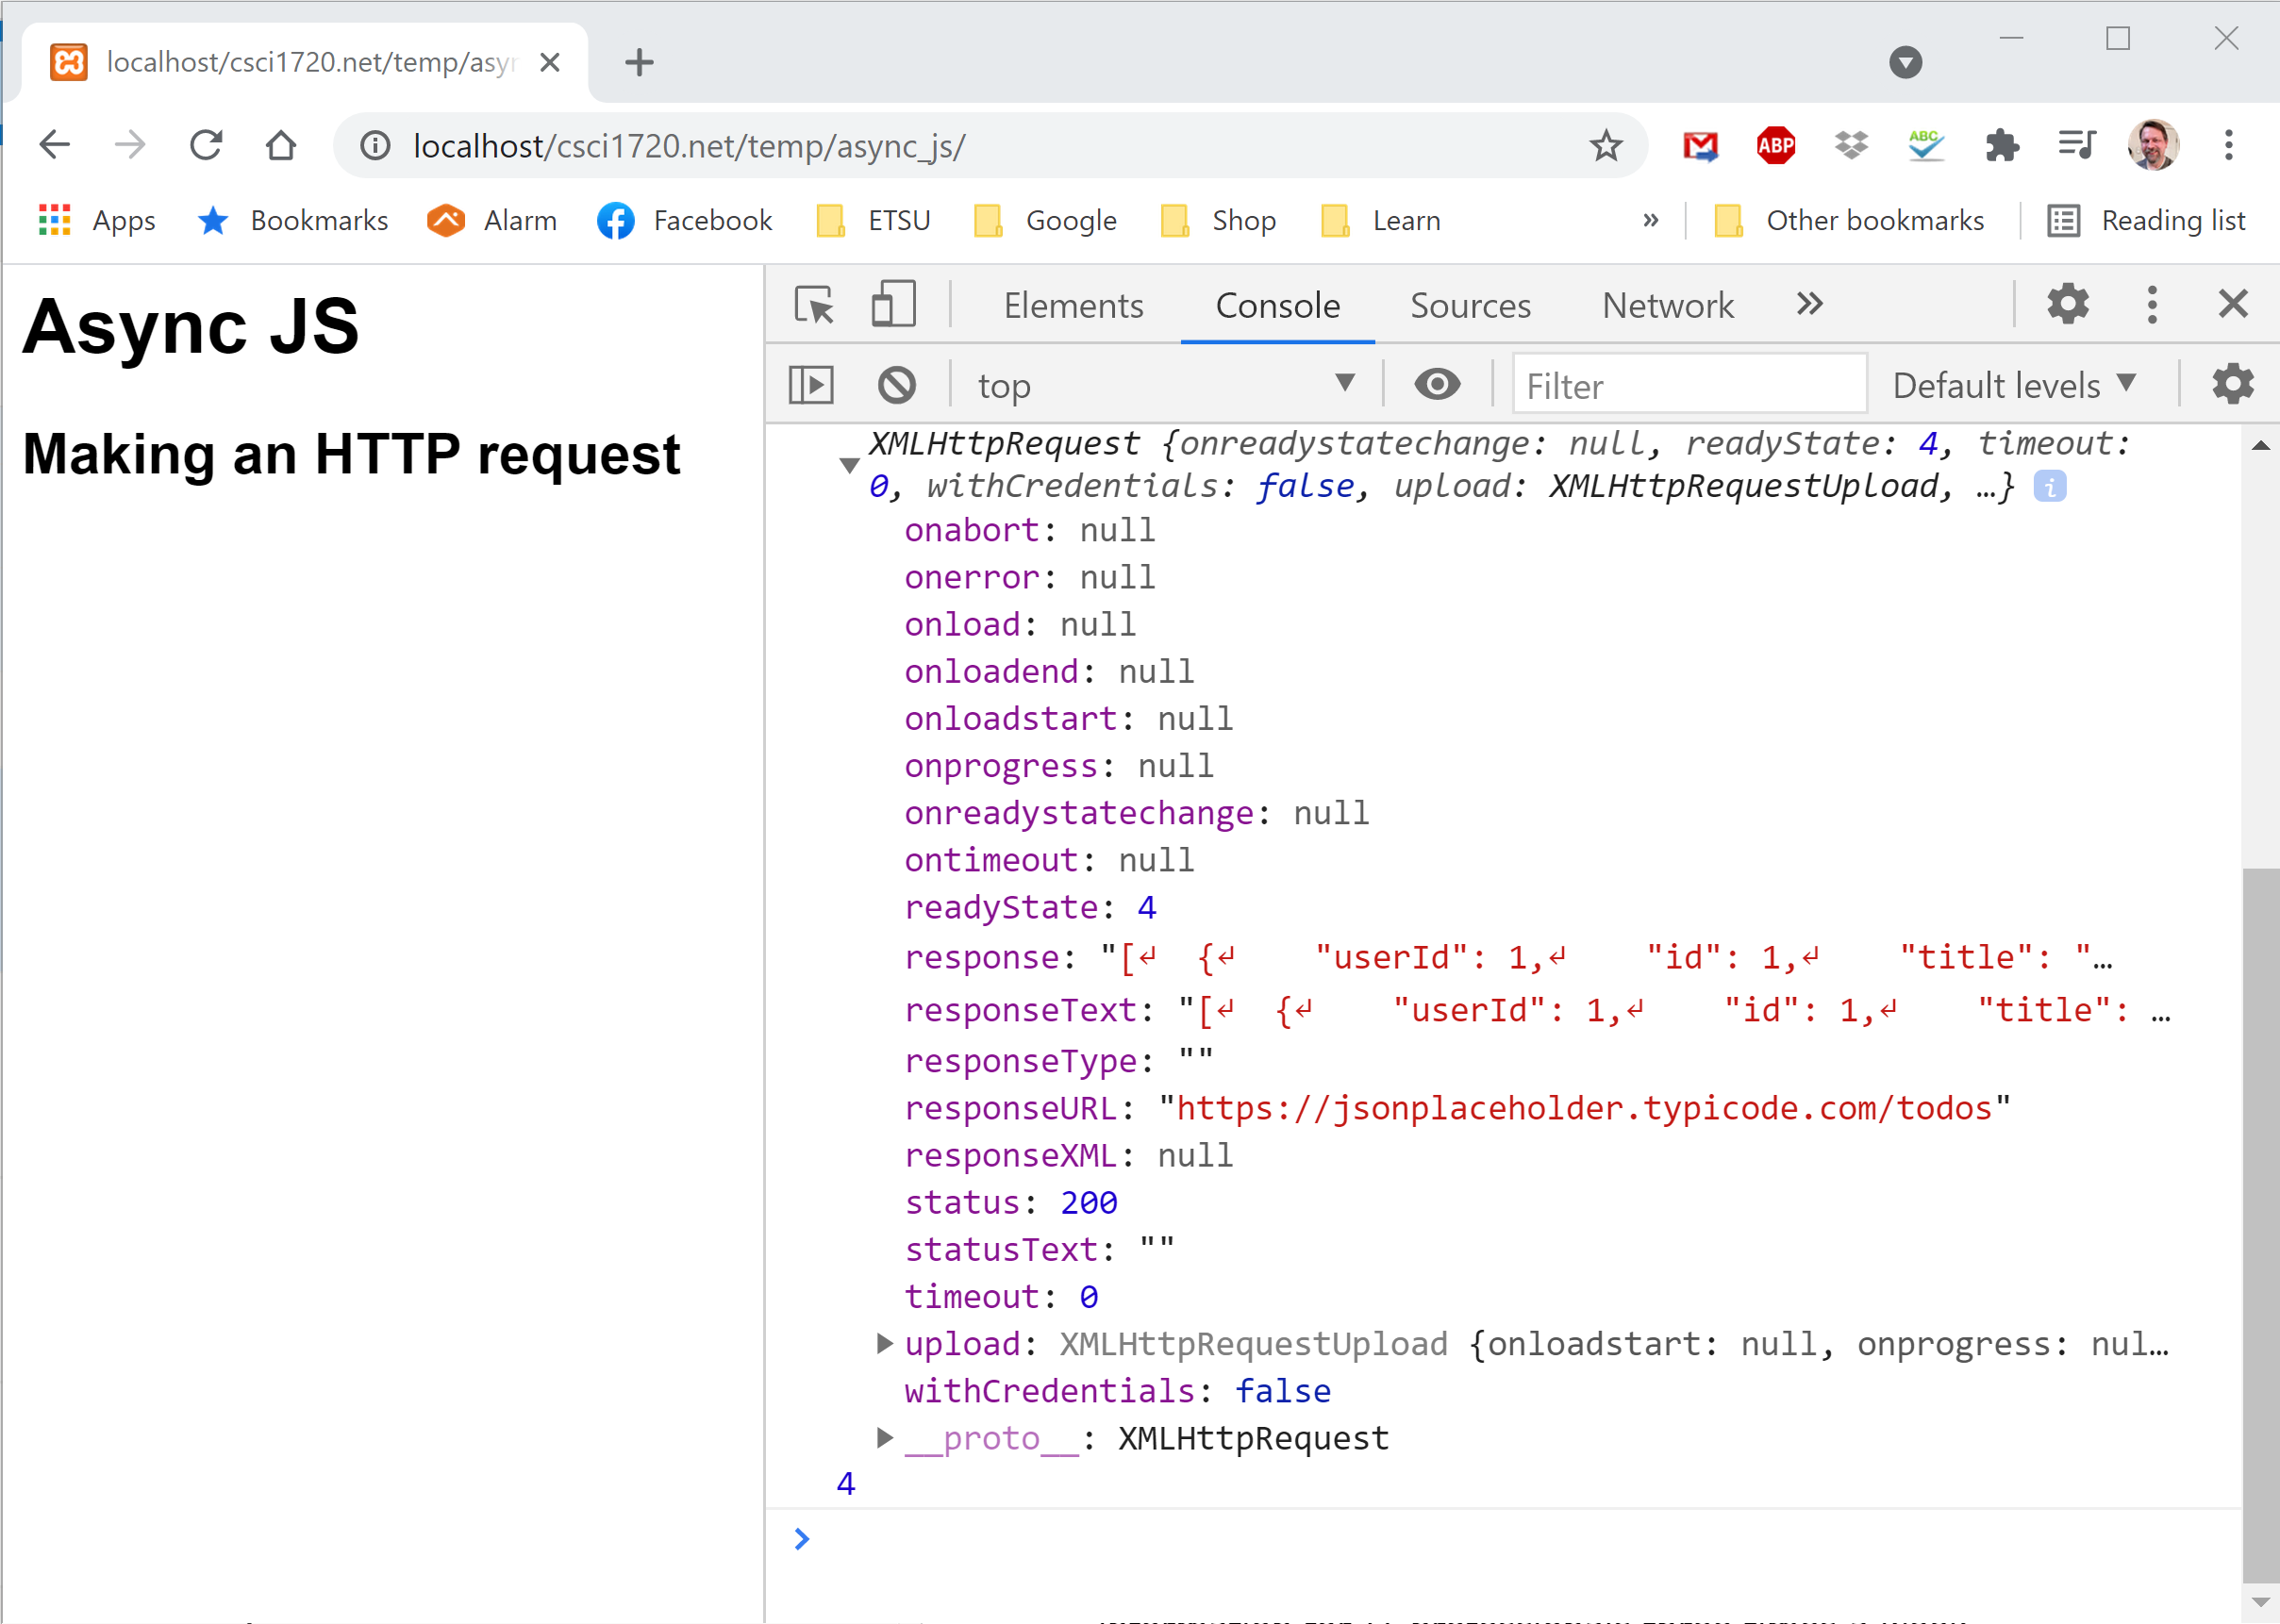
XMLHttpRequest
The response, accessible when we reach readyState == 4, is in a property called responseText
East Tennessee State University
Department of Computing
CSCI 1720
Intermediate Web Design

Slide 53
XMLHttpRequest
So we want to add a check of the readyState
          if(request.readyState === 4) {
          }
East Tennessee State University
Department of Computing
CSCI 1720
Intermediate Web Design

Slide 54
XMLHttpRequest
https://csci1720.net/lecture/video/lecture13-json/009.mp4
East Tennessee State University
Department of Computing
CSCI 1720
Intermediate Web Design

Slide 55
XMLHttpRequest
          if(request.readyState === 4) {
          }
isn’t quite enough
We need to also verify that the response was successful
East Tennessee State University
Department of Computing
CSCI 1720
Intermediate Web Design

Slide 56
XMLHttpRequest
          if(request.readyState === 4 &&
          request.status == 200) {
          } else if(request.readyState === 4) {
          console.log('Could not fetch data');
          }
So if the request finishes with an error, we’ll log an error message to the console
East Tennessee State University
Department of Computing
CSCI 1720
Intermediate Web Design

Slide 57
XMLHttpRequest
https://csci1720.net/lecture/video/lecture13-json/010.mp4
THIS ACTUALLY SHOULD BE 200, NOT '200'. OOPS
East Tennessee State University
Department of Computing
CSCI 1720
Intermediate Web Design

Slide 58
XMLHttpRequest
Now we’re making the request, waiting for the response, and making sure that the response is error-free
Now we need to add a callback function that’ll do something with the data once it has been received
First, let’s declare a callback function and put all the code we’ve got so far into it
East Tennessee State University
Department of Computing
CSCI 1720
Intermediate Web Design

Slide 59
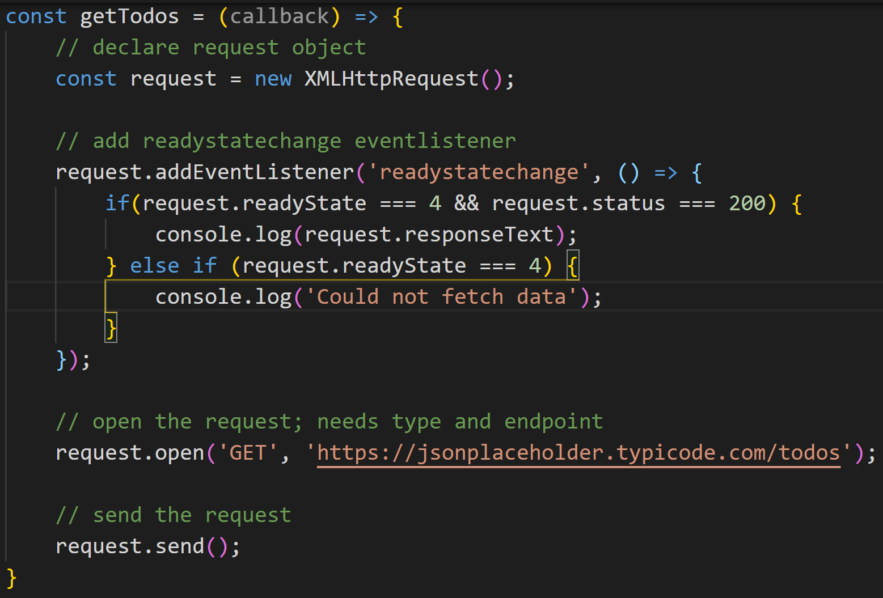
XMLHttpRequest
East Tennessee State University
Department of Computing
CSCI 1720
Intermediate Web Design

Slide 60

XMLHttpRequest
Now we can call the function with a separate function
But we need to do a little more to tie it in to the request
East Tennessee State University
Department of Computing
CSCI 1720
Intermediate Web Design

Slide 61
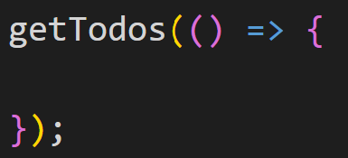
XMLHttpRequest
Turn it into a callback
East Tennessee State University
Department of Computing
CSCI 1720
Intermediate Web Design

Slide 62
XMLHttpRequest
Add a call to the callback to our code
We’ll call it ‘callback,’ but the name could be anything
East Tennessee State University
Department of Computing
CSCI 1720
Intermediate Web Design

Slide 63
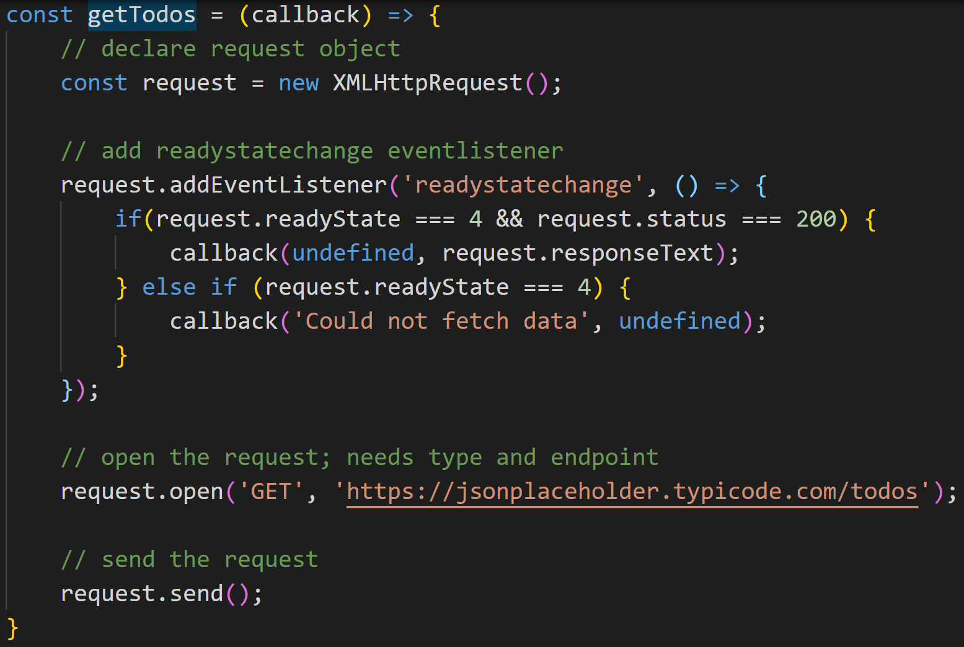
XMLHttpRequest
East Tennessee State University
Department of Computing
CSCI 1720
Intermediate Web Design

Slide 64
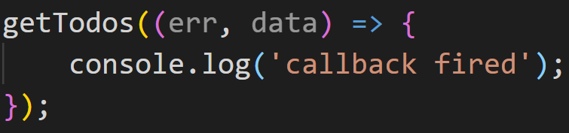
XMLHttpRequest
Add some test code
East Tennessee State University
Department of Computing
CSCI 1720
Intermediate Web Design

Slide 65
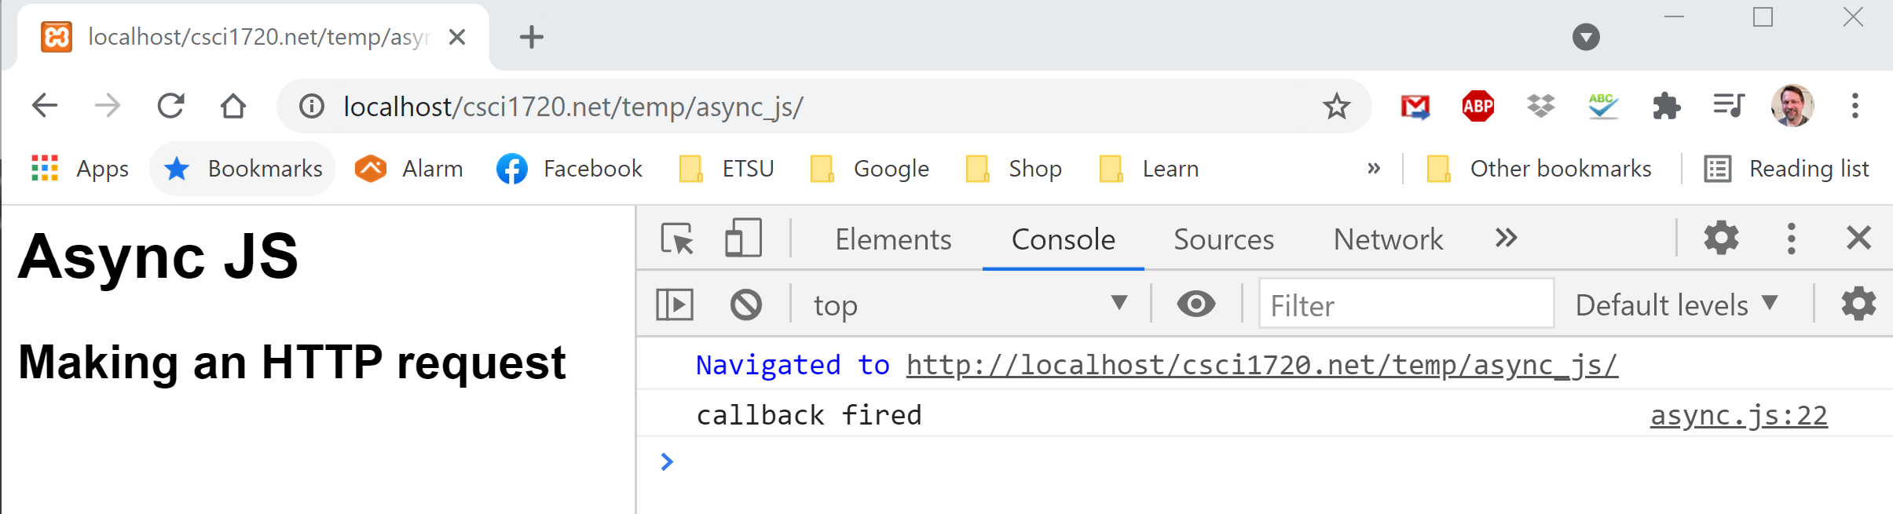
XMLHttpRequest
Test the code
East Tennessee State University
Department of Computing
CSCI 1720
Intermediate Web Design

Slide 66
XMLHttpRequest
This is fine, as far as it goes
But notice that we get the same feedback whether the call was a success or not
We need to add a couple of parameters to be able to distinguish between the two
East Tennessee State University
Department of Computing
CSCI 1720
Intermediate Web Design

Slide 67
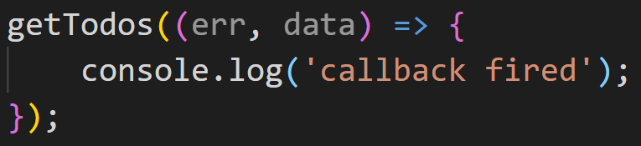
XMLHttpRequest
So we’re going to pass two parameters -> err (error) and data (data)
By convention, we call them ‘err’ and ‘data’
Now, we can modify the code above to differentiate between success and failure
East Tennessee State University
Department of Computing
CSCI 1720
Intermediate Web Design

Slide 68
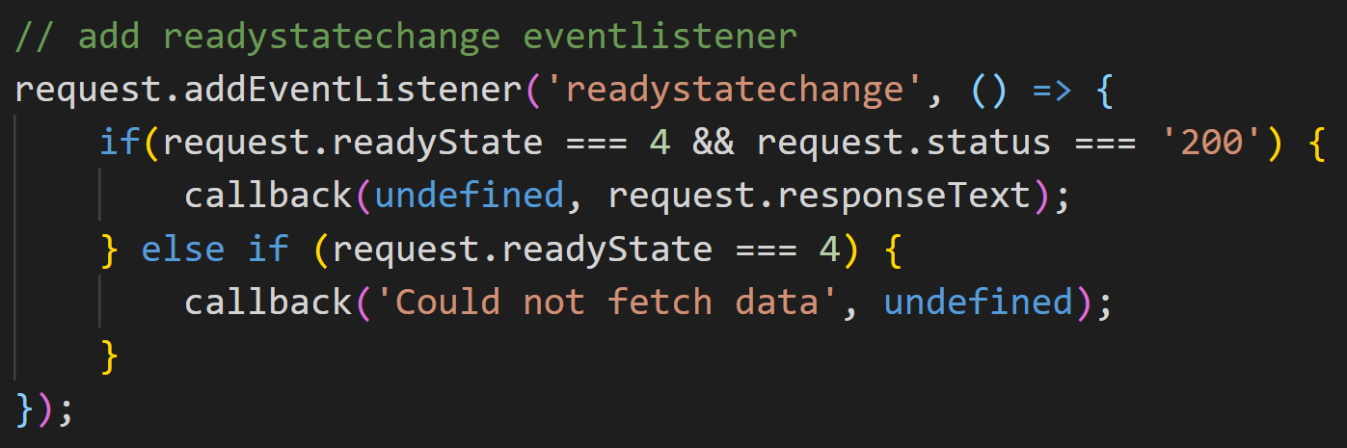
XMLHttpRequest
If the call is successful, the ‘err’ parameter will be undefined and we can pass the data back
If it is not successful, we can pass an error message back while the data parameter is undefined
East Tennessee State University
Department of Computing
CSCI 1720
Intermediate Web Design

Slide 69
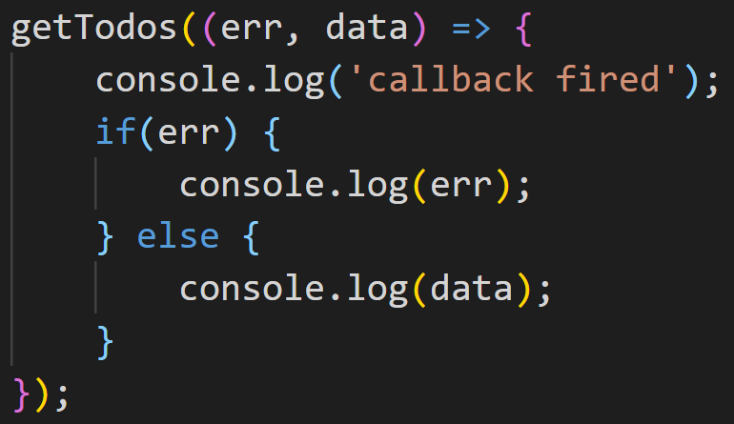
XMLHttpRequest
Now, we can modify the callback to handle either condition
If we load this into the browser (without the ‘Intentional error’):
East Tennessee State University
Department of Computing
CSCI 1720
Intermediate Web Design

Slide 70
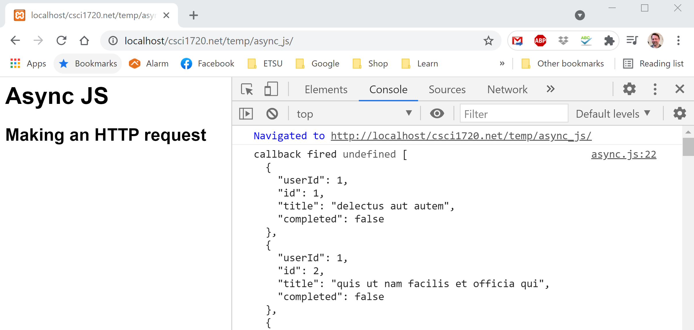
XMLHttpRequest
NO ERROR
East Tennessee State University
Department of Computing
CSCI 1720
Intermediate Web Design

Slide 71
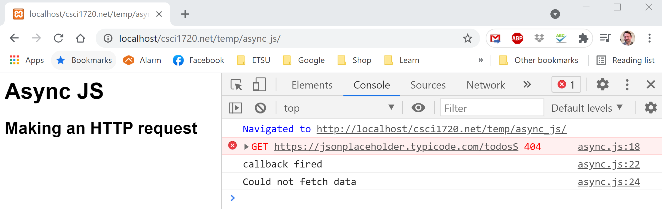
XMLHttpRequest
ERROR OCCURRED
East Tennessee State University
Department of Computing
CSCI 1720
Intermediate Web Design

Slide 72
XMLHttpRequest
https://csci1720.net/lecture/video/lecture13-json/011.mp4
East Tennessee State University
Department of Computing
CSCI 1720
Intermediate Web Design

Slide 73
XMLHttpRequest
So now we’ve got the data back from the request without blocking the code
So, what do we do with it?
How can we manipulate the data once it has been returned?
The data is returned as text, but we need to convert it to something we can use
Enter JSON
East Tennessee State University
Department of Computing
CSCI 1720
Intermediate Web Design

Slide 74
XMLHttpRequest
https://csci1720.net/lecture/video/lecture13-json/012.mp4
East Tennessee State University
Department of Computing
CSCI 1720
Intermediate Web Design

Slide 75
XMLHttpRequest
JSON.parse() will convert a properly formatted text string into an array of JSON objects
We can then access that array and process the data however our application requires
We could use a local JSON file for our data:
East Tennessee State University
Department of Computing
CSCI 1720
Intermediate Web Design

Slide 76
XMLHttpRequest
https://csci1720.net/lecture/video/lecture13-json/013.mp4
East Tennessee State University
Department of Computing
CSCI 1720
Intermediate Web Design

Slide 77
XMLHttpRequest
Naturally, there are more issues with asynchronous requests…
What if we want to do multiple requests against (possibly) multiple endpoints
A typical use-case is getting data from one endpoint, doing something with it, then another endpoint, doing something, and so on
But for now, that’s the basics of performing an asynchronous call in JavaScript
East Tennessee State University
Department of Computing
CSCI 1720
Intermediate Web Design

Slide 78
XMLHttpRequest
You may be asking yourself at this point, “So what?”
We requested the data
We did some basic error checking
We got the data back
We logged it to the console
But, all “oohs” and “ahhs” aside, what next?
Well, here’s one example
East Tennessee State University
Department of Computing
CSCI 1720
Intermediate Web Design

Slide 79
XMLHttpRequest
https://csci1720.net/lecture/video/lecture13-json/014.mp4
East Tennessee State University
Department of Computing
CSCI 1720
Intermediate Web Design

Slide 80

East Tennessee State University
Department of Computing
CSCI 1720
Intermediate Web Design

Slide 81


Copyrights
Presentation prepared by and copyright of John Ramsey, East Tennessee State University, Department of Computing . (ramseyjw@etsu.edu)
Microsoft, Windows, Excel, Outlook, and PowerPoint are registered trademarks of Microsoft Corporation.
IBM, DB2, DB2 Universal Database, System i, System i5, System p, System p5, System x, System z, System z10, System z9, z10, z9, iSeries, pSeries, xSeries, zSeries, eServer, z/VM, z/OS, i5/OS, S/390, OS/390, OS/400, AS/400, S/390 Parallel Enterprise Server, PowerVM, Power Architecture, POWER6+, POWER6, POWER5+, POWER5, POWER, OpenPower, PowerPC, BatchPipes, BladeCenter, System Storage, GPFS, HACMP, RETAIN, DB2 Connect, RACF, Redbooks, OS/2, Parallel Sysplex, MVS/ESA, AIX, Intelligent Miner, WebSphere, Netfinity, Tivoli and Informix are trademarks or registered trademarks of IBM Corporation.
Linux is the registered trademark of Linus Torvalds in the U.S. and other countries.
Oracle is a registered trademark of Oracle Corporation.
HTML, XML, XHTML and W3C are trademarks or registered trademarks of W3C®, World Wide Web Consortium, Massachusetts Institute of Technology.
Java is a registered trademark of Sun Microsystems, Inc.
JavaScript is a registered trademark of Sun Microsystems, Inc., used under license for technology invented and implemented by Netscape.
SAP, R/3, SAP NetWeaver, Duet, PartnerEdge, ByDesign, SAP Business ByDesign, and other SAP products and services mentioned herein as well as their respective logos are trademarks or registered trademarks of SAP AG in Germany and other countries.
Business Objects and the Business Objects logo, BusinessObjects, Crystal Reports, Crystal Decisions, Web Intelligence, Xcelsius, and other Business Objects products and services mentioned herein as well as their respective logos are trademarks or registered trademarks of Business Objects S.A. in the United States and in other countries. Business Objects is an SAP company.
ERPsim is a registered copyright of ERPsim Labs, HEC Montreal.
Other products mentioned in this presentation are trademarks of their respective owners.
East Tennessee State University
Department of Computing
CSCI 1720
Intermediate Web Design

