Slide 1

Architecture and
Single Page Applications
East Tennessee State University
Department of Computing
CSCI 1720
East Tennessee State University
Department of Computing
CSCI 1720
Intermediate Web Design

Slide 2
Architecture
"If builders built buildings the way programmers wrote programs, then the first woodpecker that came along would destroy civilization."
Gerald Weinberg
“Architecture is about the important stuff. Whatever that is”
- Ralph Johnson
East Tennessee State University
Department of Computing
CSCI 1720
Intermediate Web Design

Slide 3
Architecture
The definition of [software] Architecture is a little slippery, but crucial in Information Technology
It almost falls into “I’ll know it when I see it” territory
While entire courses can be, and are, devoted to this concept, we want to look at how we can apply some of the common principles of Software Architecture to web development
Many of the principles of ‘good architecture’ can be applied to web applications
East Tennessee State University
Department of Computing
CSCI 1720
Intermediate Web Design

Slide 4
Architecture
Why?
Almost since the first web page was published, a ‘gold standard’ has been identified
That standard is crafting web-based/-hosted applications that are indistinguishable, or at least almost so, from desktop applications
East Tennessee State University
Department of Computing
CSCI 1720
Intermediate Web Design

Slide 5
Architecture
The motivation lies in the shortcomings associated with network-based applications
Latency
Scalability
Usability
Mostly, Latency…
East Tennessee State University
Department of Computing
CSCI 1720
Intermediate Web Design

Slide 6
Architecting Applications
Some Common Characteristics
  Maintainability
  Usability
  Extensibility
  Discrete components that are not tightly coupled
  Communication through explicit interfaces or messaging systems
East Tennessee State University
Department of Computing
CSCI 1720
Intermediate Web Design

Slide 7
Characteristics
Separation of Concerns
East Tennessee State University
Department of Computing
CSCI 1720
Intermediate Web Design

Slide 8
Separation of Concerns
A guiding principle when developing is Separation of Concerns
Software should be separated based on the kinds of work it performs
For instance, consider an application that includes logic for identifying noteworthy items to display to the user, and which formats such items in a particular way to make them more noticeable
East Tennessee State University
Department of Computing
CSCI 1720
Intermediate Web Design

Slide 9
Separation of Concerns
The behavior responsible for choosing which items to format should be kept separate from the behavior responsible for formatting the items
These behaviors are separate concerns that are only coincidentally related to one another
East Tennessee State University
Department of Computing
CSCI 1720
Intermediate Web Design

Slide 10
Separation of Concerns
Architecturally, applications can be logically built to follow this principle by separating core business behavior from infrastructure and user-interface logic
Business rules and logic should reside in a separate project, which should not depend on other projects in the application
This helps ensure that the business model is easy to test and can evolve without being tightly coupled to low-level implementation details
Separation of concerns is a key consideration behind the use of layers in application architectures
East Tennessee State University
Department of Computing
CSCI 1720
Intermediate Web Design

Slide 11
Characteristics
Encapsulation
East Tennessee State University
Department of Computing
CSCI 1720
Intermediate Web Design

Slide 12
Encapsulation
Parts of an application should use encapsulation to insulate them from other parts of the application
Application components and layers should be able to adjust their internal implementation without breaking their collaborators as long as external contracts are not violated
Proper use of encapsulation helps achieve loose coupling and modularity in application designs, since objects and packages can be replaced with alternative implementations so long as the same interface is maintained
East Tennessee State University
Department of Computing
CSCI 1720
Intermediate Web Design

Slide 13
Coupling
The degree of interdependence between software modules
A measure of how closely connected two routines or modules area
The strength of the relationships between modules
East Tennessee State University
Department of Computing
CSCI 1720
Intermediate Web Design

Slide 14
Coupling
Tightly coupled systems tend to exhibit the following developmental characteristics, which are often seen as disadvantages:
  A change in one module usually forces a ripple effect of changes in other modules
  Assembly of modules might require more effort and/or time due to the increased inter-module dependency
  A particular module might be harder to reuse and/or test because dependent modules must be included
East Tennessee State University
Department of Computing
CSCI 1720
Intermediate Web Design

Slide 15
Cohesion
Cohesion refers to the degree to which the elements inside a module belong together
In one sense, it is a measure of the strength of relationship between the methods and data of a class and some unifying purpose or concept served by that class
In another sense, it is a measure of the strength of relationship between the class's methods and data themselves
East Tennessee State University
Department of Computing
CSCI 1720
Intermediate Web Design

Slide 16
Cohesion
Cohesion is an ordinal type of measurement and is usually described as “high cohesion” or “low cohesion”
Modules with high cohesion tend to be preferable, because high cohesion is associated with several desirable traits of software including robustness, reliability, reusability, and understandability
In contrast, low cohesion is associated with undesirable traits such as being difficult to maintain, test, reuse, or even understand
East Tennessee State University
Department of Computing
CSCI 1720
Intermediate Web Design

Slide 17
Cohesion
dimensions.css
 | .sm
 | .md
 | .lg
 | .xs
 | .xl
style.css
 | .dark-gray
 | .sm
 | .md
 | .dark-red
 | .lg
 | .light-green
 | .highlight-text
 | .xs
 | .xl
colors.css
 | .dark-gray
 | .dark-red
 | .light-green
 | .fuschia
LOW
HIGH
East Tennessee State University
Department of Computing
CSCI 1720
Intermediate Web Design

Slide 18
Coupling vs. Cohesion
Coupling and cohesion are terms which occur together very frequently
Coupling refers to the interdependencies between modules, while cohesion describes how related the functions within a single module are
Low cohesion implies that a given module performs tasks which are not very related to each other and hence can create problems as the module becomes large
East Tennessee State University
Department of Computing
CSCI 1720
Intermediate Web Design

Slide 19
Characteristics
Single Responsibility
East Tennessee State University
Department of Computing
CSCI 1720
Intermediate Web Design

Slide 20
Single Responsibility
The single responsibility principle applies to object-oriented design, but can also be considered as an architectural principle similar to separation of concerns
It states that objects should have only one responsibility and that they should have only one reason to change
East Tennessee State University
Department of Computing
CSCI 1720
Intermediate Web Design

Slide 21
Single Responsibility
The only situation in which the object should change is if the manner in which it performs its one responsibility must be updated
Following this principle helps to produce more loosely coupled and modular systems, since many kinds of new behavior can be implemented as new classes, rather than by adding additional responsibility to existing classes
Adding new classes is always safer than changing existing classes, since no code yet depends on the new classes
East Tennessee State University
Department of Computing
CSCI 1720
Intermediate Web Design

Slide 22
Characteristics
Don’t Repeat Yourself (DRY)
East Tennessee State University
Department of Computing
CSCI 1720
Intermediate Web Design

Slide 23
DRY
The application should avoid specifying behavior related to a particular concept in multiple places as this practice is a frequent source of errors
At some point, a change in requirements will require changing this behavior
It's likely that at least one instance of the behavior will fail to be updated, and the system will behave inconsistently
East Tennessee State University
Department of Computing
CSCI 1720
Intermediate Web Design

Slide 24
DRY
Rather than duplicating logic, encapsulate it in a programming construct (or, in the case of web development, a single file/folder)
Make this construct the single authority over this behavior, and have any other part of the application that requires this behavior use the new construct
We see an excellent example of DRY in this course when we use Sass
East Tennessee State University
Department of Computing
CSCI 1720
Intermediate Web Design

Slide 25
Characteristics
Bounded Contexts
East Tennessee State University
Department of Computing
CSCI 1720
Intermediate Web Design

Slide 26
Bounded Contexts
Bounded contexts are a central pattern in Domain-Driven Design
Provide a way of tackling complexity in large applications or organizations by breaking it up into separate conceptual modules
Each conceptual module then represents a context that is separated from other contexts (hence, bounded), and can evolve independently
Each bounded context should ideally be free to choose its own names for concepts within it, and should have exclusive access to its own persistence store
East Tennessee State University
Department of Computing
CSCI 1720
Intermediate Web Design

Slide 27
Bounded Contexts
At a minimum, individual web applications should strive to be their own bounded context, with their own persistence store for their business model, rather than sharing a database with other applications
Communication between bounded contexts occurs through programmatic interfaces, rather than through a shared database, which allows for business logic and events to take place in response to changes that take place
Bounded contexts map closely to microservices, which also are ideally implemented as their own individual bounded contexts
East Tennessee State University
Department of Computing
CSCI 1720
Intermediate Web Design

Slide 28
Site Architecture
Single Page Applications
East Tennessee State University
Department of Computing
CSCI 1720
Intermediate Web Design

Slide 29
SPAs
We’re all familiar with the basic, traditional web site structure
Several to many interlinked pages
Static
Dynamic
Maybe a landing page to guide visitors to the content they want
East Tennessee State University
Department of Computing
CSCI 1720
Intermediate Web Design

Slide 30
SPAs
Another, increasingly popular architecture is Single Page Applications (SPAs)
All the site’s content is included on one page, usually with dynamic components
Page only has to be downloaded once
Sections of the page updated dynamically, usually in response to user interaction
Saves bandwidth
More mobile-friendly
East Tennessee State University
Department of Computing
CSCI 1720
Intermediate Web Design

Slide 31
SPAs
Developers have been chasing the dream of delivering web applications with the look and feel of native desktop applications for about as long as they’ve been writing them
Various solutions for a more native-like experience, such as IFrames, Java applets, Adobe Flash, and Microsoft Silverlight, have been tried with varying degrees of success
East Tennessee State University
Department of Computing
CSCI 1720
Intermediate Web Design

Slide 32
SPAs
Though different technologies, they all have at least one goal in common: bringing the power of a desktop app to the thin, cross-platform environment of a web browser
The single-page (web) application, or SPA, shares in this objective, but without a browser plugin or a new language to learn
The idea that a native-like experience can be realized using only JavaScript, HTML, and Cascading Style Sheets (CSS) is a tantalizing thought, but what is an SPA under the covers, and where did this idea begin?
East Tennessee State University
Department of Computing
CSCI 1720
Intermediate Web Design

Slide 33
SPAs
The stage was set in the early 2000s
A brand-new way of thinking about web-page design came about when the AJAX movement started to gain steam
It began with an interesting, yet obscure, ActiveX control in Microsoft’s Internet Explorer browser, used to send and receive data asynchronously
These humble beginnings eventually led to a revolution, when the control’s functionality was officially adopted by the major browser vendors as the XMLHttpRequest (XHR) API (which we’ve already explored)
East Tennessee State University
Department of Computing
CSCI 1720
Intermediate Web Design

Slide 34
SPAs
Developers who began to merge this API with JavaScript, HTML, and CSS obtained remarkable results
The blending of these techniques became known as AJAX, or Asynchronous JavaScript and XML
AJAX’s unobtrusive data requests, combined with JavaScript to dynamically update the Document Object Model (DOM), and the use of CSS to change the page’s style on the fly, brought AJAX to the forefront of modern web development
East Tennessee State University
Department of Computing
CSCI 1720
Intermediate Web Design

Slide 35
SPAs
Piggybacking off this successful movement, the SPA concept takes web development to a whole new level by expanding the page-level manipulation techniques of AJAX to the entire application
Additionally, the patterns and practices commonly used in the creation of an SPA can lead to overall efficiencies in application design, code maintenance, and development time
Having a successful implementation of a single-page application, though, will be greatly impacted by your understanding of SPA architecture
East Tennessee State University
Department of Computing
CSCI 1720
Intermediate Web Design

Slide 36
SPAs
As with most emerging solutions, single-page application design comprises a variety of approaches
Varying opinions by today’s experts, plus a multitude of competing libraries and frameworks, can make finding the right solution for your SPA project challenging
The more you know going into it, the more successful you’ll be in finding the implementation that’s right for you and your development goals
East Tennessee State University
Department of Computing
CSCI 1720
Intermediate Web Design

Slide 37
SPAs
In an SPA, the entire application runs as a single web page
The presentation layer for the entire application has been factored out of the server and is managed from within the browser
East Tennessee State University
Department of Computing
CSCI 1720
Intermediate Web Design

Slide 38
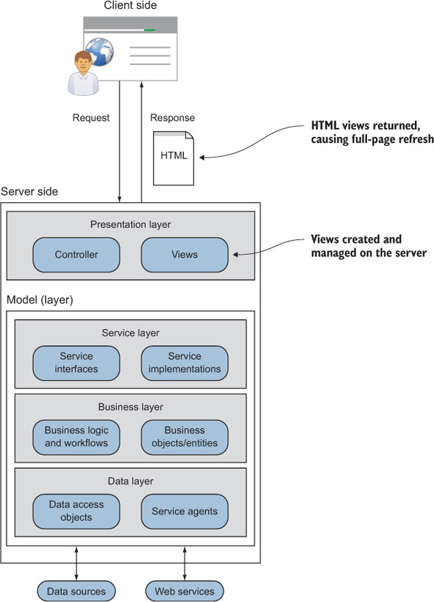
SPAs
‘Traditional’ Web Application
East Tennessee State University
Department of Computing
CSCI 1720
Intermediate Web Design

Slide 39
SPAs
With this design, each request for a new view (HTML page) results in a round-trip to the server
When fresh data is needed on the client side, the request is sent to the server side
On the server side, the request is intercepted by a controller object inside the presentation layer
East Tennessee State University
Department of Computing
CSCI 1720
Intermediate Web Design

Slide 40
SPAs
The controller then interacts with the model layer via the service layer, which determines the components required to complete the model layer’s task
After the data is fetched, either by a data access object (DAO) or by a service agent, any necessary changes to the data are then made by the business logic in the business layer
East Tennessee State University
Department of Computing
CSCI 1720
Intermediate Web Design

Slide 41
SPAs
Control is passed back to the presentation layer, where the appropriate view is chosen
Presentation logic dictates how the freshly obtained data is represented in the selected view
Often the resulting view starts off as a source file with placeholders, where data is to be inserted (and possibly other rendering instructions)
This file acts as a kind of template for how the view gets stamped whenever the controller routes a request to it
East Tennessee State University
Department of Computing
CSCI 1720
Intermediate Web Design

Slide 42
SPAs
After the data and view are merged, the view is returned to the browser
The browser then receives the new HTML page and, via a UI refresh, the user sees the new view containing the requested data
East Tennessee State University
Department of Computing
CSCI 1720
Intermediate Web Design

Slide 43
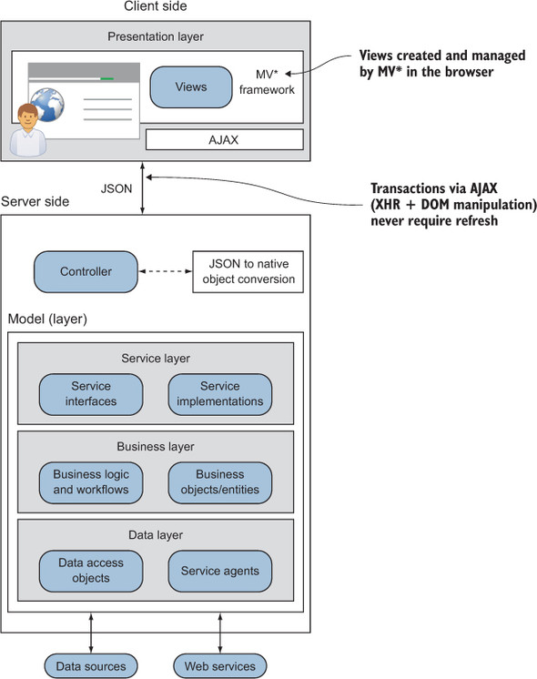
SPAs
East Tennessee State University
Department of Computing
CSCI 1720
Intermediate Web Design

Slide 44
SPAs
Moving the process for creating and managing views into the UI decouples it from the server
From an architectural standpoint, this gives the SPA an interesting advantage
Unless you’re doing partial rendering on the server, the server is no longer required to be involved in how the data is presented
East Tennessee State University
Department of Computing
CSCI 1720
Intermediate Web Design

Slide 45
SPAs
The overall SPA design is nearly the same as the traditional design
The key changes are as follows: no full browser refreshes, the presentation logic resides in the client, and server transactions can be data-only, depending on your preference for data rendering
East Tennessee State University
Department of Computing
CSCI 1720
Intermediate Web Design

Slide 46
SPAs
In an SPA, views aren’t complete HTML pages
They’re merely portions of the DOM that make up the viewable areas of the screen
After the initial page load, all the tools required for creating and displaying views are downloaded and ready to use
If a new view is needed, it’s generated locally in the browser and dynamically attached to the DOM via JavaScript
No browser refreshes are ever needed
East Tennessee State University
Department of Computing
CSCI 1720
Intermediate Web Design

Slide 47
SPAs
Because the presentation logic is mostly client side in an SPA, the task of combining HTML and data is moved from the server to the browser
As on the server side, source HTML contains placeholders where data is to be inserted (and possibly other rendering instructions)
This client-side template is used as a basis for stamping out new views in the client. It’s not template HTML for a complete page, though
It’s for only the portion of the page the view represents
East Tennessee State University
Department of Computing
CSCI 1720
Intermediate Web Design

Slide 48
SPAs
The heavy lifting of routing to the correct view, combining data with the HTML template, and managing a view’s lifecycle is typically delegated to a third-party Java-Script file commonly referred to as an MV* framework (sometimes called an SPA framework)
East Tennessee State University
Department of Computing
CSCI 1720
Intermediate Web Design

Slide 49
SPAs
You may have heard of the Model-View-Controller framework
Popular conceptualization that allows us to separate concerns:
Model == Data persistence
View == Presentation to the user
Controller == processing/communication between M and V
East Tennessee State University
Department of Computing
CSCI 1720
Intermediate Web Design

Slide 50
SPAs
In an SPA, several approaches can be used to render data from the server
These include server-side partial rendering, in which snippets of HTML are combined with data in the server’s response
Another approach is when rendering is done on the client and only data is sent and received during business transactions
East Tennessee State University
Department of Computing
CSCI 1720
Intermediate Web Design

Slide 51
SPAs
This is always done asynchronously via the XHR API
The data-exchange format is typically JavaScript Object Notation (JSON), though it doesn’t have to be
Even using client-side rendering, though, the server still plays a vital role in the SPA
East Tennessee State University
Department of Computing
CSCI 1720
Intermediate Web Design

Slide 52
SPAs – The Shell
The single-page part of the SPA refers to the initial HTML file, or shell
This single HTML file is loaded once and only once, and it serves as the starting point for the rest of the application
This is the only full browser load that happens in an SPA
Subsequent portions of the application are loaded dynamically and independently of the shell, without a full-page reload, giving the user the perception that the page has changed
East Tennessee State University
Department of Computing
CSCI 1720
Intermediate Web Design

Slide 53
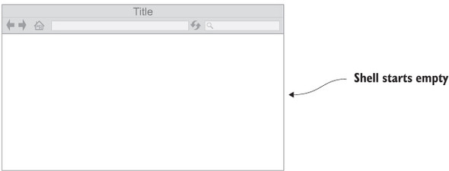
SPAs – The Shell
East Tennessee State University
Department of Computing
CSCI 1720
Intermediate Web Design

Slide 54
SPAs – The Shell
Typically, the shell is minimal in structure and often contains a single, empty DIV tag that will house the rest of the application’s content
You can think of this shell HTML file as the mother ship and the initial container DIV as the docking bay
East Tennessee State University
Department of Computing
CSCI 1720
Intermediate Web Design

Slide 55
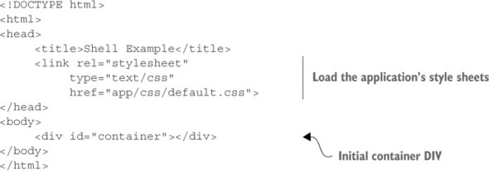
SPAs – The Shell
East Tennessee State University
Department of Computing
CSCI 1720
Intermediate Web Design

Slide 56
SPAs – The Shell
The initial container DIV can have child containers beneath it if the application’s viewable area is divided into subsections
The child containers are often referred to as regions, because they’re used to visually divide the screen into logical zones
East Tennessee State University
Department of Computing
CSCI 1720
Intermediate Web Design

Slide 57
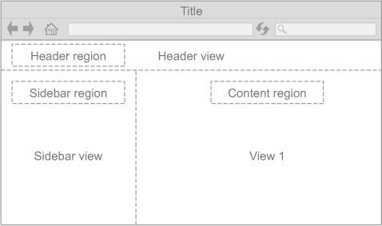
SPAs – The Shell
East Tennessee State University
Department of Computing
CSCI 1720
Intermediate Web Design

Slide 58
SPAs
Regions help you divide the viewable area into manageable chunks of content
The region container DIV is where you tell the MV* framework to insert dynamic content
It’s worth noting, though, that there are other paradigms
React, for example, uses DOM patching rather than the replacement of particular regions
East Tennessee State University
Department of Computing
CSCI 1720
Intermediate Web Design

Slide 59
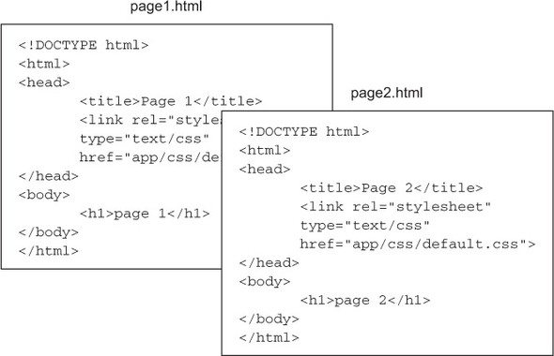
SPAs
Imagining the difference between the average web page and the view of an SPA can be difficult
This shows a simple website composed of two web pages
As you can see, both web pages of the traditional site contain the complete HTML structure, including the HEAD and BODY tags
East Tennessee State University
Department of Computing
CSCI 1720
Intermediate Web Design

Slide 60
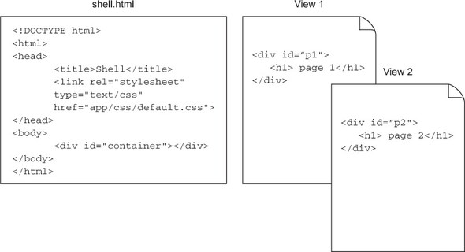
SPAs
This shows the same website as an SPA
The SPA “pages” are only HTML fragments. If the content of the viewable area of the screen changes, that’s the equivalent of changing pages in a traditional website
East Tennessee State University
Department of Computing
CSCI 1720
Intermediate Web Design

Slide 61
SPAs
There are many frameworks that implement single page applications
There is a front-end cost – the learning curve
But they streamline the design and development of SPAs, once you’ve learned them
Angular, React, Laravel, etc.
East Tennessee State University
Department of Computing
CSCI 1720
Intermediate Web Design

Slide 62
In Practice
East Tennessee State University
Department of Computing
CSCI 1720
Intermediate Web Design

Slide 63
Lab 14
This week’s lab will illustrate the implementation of a simple SPA – a sign-in/registration page
The page only loads once, but will display a sign-in form, a registration form, or an admin view (a table of registered users) in response to the user’s selection
East Tennessee State University
Department of Computing
CSCI 1720
Intermediate Web Design

Slide 64
Lab 14
Sign-In
The sign-in form will verify that the user has entered the correct password
The lab will also illustrate how passwords are hashed and stored in a back-end database
No-one but the user will know what password was entered
Can use hashed value for authentication
East Tennessee State University
Department of Computing
CSCI 1720
Intermediate Web Design

Slide 65
Lab 14
Registration
The ‘registration’ form will illustrate creating new users and storing their information in the database
May (I haven’t implemented it yet) include validation to ensure the password/confirmation password entries are the same
Should provide ‘successful registration’ feedback (again, it’s on my ‘to-do’ list)
East Tennessee State University
Department of Computing
CSCI 1720
Intermediate Web Design

Slide 66
Lab 14
Admin
The admin link will dynamically produce a table listing all of the current ‘registered’ users
East Tennessee State University
Department of Computing
CSCI 1720
Intermediate Web Design

Slide 67
Lab 14
We’ll see separation of concerns in separate JS & PHP files, each of which performs methods associated with its respective responsibility
The lab will feature dynamic DOM manipulation – creating, adding, updating, and deleting DOM elements as needed to a single initially empty page element, based on the chosen action
Hopefully, this will also illustrate how mastery of HTML and CSS is necessary to perform these dynamic changes
East Tennessee State University
Department of Computing
CSCI 1720
Intermediate Web Design

Slide 68
Lab 14
Instead of trying to learn one of the frameworks, here, I’m providing a generic (and simplified) look at some of the practices that are common to them all
This should make learning whichever one(s) you find yourself tackling in the future easier
East Tennessee State University
Department of Computing
CSCI 1720
Intermediate Web Design

Slide 69
Lab 14
It may take us more than a single lab meeting to complete
We’ll have to be flexible
East Tennessee State University
Department of Computing
CSCI 1720
Intermediate Web Design

Slide 70
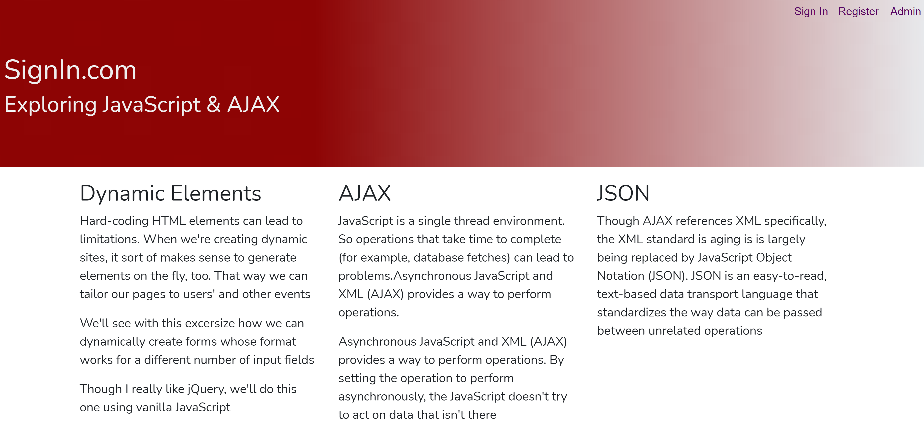
Lab 14
It may take us more than a single lab meeting to complete
We’ll have to be flexible
East Tennessee State University
Department of Computing
CSCI 1720
Intermediate Web Design

Slide 71
Sources
https://martinfowler.com/architecture/
https://livebook.manning.com/book/spa-design-and-architecture/
East Tennessee State University
Department of Computing
CSCI 1720
Intermediate Web Design

